Slide 1

Facilitating
Small Groups/Communities
Forming Missionary Disciples!

Slide 2
Logistics of Small Groups for V Encuentro
Parish Encuentro Team oversees the groups/Facilitators
Form groups now. What groups already exist? How will you invite? Sign ups? Locations?
All Catholics of all backgrounds are encouraged and welcomed to be part of the V Encuentro process…parishes, movements, SCCs, schools, campus ministry, organizations…
Children in groups if they can follow the conversation and participate – Adaptations? Please share…
5 Sessions – weekly, biweekly, other
Lent? Easter? Complete first half of 2017
7-12 members per group is ideal
Meet in homes, parish grounds, schools, prisons, offices, funeral homes, parks, community rooms, hospitals…
90 minutes per session
Music found at www.vencuentro.org
Notes:
Logistics of Small Groups for V Encuentro
Parish Encuentro Team oversees the groups/Facilitators
Form groups now. What groups already exist? How will you invite? Sign ups? Locations?
All Catholics of all backgrounds are encouraged and welcomed to be part of the V Encuentro process…parishes, movements, SCCs, schools, campus ministry, organizations…
Children in groups if they can follow the conversation and participate – Adaptations? Please share…
5 Sessions – weekly, biweekly, other
Lent? Easter? Complete first half of 2017
7-12 members per group is ideal
Meet in homes, parish grounds, schools, prisons, offices, funeral homes, parks, community rooms, hospitals…
90 minutes per session
Music found at www.vencuentro.org

Slide 3
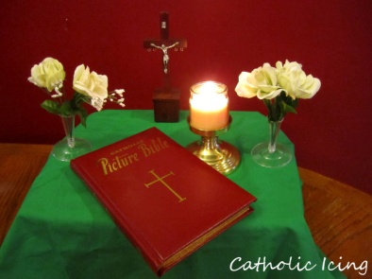

Responsibilities of
Small Group Facilitators
Prepare the space for the group to meet.
Guide the conversation, ensuring that everyone is welcomed and has a chance to participate.
Procure and distribute the symbols and any other materials to be used for each of the sessions.
Keep records of who participated in the sessions, respecting privacy and confidentiality.
Submit a report to the Parish Encuentro Team (or coordinating team) at the end of the five session experience.
Notes:
Prepare the space for the group to meet.
Facilitators will make sure that there are enough chairs for all participants.
All groups should ideally have a small altar or table with a Bible and a crucifix and, ideally, one or two other religious symbols that are meaningful to the members of the group.
Be sure all people and pets are taken care of as well as other devices/obstacles that may cause distractions/interruptions.
Pens available for jotting down notes and activities.
Water at least for participants.
Access to restrooms.
Guide the conversation, ensuring that everyone is welcomed and has a chance to participate.
Procure and distribute the symbols and any other materials to be used for each of the sessions.
Keep records of who participated in the sessions. The info will be used as part of the consultation process and shared with the bishops.
Submit a report to the Parish Encuentro Team (or coordinating team) at the end of the five session experience. Will soon be available for download at www.vencuentro.org

Slide 4

Facilitating a
Small Group Conversation (Dialogue)
Create an inclusive environment
  Invite participants to introduce themselves.
  Share expectations for effective dialogue.
  Invite everyone to express their opinions and thoughts.
  Allow for the sharing of alternate views.
  Treat participants with respect and consideration.
  Be aware of barriers to sharing (cultural, social, experiential, etc.)
  Invite and encourage all participants to share at least once before inviting participants to share again.
Notes:
Effective facilitation of a dialogue involves the recognition and employment of different perspectives and various skills to create an inclusive environment. In order to do so, it is important to consider the features of effective dialogues, and conditions that promote small group interaction and engagement.
Dialogue is a powerful mechanism for active learning; a well-facilitated dialogue allows the participant to explore new ideas while recognizing and valuing the contributions of others.
Create an inclusive environment
Invite participants to introduce themselves
Share expectations and intentions among the participants and the facilitator for effective dialogue.
Invite everyone to express their opinions and thoughts, avoiding situations where one or a few monopolize the conversation.
Treat participants with respect and consideration.
Be aware of barriers to sharing (cultural, social, experiential, etc.)
Invite and encourage all participants to share at least once before inviting participants to share again.
Allow for the sharing of alternate views.

Slide 5
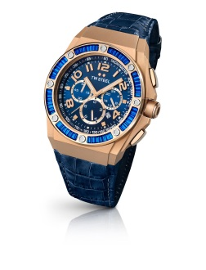
Facilitating a
Small Group Conversation (Dialogue)
Keep discussions constructive and positive
  Stay centered on the topic.
  Follow the process indicated for each session.
  Keep the group on task.
  If the group starts to veer in the direction of negativity and/or pointless venting, ask them how they would like to address this.
  Request respect if participants challenge others’ ideas.
  Ask dominant participants to allow others to speak.
  Did everyone get a chance to speak before I do again?
Notes:
Keep discussions constructive and positive
Keep the group centered on the topic.
Follow the process indicated for each session, keeping a close watch on time with the assistance of a timekeeper. Once time is up, transition the group into the next section.
Keep the group on task without rushing them.
If the group starts to veer in the direction of negativity and/or pointless venting, ask them how thy would like to address this.
Request that if participants challenge others’ ideas, they do so with respect.
Ask dominant participants to allow others to speak. Did everyone get a chance to speak before I do again?

Slide 6

Facilitating a
Small Group Conversation (Dialogue)
Encourage participation
  Do not be the first one to respond to a question!
  Invite the quiet participants to contribute without forcing them.
  Encourage others to add their reactions or ideas to build on previous comments.
  Revisit past contributions and incorporate them into subsequent discussions.
  Do not be afraid of silence. Allow for it.
  Rephrase questions, summarize sharing, ask: What are you thinking? What are your feeling?
Notes:
Encourage participants
Do not be the first one to respond to a question!
Invite the more quiet participants to contribute without forcing them.
Encourage others to add their reactions or ideas to build on previous comments.
Revisit past contributions and incorporate them into subsequent discussions.
Do not be afraid of silence. Allow for it. Rephrase questions, summarize sharing, ask: What are you thinking? What are your feeling?

Slide 7
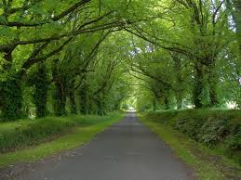
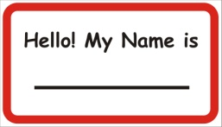
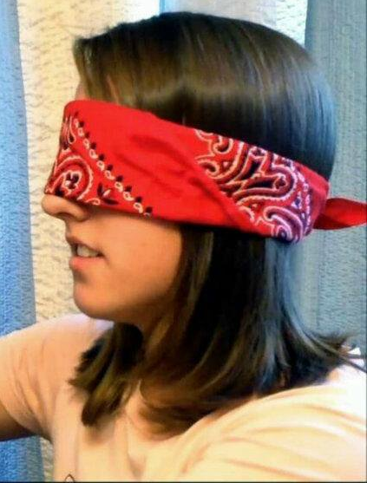
Session 1: Called to a Loving Encounter with Jesus in the Church
Symbols and Supplies:
  Nametags
  Chairs in a circle
  Image of a Path in center
  Blindfolds (one for each participant)
  Basket with Wristbands (two per person)
  Music and player/speakers (Resources/Music)
  www.vencuentro.org/v-encuentro-documents/music/
  Prayer (Celebrate)
    Blindfolds
    Small pieces of paper and pens
    Prayer on page 14 (Saint Teresa of Avila)
    Music and player/speakers
    V Encuentro Mission and Consultation Journal
    Wristbands
Notes:
Session 1: Called to a Loving Encounter with Jesus in the Church
Symbols and Supplies:
Nametags
Chairs in a circle
Image of a Path in center
Blindfolds (one for each participant)
Music and player/speakers (Resources/Music)
www.vencuentro.org/v-encuentro-documents/music/
Prayer (Celebrate)
Blindfolds
Small pieces of paper and pens
Prayer on page 14 (Saint Teresa of Avila)
Music and player/speakers
V Encuentro Mission and Consultation Journal

Slide 8

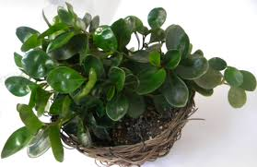

Session 2: With Words and Actions: Do It!
Symbols and Supplies
  Nametags
  Chairs in a circle
  Image of a Path
  Bottle of Water (for each participant)
  Music and player/speakers
  Prayer (Celebrate)
    Clear bowl with water
    Green plant with leaves
    Containers that workers or immigrants use for water
    Soft music sounds of water flowing
    Bottle of water for each participant
    Music and player/speakers
Notes:
Session 2: With Words and Actions: Do It!
Symbols and Supplies
Nametags (if there are people not known to all)
Chairs in a circle
Image of a Path
Bottles of Water (for each participant)
Prayer (Celebrate)
Clear bowl with water
Green plant with leaves
Containers (jars/bottles) that workers or immigrants use for water
Soft music sounds of water flowing
Basket with Pocket Books of Four Gospels (2 for each participant)
Music and player/speakers

Slide 9
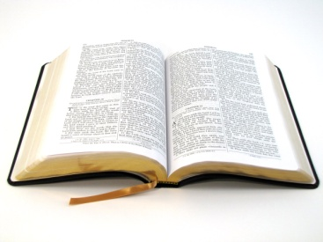

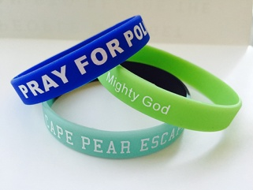
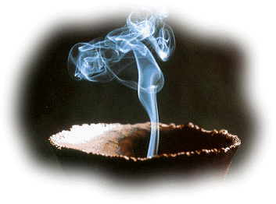
Session 3: Walking Together with Jesus
Symbols and Supplies
  Chairs in a circle
  Image of the Path in the center
  On a table
    Bible
    Basket with V Encuentro Wristbands
    (2 for each participant)
  Music and player/speaker
  Prayer (Celebrate)
    Lit candles
    Flowers
    Incense
    Table with Bible and wristbands
    Music and player/speaker
Notes:
Session 3: Walking Together with Jesus
Symbols and Supplies
Chairs in a circle
Image of the Path in the center
On a table
Bible
Basket with V Encuentro Wristbands
(2 for each participant)
Music and player/speaker
Prayer (Celebrate)
Lit candles
Flowers
Incense
Table with Bible and wristbands
Music and player/speaker

Slide 10
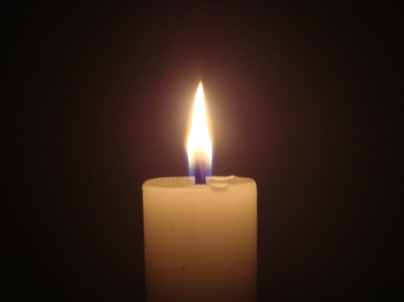
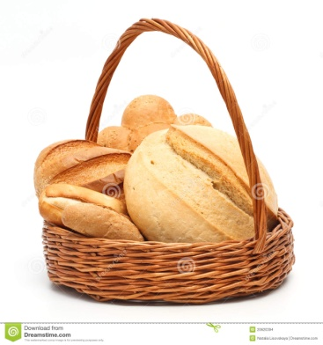

Session 4: Bearing Fruits of New Life
Symbols and Supplies
  Chairs in a circle
  Image of a path in the center
  Candle
  Basket with bread
  Music and player/speakers
  Prayer (Celebrate)
    A candle placed high
    Basket with enough bread for all participants
    Tea light candles for all participants
    Music and player/speakers
Notes:
Session 4: Bearing Fruits of New Life
Symbols and Supplies
Chairs in a circle
Image of a path in the center
Candle
Basket with bread
Music and player/speakers
Prayer (Celebrate)
A candle placed high
Basket with enough bread for all participants
Tea light candles for all participants
Music and player/speakers

Slide 11

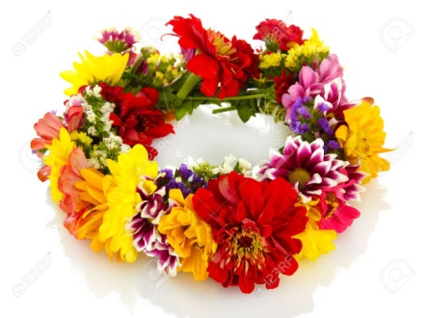
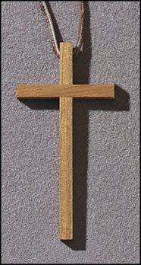
Session 5: Celebrating the Joy of Being Missionary Disciples
Symbols and Supplies
  Chairs in a circle
  Image of the Path in the center
  Basket with the V Encuentro Crosses
  Candle and Open Bible
  Prayer
    Large Cross
    Side table with wreath of flowers and white cloth
    White paper cross and pens
    Tape
Notes:
Session 5: Celebrating the Joy of Being Missionary Disciples
Symbols and Supplies
Chairs in a circle
Image of the Path in the center
Basket with the V Encuentro Crosses
Candle and Open Bible
Prayer
Large Cross
Side table with wreath of flowers and white cloth
White paper cross and pens
Tape

Slide 12

Leading a Group in Contemplative and Reflective Prayer
Reflection
  The opportunity to pause, quiet ourselves and review what is before us and what is inside us
  Non-judgmental way of perceiving in which we become more present to our Encuentro experience.
  We listen to our experience, paying attention to how it is speaking to us and to what is occurring within us and the group.
Notes:
Leading a Group in Contemplative and Reflective Prayer
Reflection
The opportunity to pause, quiet ourselves and review what is before us and what is inside us
Non-judgmental way of perceiving in which we become more present to our Encuentro experience.
We listen to our experience, paying attention to how it is speaking to us and to what is occurring within us and the group.

Slide 13
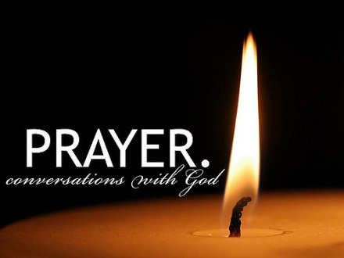
Leading a Group in Contemplative and Reflective Prayer
Prayer
  A turning toward God through the words we are sharing with an open heart.
  In prayer, we become more aware of God’s presence in the Encuentro and we seek a deeper understanding.
  Praying as a group also opens us to a great appreciation of God’s presence in our ministry, and inspires us to act as a community.
Notes:
Leading a Group in Contemplative and Reflective Prayer
Prayer
A turning toward God through the words we are sharing with an open heart.
In prayer, we become more aware of God’s presence in the Encuentro and we seek a deeper understanding.
Praying as a group also opens us to a great appreciation of God’s presence in our ministry, and inspires us to act as a community.

Slide 14

Leading a Group in Contemplative and Reflective Prayer
Contemplation
  Clearing the mind of outside concerns
  so that God’s voice may more easily be heard and be united with the movement of the Spirit within oneself and the group.
  The necessary silence, waiting to and listening to hear from God.
Notes:
Leading a Group in Contemplative and Reflective Prayer
Contemplation
Clearing the mind of outside concerns
so that God’s voice may more easily be heard and be united with the movement of the Spirit within oneself and the group.
The necessary silence, waiting to and listening to hear from God.

Slide 15
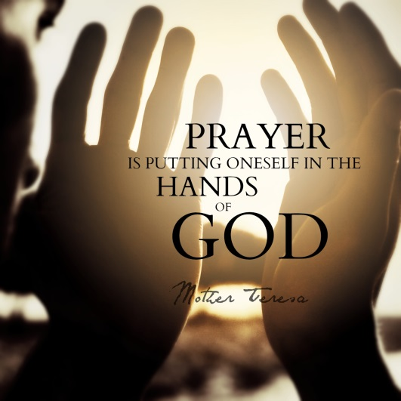
Leading a Group in Contemplative and Reflective Prayer
Role of the Spiritual Leader
  Leading Group Contemplative/Reflective Prayer
    Prepare with personal prayer.
    Begin and conclude the gathering with prayer as indicated.
    The first step is slowing down
    and refocusing attention.
    Speak slowly and meaningfully.
    Be open to being guided into this
    by the Spirit.
Notes:
Role of the Spiritual Leader
One who leads prayer or reflection well brings a quality of personal presence that creates a sense of welcome, safety and sacred space that enable participants to be fully present and open to the presence of the Holy Spirit in our midst. Without calling attention to him or herself, a good prayer leader helps the group to see their own connection to the divine within them and all around them.
Prepare for leading group reflective prayer with a personal prayer, asking to be god’s instrument.
Begin and conclude the gathering with prayer that should be considered a part of the process.
In leading prayer, the first step is slowing down the refocusing attention. Invite the group to quiet themselves and be present before you speak.
Speak slowly and meaningfully, pausing at commas and stopping at periods. The slow speaking helps facilitate a reflective spirit.
Be open to being guided into this by the Spirit. Pay attention to your intuition, a hunch or a last-second feeling.

Slide 16
Leading a Group in Contemplative and Reflective Prayer
Role of the Spiritual Leader
  Leading a Group in Faith Sharing
    The role of the facilitator is one of listening and encouraging by inviting group members to participate.
    The facilitator does not provide answers to personal faith questions participants might have.
    The facilitator is not a teacher who instructs,
    nor a judge who renders verdicts, or a counselor who provides spiritual or moral guidance.
    Remind all of the importance of maintaining confidentiality so that a trust level grows
    in the group and all are honored.
Notes:
Leading a Group in Contemplative and Reflective Prayer
Leading the Group in Faith Sharing (Connecting Faith and Life and Life and Faith) We bring our experience to the Scripture and Church Teaching and we wrestle with it, finding what attracts us to it and causes resistance, and then we listen to the Spirit for guidance in how we will grow in it. Through prayer and support, we then do what we know we are being called to do to change the world for Christ.
The role of the facilitator is one of listening and encouraging by inviting group members to participate.
The facilitator does not provide answers to personal faith questions participants might have.
The facilitator is not a teacher who instructs, nor a judge who renders verdicts, or a counselor who provides spiritual or moral guidance.
Remind all of the importance of maintaining confidentiality so that a trust level grows in the group and all are honored.

Slide 17

Facilitator Best Practices
Spend time in prayer before each session.
Read the entire content of each session before meeting with the small group. Answer questions for yourself and jot down ideas before meeting. Dream.
Assign adequate time for the completion of each of the five moments of the session.
Develop a strategy to facilitate the conversation.
Confirm that the number of symbols to be handed out at each session matches that of the participants in your small group.
Test media equipment before the session.
Notes:
Facilitator Best Practices
Spend time in prayer before each session.
Read the entire content of each session before meeting with the small group.
Assign adequate time for the completion of each of the five moments of the session.
Develop a strategy to facilitate the conversation.
Confirm that the number of symbols to be handed out at each session matches that of the participants in your small group.
Test media equipment before the session.

Slide 18
Facilitator Best Practices cont.
Arrive at least 15 minutes before your small group meets to prepare the sacred space.
Make sure that the meeting space is free of interruptions and noises that will distract.
Offer a warm welcome to every participant in your small group. Nametags if needed.
Make sure that the interaction among the group is always inviting, welcoming, respectful and affirming.
At the first session, ask all participants for their preferred contact method (email, text, etc.).
At the end of each session, thank all participants, and remind them of the day and time of the next meeting.
Notes:
Facilitator Best Practices cont.
Arrive at least 15 minutes before your small group meets to prepare the sacred space.
Make sure that the meeting space is free of interruptions and noises that will distract.
Offer a warm welcome to every participant in your small group. Nametags if needed.
Make sure that the interaction among the group is always inviting, welcoming, respectful and affirming.
At the first session, ask all participants for their preferred contact method (email, text, etc.).
At the end of each session, thank all participants, and remind them of the day and time of the next meeting.

Slide 19
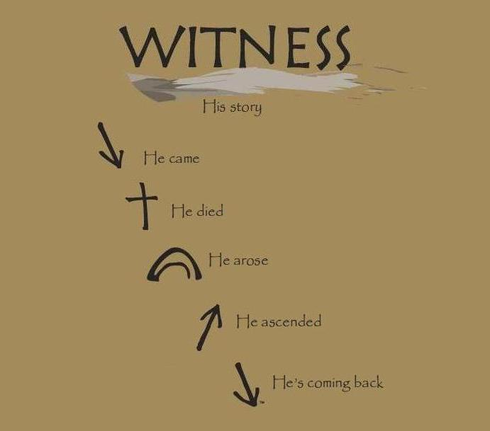
Missionary Activity
The V Encuentro embraces a spirit of the New Evangelization and the vision of a Church
that goes forth and reaches out.
At the end of each session,
all participants are invited to
take part in a simple
missionary action.
This action is an opportunity to
witness one’s identity as a
missionary disciple of Jesus Christ.
Also, it is an invitation to go into
the peripheries of our Church and our society.
Notes:
Missionary Activity
The V Encuentro embraces a spirit of the New Evangelization and the vision of a Church that goes forth and reaches out.
At the end of each session, all participants are invited to take part in a simple missionary action.
This action is an opportunity to witness one’s identity as a missionary disciple of Jesus Christ.
Also, it is an invitation to go into the peripheries of our Church and our society.
Witness – His Story
He came
He died
He rose
He ascended
He’s coming back…

Slide 20
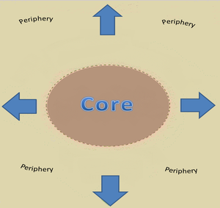
The Periphery?
Places where our sisters and brothers are
vulnerable, excluded, treated as outsiders,
living in fear, isolated, ignored, invisible.
Pope Francis reminds us that as baptized Christians,
Catholics must embrace the call from Jesus Christ
“to go forth from our own comfort zone in order to reach
all the ‘peripheries’ in need of the light of the Gospel.”
Each community, each family, each person must identify the immediate peripheries and then go and meet people there with a message of love and hope in a spirit of accompaniment.
Many Hispanic Catholics—as well as other Catholics—
live in the peripheries of our Church and society.
We are called to bring the light of the Gospel to all these groups.
Notes:
The Periphery?
We invite you to focus as much as possible on Hispanic/Latino young people and families, especially those living in the peripheries of church and society. What is a periphery? Places where our sisters and brothers are vulnerable, excluded, treated as outsiders, living in fear, isolated, ignored, invisible. Many Hispanic/Latino Catholics may not be active in our churches. Others find themselves estranged, feeling that they do not belong to our parish communities. They can be college students, farmworkers, at risk youth, people who are homeless, and those in prison. Many are waiting for someone to share the Good News of the Gospel and that God cares about them. You are God’s eyes, hands, and feet to reach out to them. Carry this journal with you. Treasure it. Discuss it. Bring it to the V Encuentro sessions.
Places where our sisters and brothers are vulnerable, excluded, treated as outsiders, living in fear, isolated, ignored, invisible. The “peripheries” are all those circumstances in which many sisters and brothers are experiencing some form of hardship—material, social, cultural, or spiritual.
Pope Francis reminds us that as baptized Christians, Catholics must embrace the call from Jesus Christ to “to go forth from our own comfort zone in order to reach all the ‘peripheries’ in need of the light of the Gospel.” l.
Not all peripheries are the same. Each community, each family, each person must identify the immediate peripheries and then go and meet people there with a message of love and hope in a spirit of accompaniment.
Many Hispanic Catholics—as well as other Catholics—live in the peripheries of our Church and society: the young people who do not see the Church as their home anymore, the disaffected, the undocumented, the poor, the victims of abuse and prejudice, the farmworker and the factory worker who cannot make ends meet, the elderly, the broken family, the lonely, the addict, the imprisoned, the sick, etc.
To all these groups we are called to bring the light of the Gospel.

Slide 21
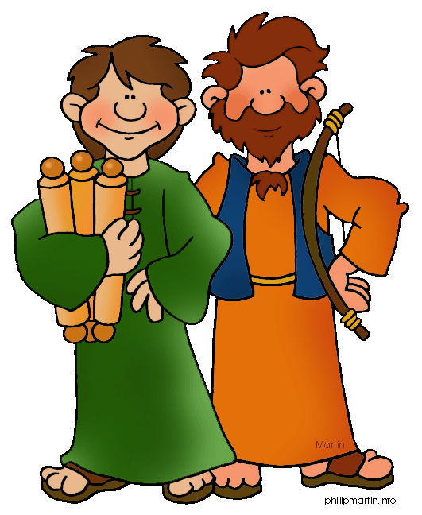
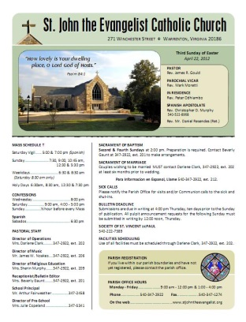
10 Tips for Missionary Activities
Choose your missionary partner.
The Lord sent his disciples in pairs (Lk 10:1).
Pray for wisdom before going to visit someone.
Pray in thanksgiving after returning.
If you are reaching out to people you know,
contact them in advance of the visit.
If you are going to the periphery, engage
people in a natural and polite way,
showing authentic interest in
getting to know them.
Bring some information about your
parish or faith community to share.
Notes:
TIPS FOR MISSIONARY ACTIVITIES
If you are a baptized Catholic, then you already are a missionary! Yes, our entire lives as Christians are about participating in the Lord’s evangelizing mission. The Church exists to evangelize. As baptized Catholics, the Holy Spirit moves us to announce the Good News and give witness of the great things God has done in our lives through Jesus Christ.
Just by living an authentic Catholic life inspired by the values of the Gospel and faithful to God’s Word, you are doing missionary work. Make sure you continue to do this!
10 Tips
1Choose your missionary partner.
The Lord sent his disciples in pairs (Lk 10:1).
Pray for wisdom before going to visit someone.
Pray in thanksgiving after returning.
If you are reaching out to people you know, contact them in advance of the visit.
If you are going to the periphery, engage people in a natural and polite way, showing authentic interest in getting to know them.
Bring some information about your parish or faith community to share.

Slide 22


10 Tips for Missionary Activities cont.
Be respectful. Avoid entering into controversies.
Use the questions in the
Mission and Consultation Journal.
Then, listen... listen attentively and lovingly.
Keep the conversation short.
Write a few notes and respond to questions in the Mission and Consultation Journal after your return.
If you have any questions, consult with the leaders of the V Encuentro team in your parish or faith community.
Notes:
Be respectful. Avoid entering into controversies. If you don’t know the answer to a question, write it down and indicate that you will bring an answer next time.
Use the questions in the Mission and Consultation Journal. Then, listen... listen... listen attentively and lovingly.
Ask the following questions while talking with them.
Make sure it does not sound like a survey, but a conversation in which you want to learn about them.
Feel free to change the question so it sounds more like something you would say.
If they do not want to answer or don’t feel comfortable answering, do not push them.
When you are done, thank them for their time and ask if you can stay in touch.
After the conversation, jot down this information in your journal and complete the consultation form.
Keep the conversation short.
Write a few notes and respond to questions in the Mission and Consultation Journal after your return.
If you have any questions, consult with the leaders of the V Encuentro team in your parish or faith community.
Note: Missionaries should not visit or contact minors under the age of 18 without the presence of a parent or adult following Safe Environment Guidelines.

Slide 23

Possible Scenarios - Visitation
We are a new Catholic family in the area…
I am no longer a practicing Catholic…
I am angry at the Church because…
I am too busy at this time to talk…
I am not a Catholic and I practice my faith at…
I do not go to any church…
Why are you visiting me?
Notes:
We are a new Catholic family in the area…
“Welcome, would you like to visit our parish? Is is a great community because…. Here are the Mass times…”
I am no longer a practicing Catholic…
“I am sorry to hear that. Is there anything we can do that might make you reconsider coming back to the Church? Do you mind if I ask why you left the Church? If you ever reconsider we invite you to visit our parish.” (Name parish and talk about strong points.”
I am angry at the Church because…
“While divine, the Church is a human institution as well. It is unfortunate that we cause pain to one another. In the name of the Church, I apologize and hope that you will join us again.”
I am too busy at this time to talk…
“We certainly understand, could we stop by at another time when it will be more convenient?”
I am not a Catholic and I practice my faith at…
“It is a pleasure meeting you, let us continue to pray for one another.”
I do not go to any church…
“It is a pleasure meeting you. If you are interested I would like to invite you to visit our parish.”
Why are you visiting me?
“During this month of …we are visiting people (in the parish area) to hear their concerns, to get to know you, and to seek suggestions on how to improve the parish.”

Slide 24
Mission and Consultation Journal
During the first session all participants in the five session experience will receive a notebook called
The V Encuentro Mission and Consultation Journal.
This Journal will help you to:
Reflect on your own experience of the
V Encuentro Sessions
Engage people in the peripheries, build relationships, and ask questions
Discern & Write down new insights gained from this missionary experience and fill out the consultation form weekly
Notes:
During the first session all participants in the five session experience will receive a notebook called The V Encuentro Mission and Consultation Journal.
This book will have a number of questions and instructions for participants to record basic details about their own reflections and the missionary activities they will be taking part in during the process.
This Journal will help you to:
Reflect on your own experience of the V Encuentro Sessions
Engage people in the peripheries, build relationships, and ask questions
Discern & Write down new insights gained from this missionary experience and fill out the consultation form

Slide 25
QUESTIONS?

Slide 26
God of Mercy,
You that went out to encounter the disciples
on the way to Emmaus,
grant us a missionary spirit
and send us forth to encounter our brothers and sisters,
to walk along beside them,
listen to their hopes and dreams,
rekindle their faith with the fire of your Word,
prepare them to recognize you in the Eucharist
and send them as missionary disciples
to share the joy of the Gospel to present and future generations
of every race, language and culture.
We ask you this from our burning hearts filled with the Holy Spirit,
in the Name of your beloved Son
and through the intercession of our Mother, Mary of Guadalupe
Star of the New Evangelization
Amen.
Notes:
God of Mercy,
You that went out to encounter the disciples
on the way to Emmaus,
grant us a missionary spirit
and send us forth to encounter our brothers and sisters,
to walk along beside them,
listen to their hopes and dreams,
rekindle their faith with the fire of your Word,
prepare them to recognize you in the Eucharist
and send them as missionary disciples
to share the joy of the Gospel to present and future generations
of every race, language and culture.
We ask you this from our burning hearts filled with the Holy Spirit,
in the Name of your beloved Son
and through the intercession of our Mother, Mary of Guadalupe
Star of the New Evangelization
Amen.

