Slide 1

V Encuentro Parish guide
Fifth National Encuentro
of Hispanic/Latino Ministry
A usccb initiative
St. John of the Woods, Tacoma
January 21, 2017
Archdiocese of Seattle

Slide 2

MILESTONES OF THE V ENCUENTRO PROCESS

Slide 3
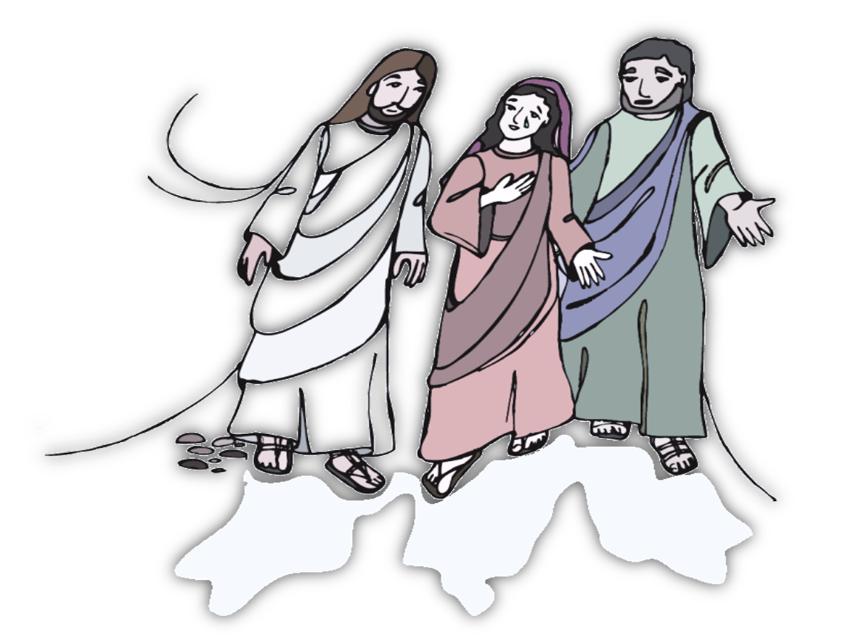

Themes of the Guide
At the heart of the V Encuentro process is a five-week experience of reflection, evangelization, and consultation guided by five themes inspired by Pope Francis’ call to foster a culture of Encounter (cf. The Joy of the Gospel, n. 24):
Called to a loving encounter with Jesus
With words and actions: Do it!
Walking together with Jesus
Bearing fruits of new life
Celebrating the joy of being missionary disciples
1
2
3
4
5

Slide 4
10 Things You Need to
Know about the Guide
9
The Guide is a resource for the V Encuentro, which in turn is a process of evangelization, consultation, and communion.
The Guide has been designed to be used primarily in the context of small faith communities. However, communities can use it in larger contexts.
The Guide has been written in English and Spanish.
The Guide has five sessions that can be scheduled based on the timeframes that work best for each local community.
The structure of the Guide is flexible enough for pastoral leaders to adapt to particular audiences and contexts (e.g., prison ministry, campus ministry, youth groups, farmworkers, etc.)
At the heart of the Guide is the well-known pastoral methodology, See – Judge – Act.
The Guide will be shipped to dioceses in the Fall 2016 to be distributed to parishes and be ready to be used in parishes, other ecclesial settings, and faith communities starting in 2017.
The V Encuentro website (http://www.vencuentro.org/) will have the guide, accompanying resources, and support materials in electronic form.
Pastoral leaders who develop related resources, adaptations, and support materials are invited to share them with the entire nation via the V Encuentro website. Instructions will be provided.

Slide 5
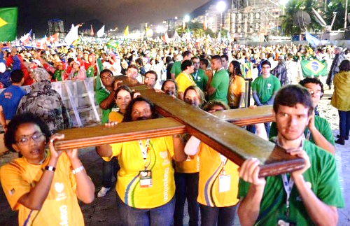
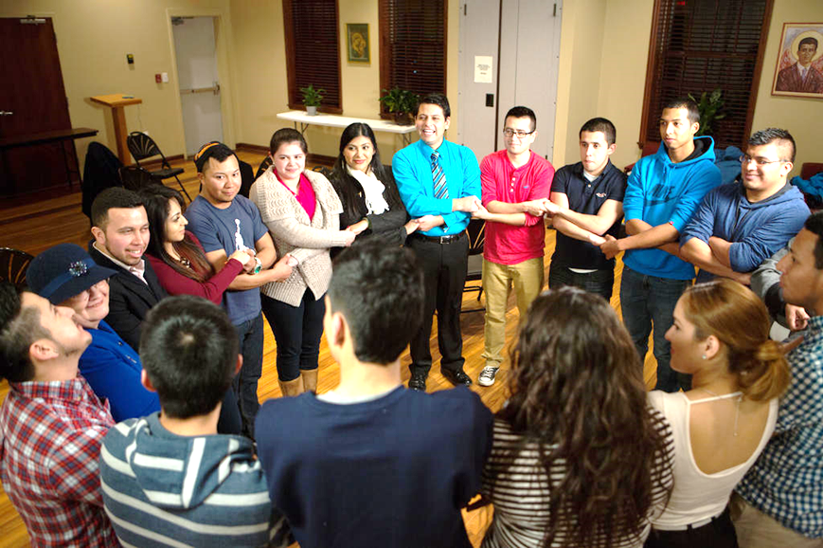
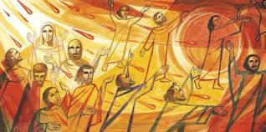
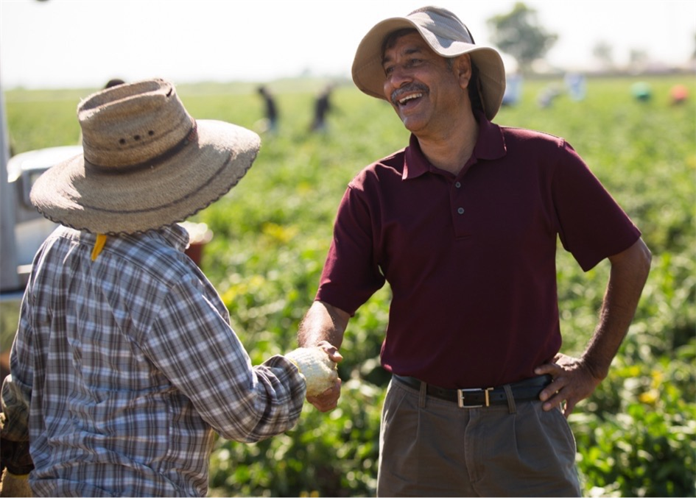

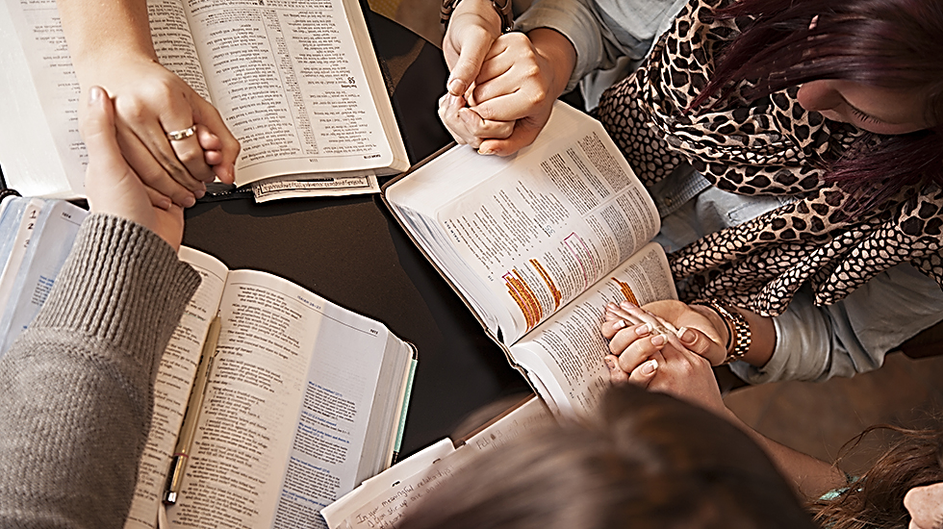
By entering this process, your faith community is being invited To:
Experience being a Church that goes forth.
Inspire a process of reflection and faith sharing among members of the small group.
Contemplate the calling to being missionary disciples.
Prepare to engage in evangelizing missions and consultations in the periphery.
Document the experience and the process of consultation to discern pastoral implications.
Make the transition from small groups into small faith communities.

Slide 6
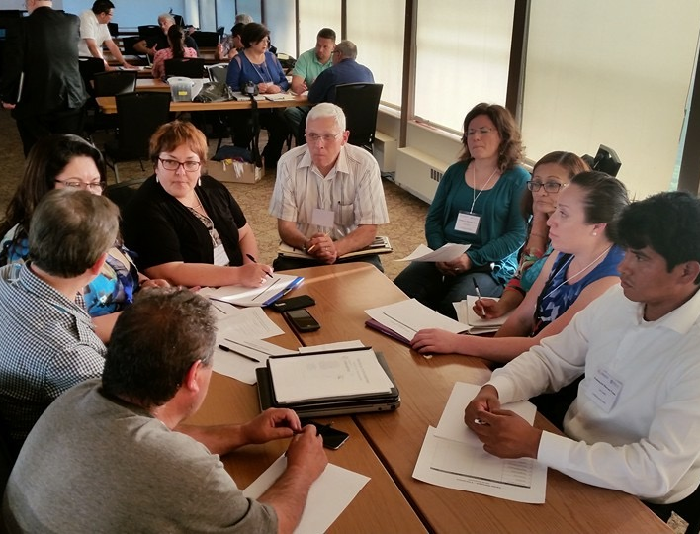
Facilitator best practices
Spend some time in prayer before each session.
Read the entire content of each session before meeting with the small group.
Assign adequate time for the completion of each of the five moments of the session. For instance, know that the sections SEE and JUDGE will require more time than the others.
Develop a strategy to facilitate the conversation.
Confirm that the number of symbols to be handed out at each session matches that of the participants in the small group.
If you are going to incorporate some media resources (e.g., video, music, images, etc.), test your media equipment before the session.
Arrive at least 15 minutes before your small group meets to prepare the altar or sacred space.

Slide 7
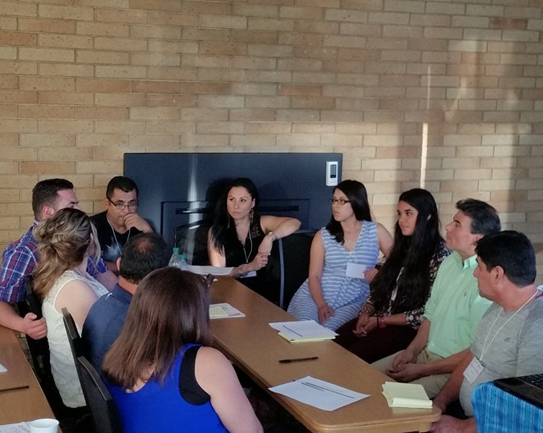
Facilitator best practices cont.
Make sure that the meeting space is free of interruptions and noises that will distract participants.
Offer a warm welcome to every participant in your small group. Greet everyone by name.
Make sure that the interaction among the group is always welcoming, respectful, and affirming.
At the first session, ask all participants for their preferred contact method, preferably email. If a participant misses a session, communicate with this person to follow up.
Renew the invitation.
At the end of each session, thank all participants, and remind them of the day and time of the next meeting.
Send a reminder the day before the next meeting.

Slide 8
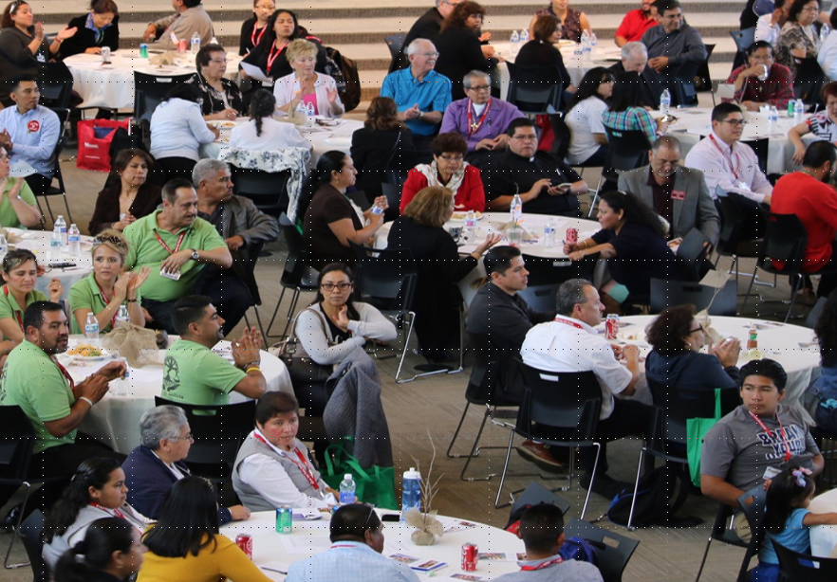
Logistics of Small Groups for V Encuentro
Parish Encuentro Team oversees the groups/Facilitators
Form groups now.
What groups already exist? How will you invite? Sign ups? Locations?
All Catholics of all backgrounds are encouraged and welcomed to be part of the V Encuentro process…parishes, movements, SCCs, schools, campus ministry, organizations…
Children in groups if they can follow the conversation and participate – Adaptations? Please share…
5 Sessions –weekly, biweekly, other
Lent? Easter? Complete first half of 2017
7-12 members per group is ideal
Meet in homes, parish grounds, schools, prisons, offices, funeral homes, parks, community rooms, hospitals…
90 minutes per session
Music found at www.vencuentro.org

Slide 9

SPECIFIC INSTRUCTIONS
FOR SMALL GROUP FACILITATORS
Recuerde las cinco responsabilidades que usted tiene como facilitador:
  Preparar el espacio donde se va a reunir el grupo.
  Guiar la conversación, asegurándose de que todos se sientan bienvenidos y tengan la oportunidad de participar.
  Procurar y distribuir los símbolos y cualquier otro material a usarse en cada una de las sesiones.
  Tomar nota de quiénes participaron en las sesiones. Esta información se utilizará como parte del proceso de consulta y será comunicada a los obispos.
  Enviar un reporte al Equipo Parroquial del Encuentro (o equipo coordinador) al final de la experiencia de cinco sesiones (ver el formato del Reporte final del facilitador(a) del pequeño grupo en el apéndice de la guía).

Slide 10
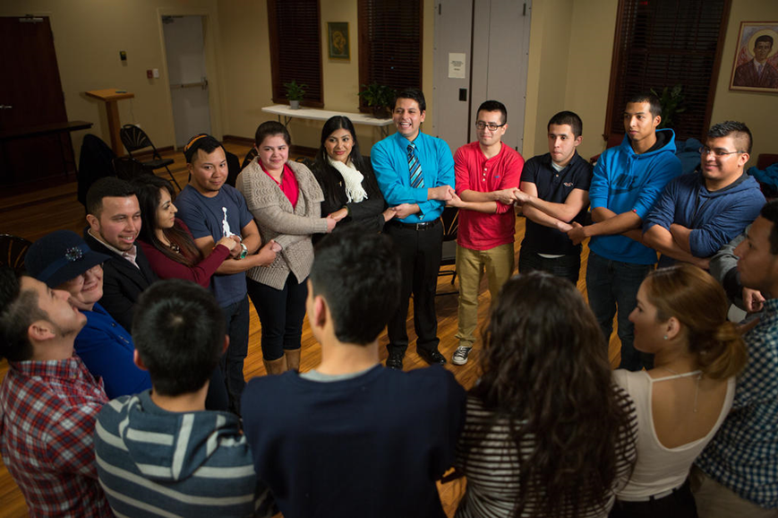
Facilitating a small group discussion (Dialogue)
Mode #1
1. Create an inclusive environment
  Invite participants to introduce themselves.
  Share expectations for effective dialogue.
  Invite everyone to express their opinions and thoughts.
  Allow for the sharing of alternate views.
  Treat participants with respect and consideration.
  Be aware of barriers to sharing (cultural, social, experiential, etc.)
  Invite and encourage all participants to share at least once before inviting participants to share again.

Slide 11
2. Keep discussions constructive and positive
  Stay centered on the topic.
  Follow the process indicated for each session.
  Keep the group on task.
  If the group starts to veer in the direction of negativity and/or pointless venting, ask them how they would like to address this.
  Request respect if participants challenge others’ ideas.
  Ask dominant participants to allow others to speak. Did everyone get a chance to speak before I do again?
Facilitating a small group discussion (Dialogue)
Mode #1

Slide 12
3. Encourage participation
  Do not be the first one to respond to a question!
  Invite the quiet participants to contribute without forcing them.
  Encourage others to add their reactions or ideas to build on previous comments.
  Revisit past contributions and incorporate them into subsequent discussions.
  Do not be afraid of silence. Allow for it. Rephrase questions, summarize sharing, ask: What are you thinking? What are your feeling?
Facilitating a small group discussion (Dialogue)
Mode #1

Slide 13
Use the RESPECT guidelines for effective communication:
R = take RESPONSIBILITY for what you say and feel without blaming others.
E = use EMPATHETIC listening.
S = be SENSITIVE to differences in communication styles.
P = PONDER what you hear and feel before you speak.
E = EXAMINE your own assumptions and perceptions.
C = keep CONFIDENTIALITY.
T = TRUST ambiguity because we are not here to debate who is right or wrong.
Facilitating a small group discussion (Dialogue)
Mode #2

Slide 14
In order to ensure that everyone who wants to share has the opportunity to speak, we will proceed in the following way:
  The leader or a designated person will share first. After that person has spoken, he or she then invites another to share. Whom you invite does not need to be the person next to you. After the next person has spoken, that person is given the privilege to invite another to share.
  If you are not ready to share yet, say “I pass for now” and we will invite [you to share later on]. If you don’t want to say anything at all, simply say “pass” and proceed to invite another to share. We will do this until everyone has been invited.
  We invite you to listen and not to respond to someone's sharing immediately. There will be time to respond and to ask clarifying questions after everyone has had an opportunity to share.
Facilitating a small group discussion (Dialogue)
Mode #2

Slide 17
Suggested Parish Committees
Process/Program
Secretary
Liturgy
Development
Comunications
Logístics
Parish Coordinating
Team
Notes:
After reviewing this chart, are there obvious areas missing? If yes, what are they?

Slide 18


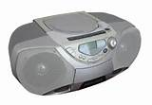
Session 1: called to a loving encounter with Jesus in the church
Symbols and Supplies:
  Nametags
  Chairs in a circle
  Image of a Path in center
  Blindfolds (one for each participant)
  Music and player/speakers (Resources/Music) www.vencuentro.org/v-encuentro-documents/music/
  Prayer (Celebrate)
    Blindfolds
    Small pieces of paper and pens
    Prayer on page 14 (Saint Teresa of Avila)
    Music and player/speakers
    V Encuentro Mission and Consultation Journal

Slide 19


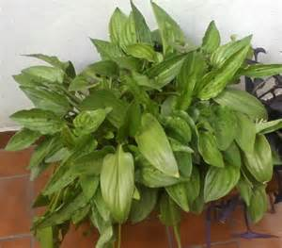
Session 2: with words and actions: do it!
Symbols and Supplies:
  Nametags
  Chairs in a circle
  Image of a Path in center
  Bottle of Water (for each participant)
  Music and player/speakers
  Prayer (Celebrate)
    Clear bowl with water
    Green plant with leaves
    Containers that workers or immigrants use for water
    Soft music sounds of water flowing
    Bottle of water for each participant
    Music and player/speakers

Slide 20
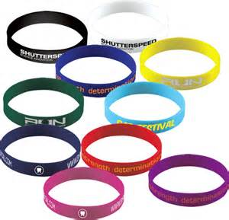
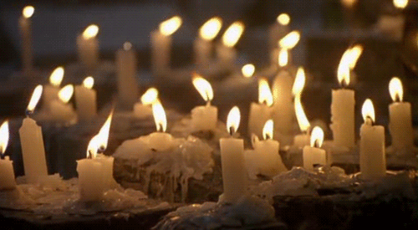
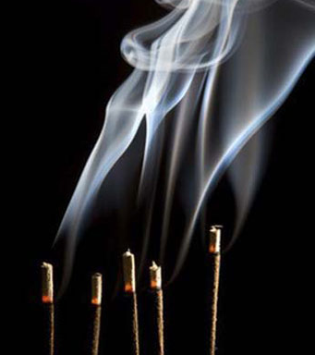

Session 3: walking together with jesus
Symbols and Supplies:
  Nametags
  Chairs in a circle
  Image of a Path in center
  On a table
    Bible
    Basket with V Encuentro Wristbands (2 for each participant) ▫
  Music and player/speaker
  Prayer (Celebrate)
    Lit candles
    Flowers
    Incense
    Table with Bible and wristbands
    Music and player/speakers

Slide 21
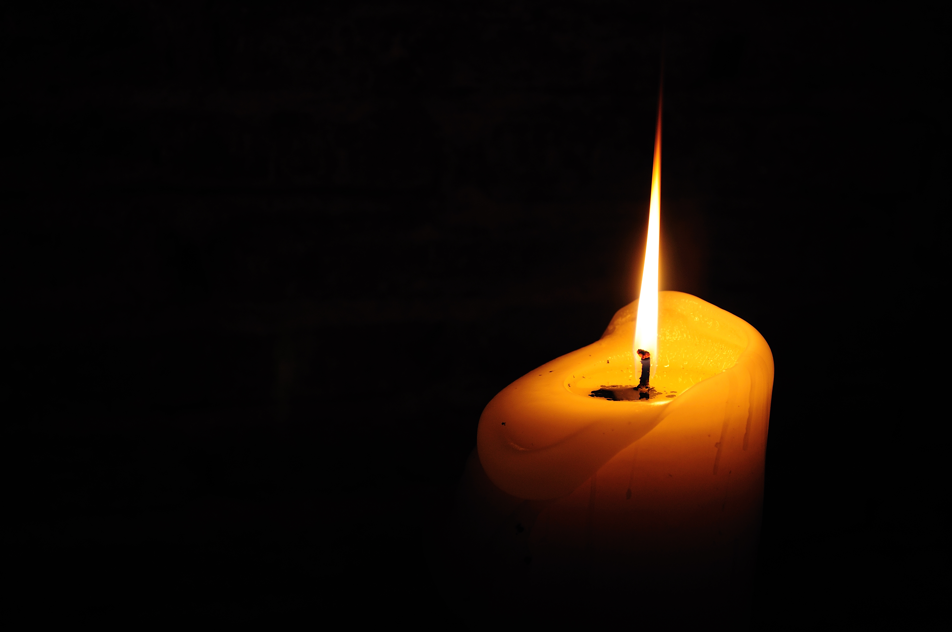
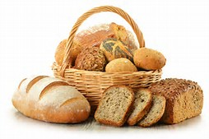
Session 4: bearing fruits of new life
Symbols and Supplies
  Chairs in a circle
  Image of a path in the center
  Candle
  Basket with bread
  Music and player/speakers
  Prayer (Celebrate)
    A candle placed high
    Basket with enough bread for all participants
    Tea light candles for all participants
    Music and player/speakers

Slide 22

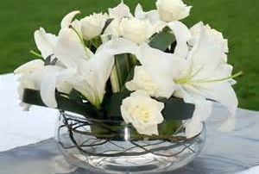
Session 5: celebrating the joy of being missionary disciples
Symbols and Supplies
  Chairs in a circle
  Image of the Path in the center
  Basket with the V Encuentro Crosses
  Candle and Open Bible
  Prayer
    Large Cross
    Side table with wreath of flowers and white cloth
    White paper cross and pens
    Tape

Slide 23
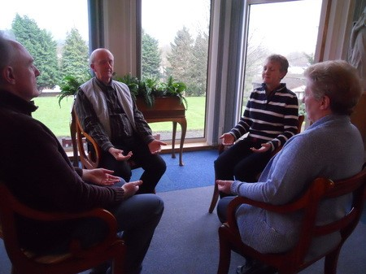
Leading a group in contemplative and reflective prayer
Reflection:
  The opportunity to pause, quiet ourselves and review what is before us and what is inside us
  Non-judgmental way of perceiving in which we become more present to our Encuentro experience.
  We listen to our experience, paying attention to how it is speaking to us and to what is occurring within us and the group.

Slide 24
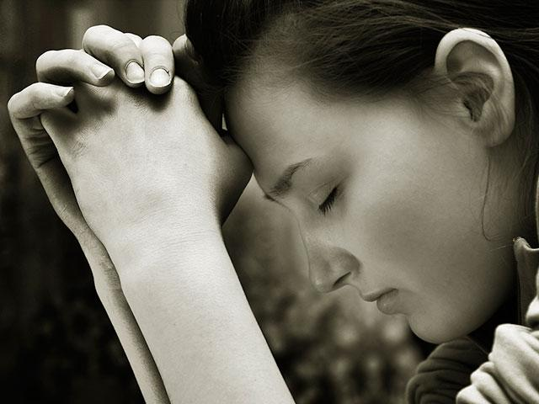
Leading a group in contemplative and reflective prayer
Prayer:
  A turning toward God through the words we are sharing with an open heart.
  In prayer, we become more aware of God’s presence in the Encuentro and we seek a deeper understanding.
  Praying as a group also opens us to a great appreciation of God’s presence in our ministry, and inspires us to act as a community.

Slide 25
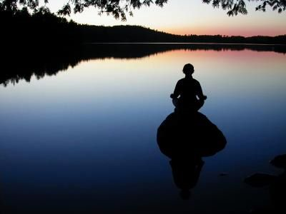
Leading a group in contemplative and reflective prayer
Contemplation:
Clearing the mind of outside concerns so that God’s voice may more easily be heard and be united with the movement of the Spirit within oneself and the group.
The necessary silence, waiting to and listening to hear from God.

Slide 26

Leading a group in contemplative and reflective prayer
The Role of the Spiritual Leader
Leading Group Contemplative/ Reflective Prayer
  Prepare with personal prayer.
  Begin and conclude the gathering with prayer as indicated.
  The first step is slowing down and refocusing attention.
  Speak slowly and meaningfully.
  Be open to being guided into this by the Spirit.

Slide 27
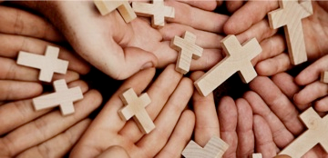
Leading a group in contemplative and reflective prayer
The Role of the Spiritual Leader
Leading a Group in Faith Sharing
  The role of the facilitator is one of listening and encouraging by inviting group members to participate.
  The facilitator does not provide answers to personal faith questions participants might have.
  The facilitator is not a teacher who instructs, nor a judge who renders verdicts, or a counselor who provides spiritual or moral guidance.
  Remind all of the importance of maintaining confidentiality so that a trust level grows in the group and all are honored.

Slide 28
Mission and consultation journal
During the first session all participants in the five session experience will receive a notebook called The V Encuentro Mission and Consultation Journal.
This Journal will help you to:
Reflect on your own experience of the V Encuentro Sessions
Engage people in the peripheries, build relationships, and ask questions
Discern & Write down new insights gained from this missionary experience and fill out the consultation form weekly

Slide 29
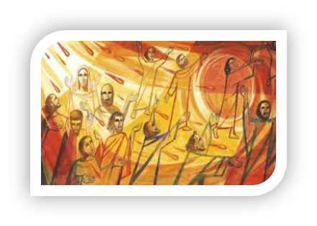
Missionary activity
The V Encuentro embraces a spirit of the New Evangelization and the vision of a Church that goes forth and reaches out.
At the end of each session, all participants are invited to take part in a simple missionary action.
This action is an opportunity to witness one’s identity as a missionary disciple of Jesus Christ.
Also, it is an invitation to go into the peripheries of our Church and our society.

Slide 30
The periphery?
Places where our sisters and brothers are vulnerable, excluded, treated as outsiders, living in fear, isolated, ignored, invisible.
Pope Francis reminds us that as baptized Christians, Catholics must embrace the call from Jesus Christ “to go forth from our own comfort zone in order to reach all the ‘peripheries’ in need of the light of the Gospel.”
Each community, each family, each person must identify the immediate peripheries and then go and meet people there with a message of love and hope in a spirit of accompaniment.
Many Hispanic Catholics—as well as other Catholics— live in the peripheries of our Church and society.
We are called to bring the light of the Gospel to all these groups.

Slide 31

tips for missionary activities
Choose your missionary partner. The Lord sent his disciples in pairs (Lk 10:1).
If you are reaching out to people you know, contact them in advance of the visit.
If you are going to the periphery, engage people in a natural and polite way, showingauthentic interest in getting to know them.
Pray for wisdom before going to visit someone. Pray in thanksgivingafter returning.
Bring some information about your parish or faith community to share.
Missionaries should not visit or contact minors under the age of 18 without the presence of a parent or adult following Safe Environment Guidelines.

Slide 32

12 tips for missionary activities cont.
Be natural and enthusiastic. Speak about what you know and what you have experienced as a Christian.
Be respectful. Avoid entering into controversies.
Use the questions in the Mission and Consultation Journal. Then, listen... listen attentively and lovingly.
Keep the conversation short.
Write a few notes and respond to questions in the Mission and Consultation Journal after your return.
If you have any questions, consult with the leaders of the V Encuentro team in your parish or faith community.

Slide 33
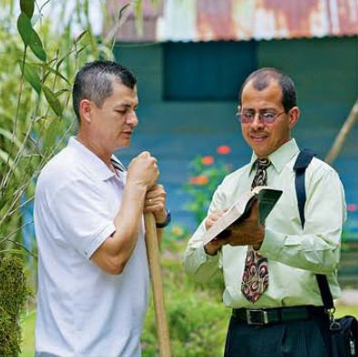
Possible scenarios – visitation
We are a new Catholic family in the area…
I am no longer a practicing Catholic…
I am angry at the Church because…
I am too busy at this time to talk…
I am not a Catholic and I practice my faith at…
I do not go to any church…
Why are you visiting me?

