Slide 1
Bethany Center, January 28, 2020
End-Of-Year Best Practices…
and IRS Requirements.

Slide 2
EOY Reporting Agenda January 28, 2010
Welcome/Opening Prayer
IRS Regulations and their impact on the parish/school
IRS forms W-9, 1096 & 1099
Contribution Statements
Break
Reflection
Lunch
Update: Courageously Living the Gospel
Health Insurance Billing
Preliminary Budget Guidance 2020-2021
Loss Prevention: How to file for a grant
Discussion

Slide 3
Form 1099
GENERAL RULE: Nonwage payments (payments not qualifying for reporting on Form W-2) of $600 or more in a calendar year must be reported on Form 1099.

Slide 4
Form 1099
Exceptions:
Vendors who provide a signed Form W-9 with their FEIN attesting they are exempt from Form 1099 Reporting (e.g. corporations).
Employee reimbursements paid under a qualified accountability plan (i.e. with proper documentation).

Slide 5
Form 1099
So, I just need to get a signed W-9?
Q: Who qualifies as a “1099 Vendor”?
A: Vendors who:
Provide a signed Form W-9 with their FEIN.
Are not employees and do not receive a Form W-2.
Are not treated like employees.
Are not supervised by the reporting entity.
Have an investment in their business.
Have multiple clients/customers.
Pay self-employment taxes.

Slide 6
Form 1099
According to the IRS, evidence falls into 3 categories:
Behavior Control
Financial Control
Type of Relationship

Slide 7
Form 1099
Behavior Control:
Subject to instruction:
When and where to do the work.
What tools or equipment to use.
What workers to hire or to assist with the work.
Where to purchase supplies and services.
What work must be performed by a specified individual.
What order or sequence or order to follow.

Slide 8
Form 1099
Behavior Control:
Employer has the right to control how the work is achieved.
Training provided by the business to the worker (regarding work methods, not orientation to the organization).

Slide 9
Form 1099
Financial Control:
Extent of unreimbursed business expenses.
Extent of worker’s investment.
Extent to which the worker makes their services available to others in the market/businessworld
How the business pays the worker (hourly wages or salary vs. flat fee for service or time and material.
Ability to achieve a profit or loss.

Slide 10
Form 1099
Type of Relationship:
Written contracts.
Employee benefits for the worker?
Permanence of the relationship:
Specific time period or project = Contractor
Continue indefinitely = Employee
Extent to which services performed by the worker are a key aspect of the regular business of the entity.

Slide 11
Form 1099
Difficulty in Applying IRS Rules:
Musicians – regular and occasional.
Lawn & landscaping vendors.
Reimbursements must have documentation as required by the IRS in order to not be taxable (receipts provided by vendors document a need for a W-9 or even worse, perhaps an I-9 and W-4).
Occasional priests earning $600 annually.
Stole fees and stipends paid or required by the parish are income and must be reported under the rules for Form W-2 and Form 1099.

Slide 12
Form 1099
Penalties:
$50 per information return if you correctly file within 30 days of the due date; maximum penalty $545,500 per year ($191,000 for small businesses).
$100 per information return if you correctly file more than 30 days after the due date but by August 1; maximum penalty $1,637,500 per year ($545,500 for small businesses).
$270 per information return if you file after August 1 or you do not file required information returns; maximum penalty $3,275,500 per year ($1,091,500 for small businesses).
$270 x 50 vendors = $13,500 each year not reported

Slide 13
Form 1099
Q: How do I make it work?
A: No payments should be made to a vendor without a completed, signed, W-9 on file.
“I am ready to cut your check, but I need a W-9.”
“I can give them a check, Father, but I need a W-9 first.”
“Father, this reimbursement to you includes payments that should be 1099’d – that means I’m supposed to include them in your W-2.”

Slide 14
Independent Contractors & IRS Reporting
All vendors:
Form W-9 required before payment
Setting up a new vendor in Parishsoft
Data Source: W-9
Auditing vendors for missing information prior to printing Form 1099’s
What to file with the IRS:
Form 1099 – Misc
Deadline: furnish Copy B to each payee by January 31
Should be postmarked no later than January 31
Form 1096 (Summary/Transmittal)
Deadline: File Form 1096 along with all 1099—Misc (copy A) forms with the IRS by February 28
Preparing & Printing Form 1099 using Parishsoft Ledger & Payables

Slide 15
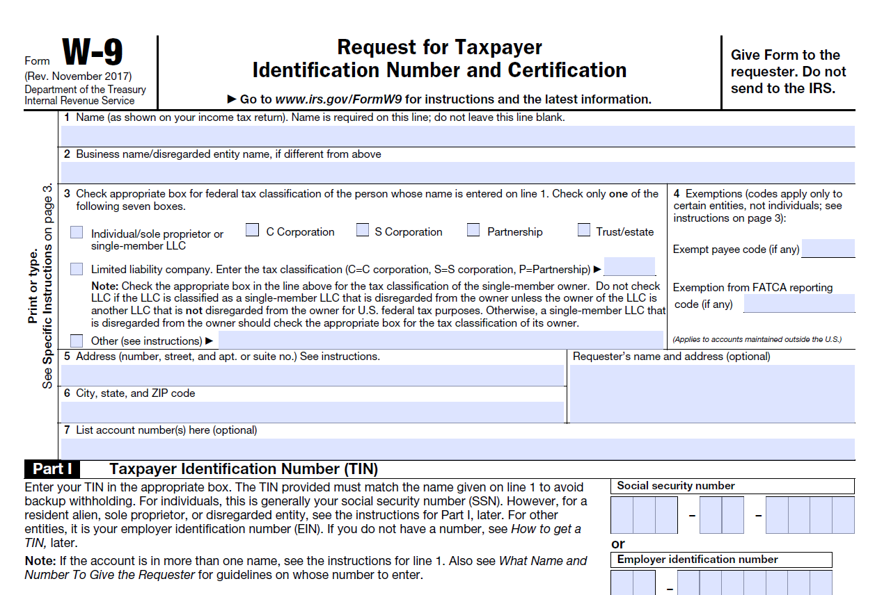
Independent Contractors & IRS Reporting

Slide 16
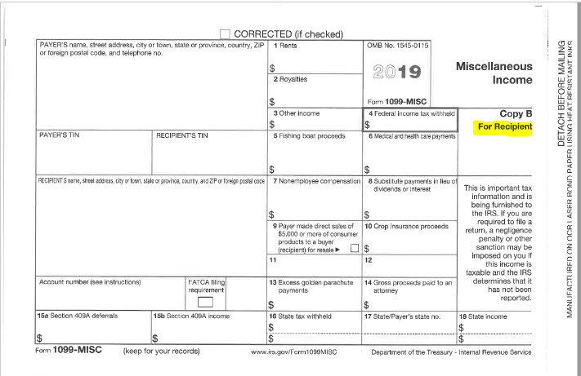
Independent Contractors & IRS Reporting

Slide 17
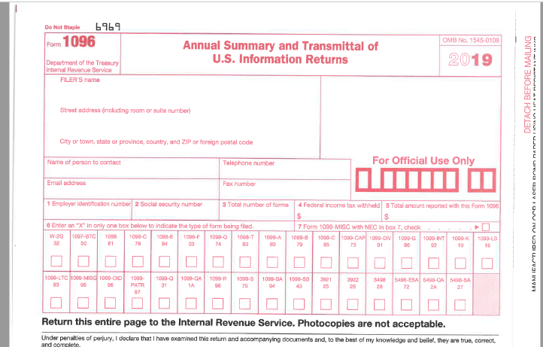
Independent Contractors & IRS Reporting

Slide 18
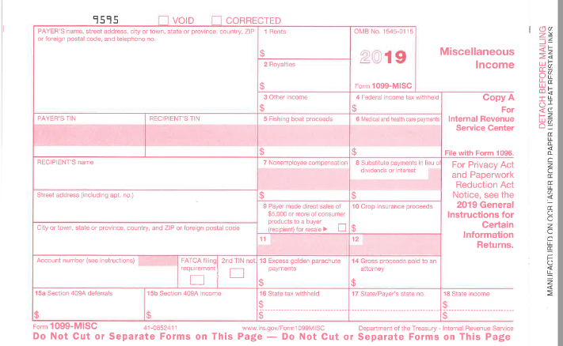
Independent Contractors & IRS Reporting

Slide 19
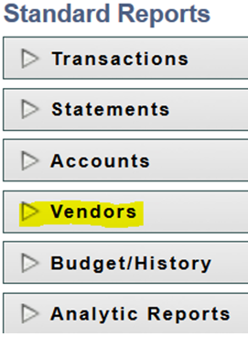
Preparing Form 1099’s using Parishsoft Ledger & Payables
From the Entry Screens Bar select:
From the Standard Reports Screen Select:

Slide 20
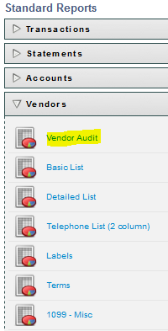
Preparing Form 1099’s using Parishsoft Ledger & Payables
From the Entry Screens Bar select:
From the Standard Reports Screen Select:

Slide 21
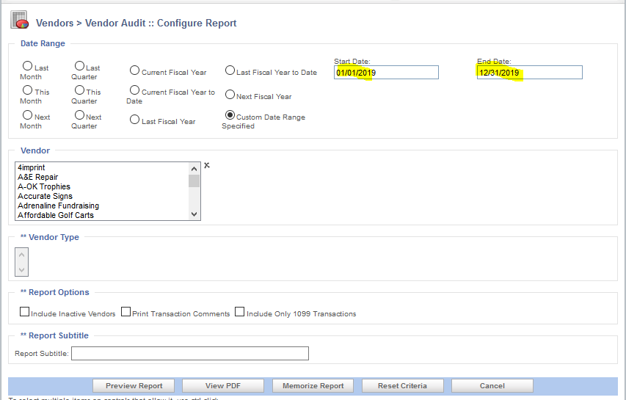
Preparing Form 1099’s using Parishsoft Ledger & Payables

Slide 22
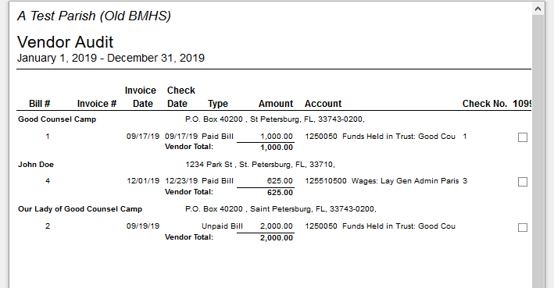
Preparing Form 1099’s using Parishsoft Ledger & Payables

Slide 23
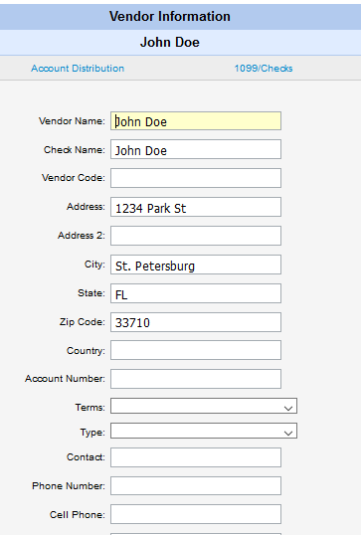
Preparing Form 1099’s using Parishsoft Ledger & Payables

Slide 24
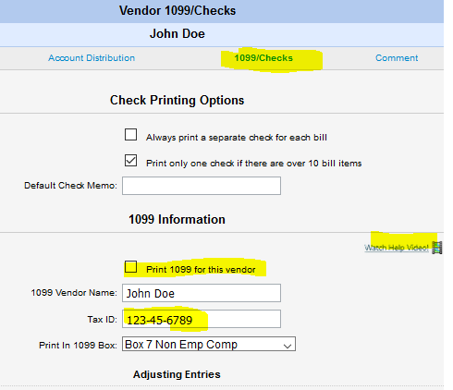
Preparing Form 1099’s using Parishsoft Ledger & Payables

Slide 25
Preparing Form 1099’s using Parishsoft Ledger & Payables
From the Entry Screens Bar select:
From the Standard Reports Screen Select:

Slide 26
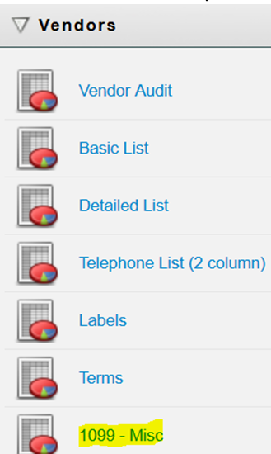
Preparing Form 1099’s using Parishsoft Ledger & Payables
From the Vendor Drop Down Screen Select:

Slide 27
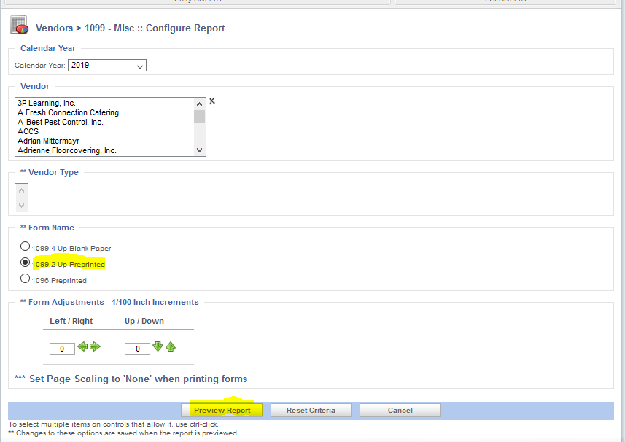
Preparing Form 1099’s using Parishsoft Ledger & Payables

Slide 28
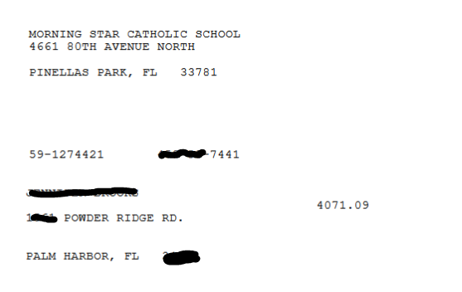
Preparing Form 1099’s using Parishsoft Ledger & Payables

Slide 29
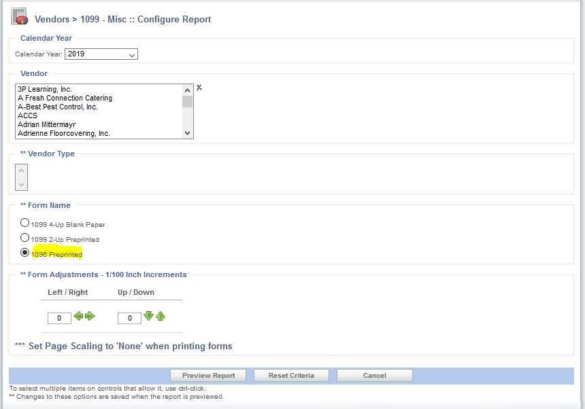
Preparing Form 1099’s using Parishsoft Ledger & Payables

Slide 30
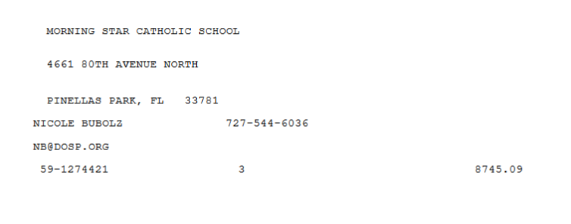
Preparing Form 1099’s using Parishsoft Ledger & Payables

Slide 31
Contribution Statements
A donor cannot claim a tax deduction for any contribution of cash, check or other monetary gift unless:
The donor maintains a record of the contribution in either a bank record or,
Has received a written communications from the parish/school showing the name of the charity, date of contribution and amount
A donor can’t claim a tax deduction for any single contribution of $250 or more unless the donor obtains a written acknowledgement from the parish/school
The acknowledgement should contain:
The name of parish/school
Date of contribution
Amount of Cash Contribution
Description, but not the value, of non-cash contributions
A statement that no goods or services were provided in return for the contribution

Slide 32
Contribution statements
Quid Pro Quo Contributions:
Defined: A Donation made by a donor in exchange for goods or services
A donor may only take a contribution deduction to the extent that the contribution exceeds the fair market value of the goods and services the donor receives in return for the contribution
Example:
A donor gives a payment of $100 and, in return, receives a ticket valued at $40
Only $60 of the donation is deductible
Best Practice: Mail Contribution Statements to all parishioners and visitors
Benefits vs. Cost
Preparing Contribution Statements using Parishsoft Family Suite

Slide 33
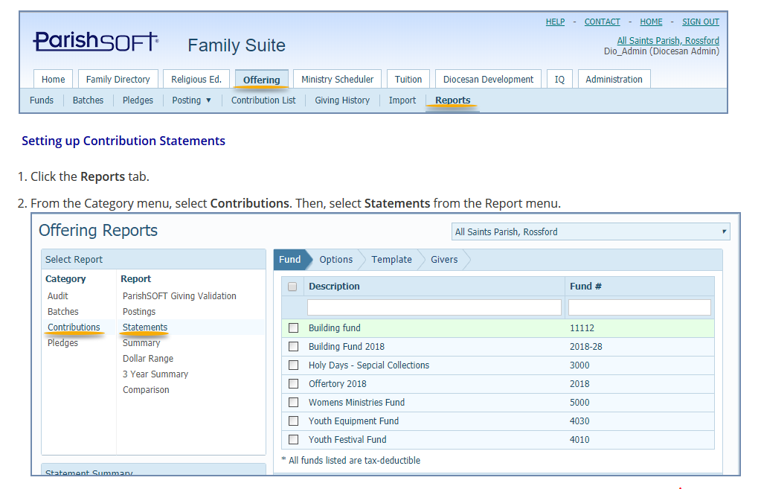
preparing Contribution Statements in parishsoft family suite

Slide 34
preparing Contribution Statements in parishsoft family suite

Slide 35
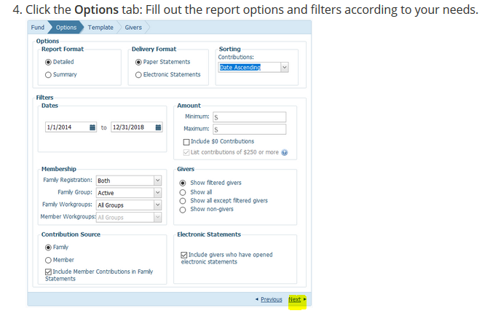
preparing Contribution Statements in parishsoft family suite

Slide 36
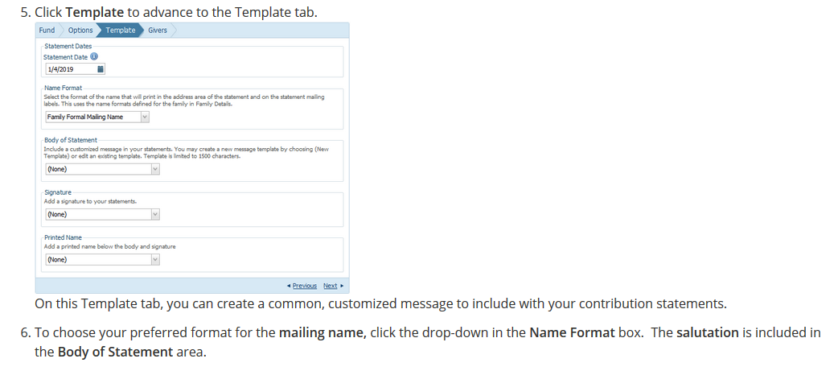
preparing Contribution Statements in parishsoft family suite

Slide 37
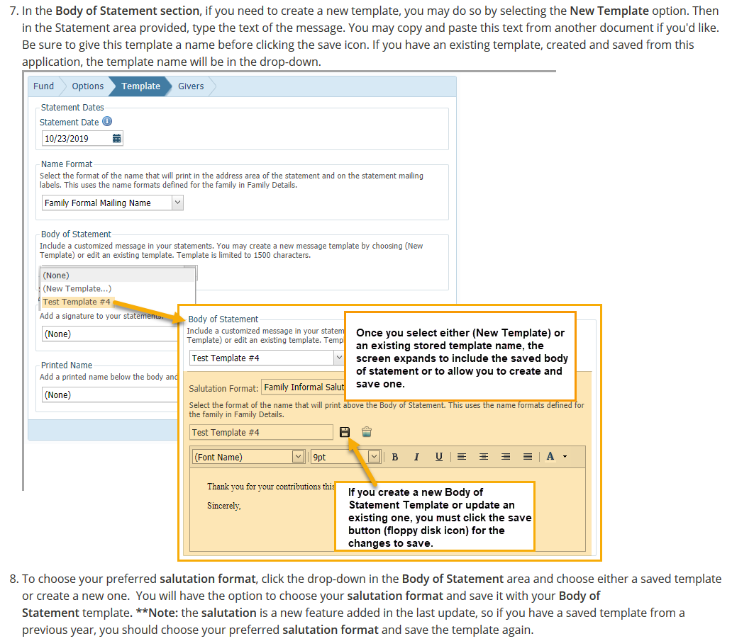
preparing Contribution Statements in parishsoft family suite

Slide 38
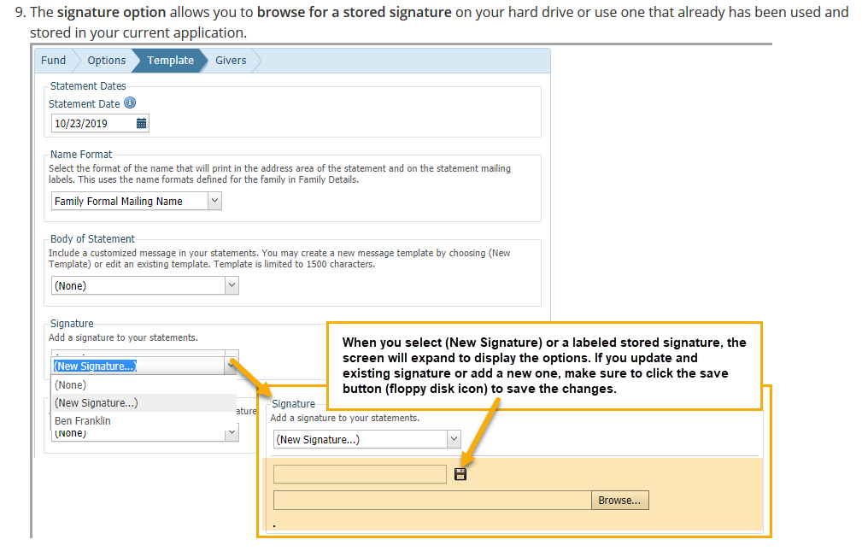
preparing Contribution Statements in parishsoft family suite

Slide 39
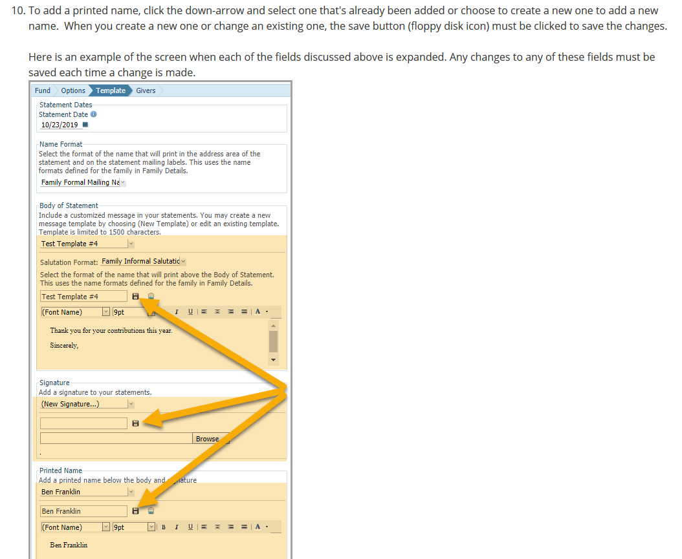
preparing Contribution Statements in parishsoft family suite

Slide 40
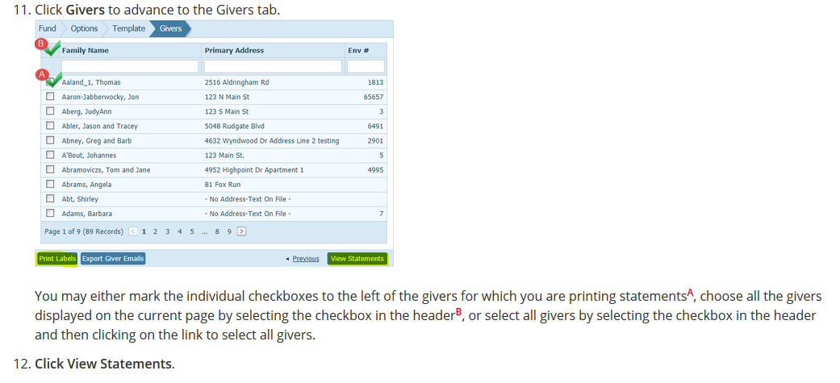
preparing Contribution Statements in parishsoft family suite

Slide 41
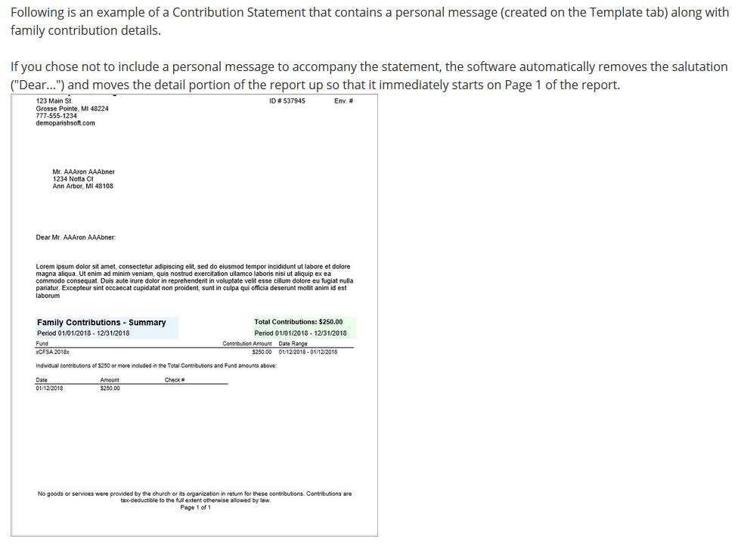
preparing Contribution Statements in parishsoft family suite

Slide 42
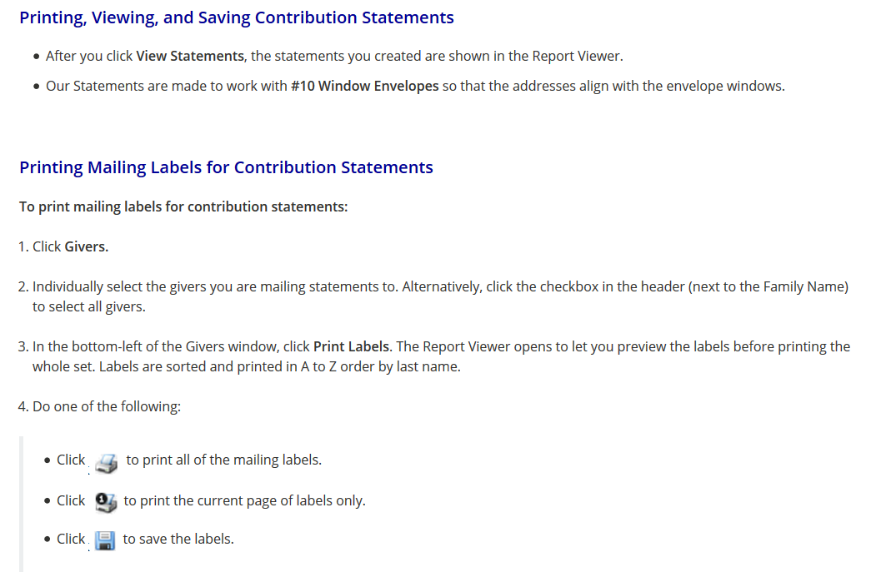
preparing Contribution Statements in parishsoft family suite

