Slide 1
Livestreaming 101
What is Facebook Live?
Why use Facebook Live?
Pre-requisites to livestreaming
Facebook Live step by step walkthrough

Slide 2
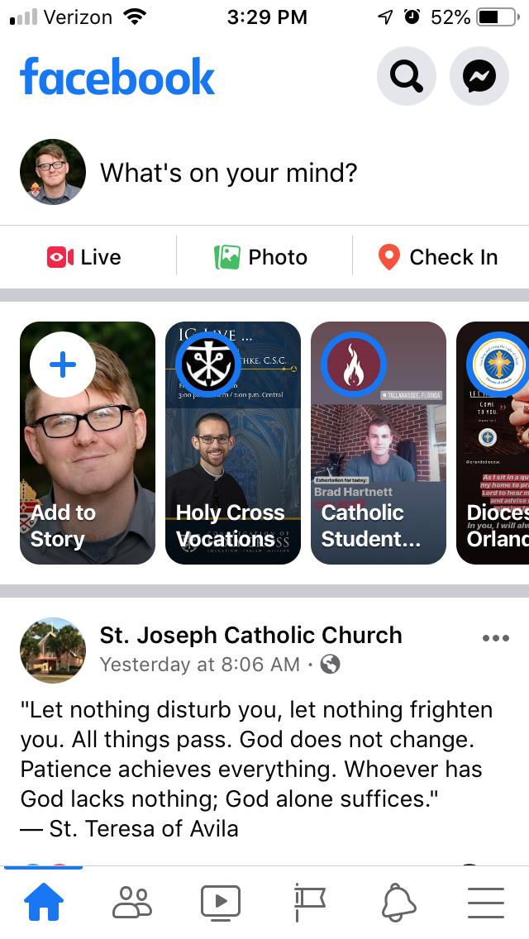

Slide 3
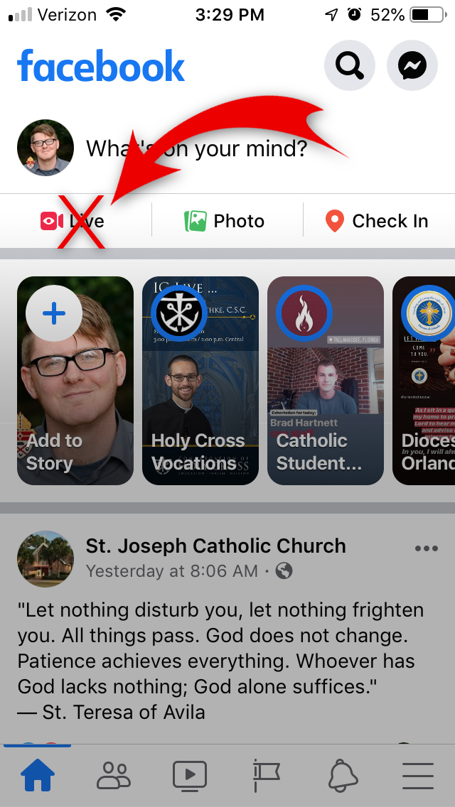

Slide 4
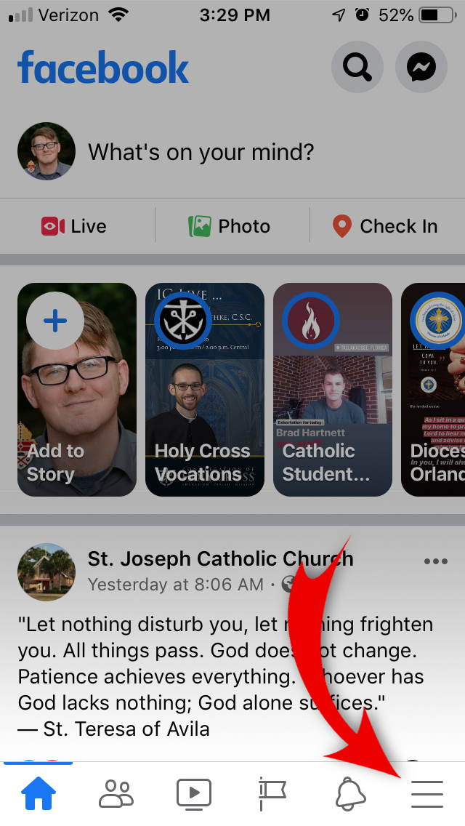

Slide 5
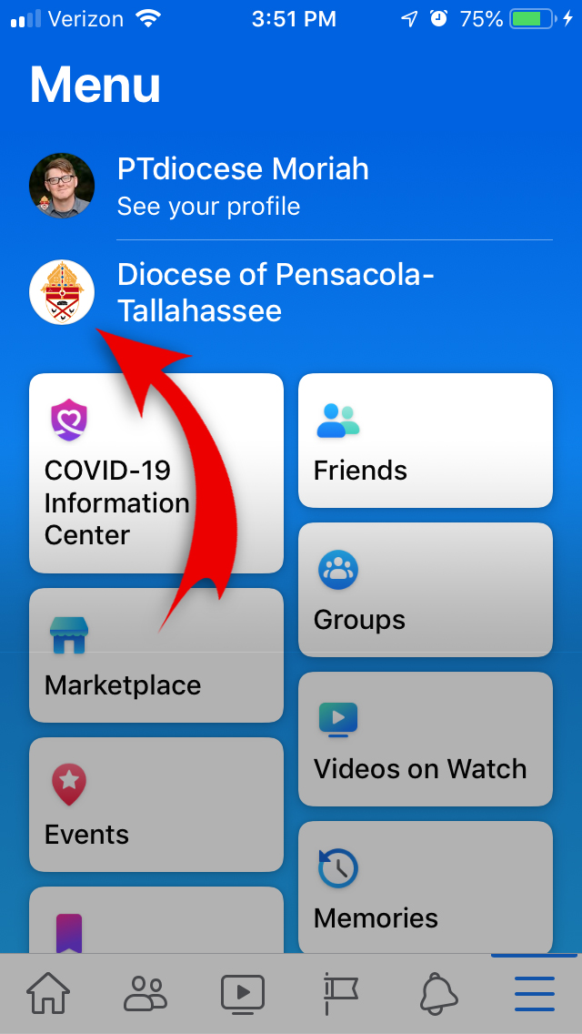

Slide 6
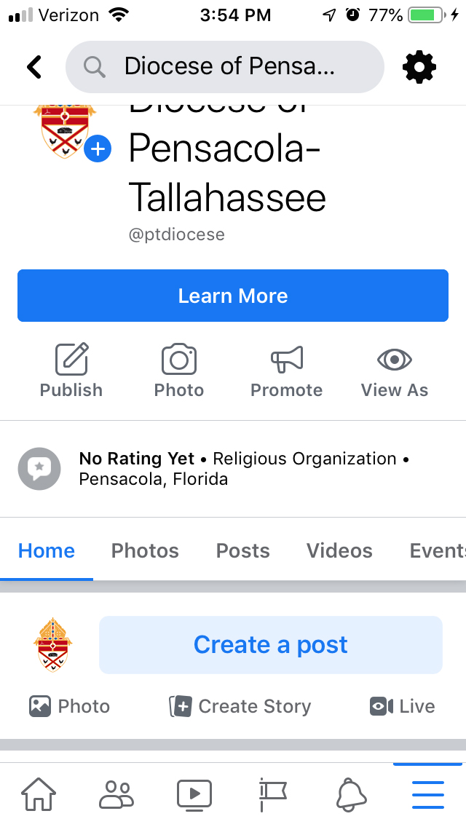

Slide 7
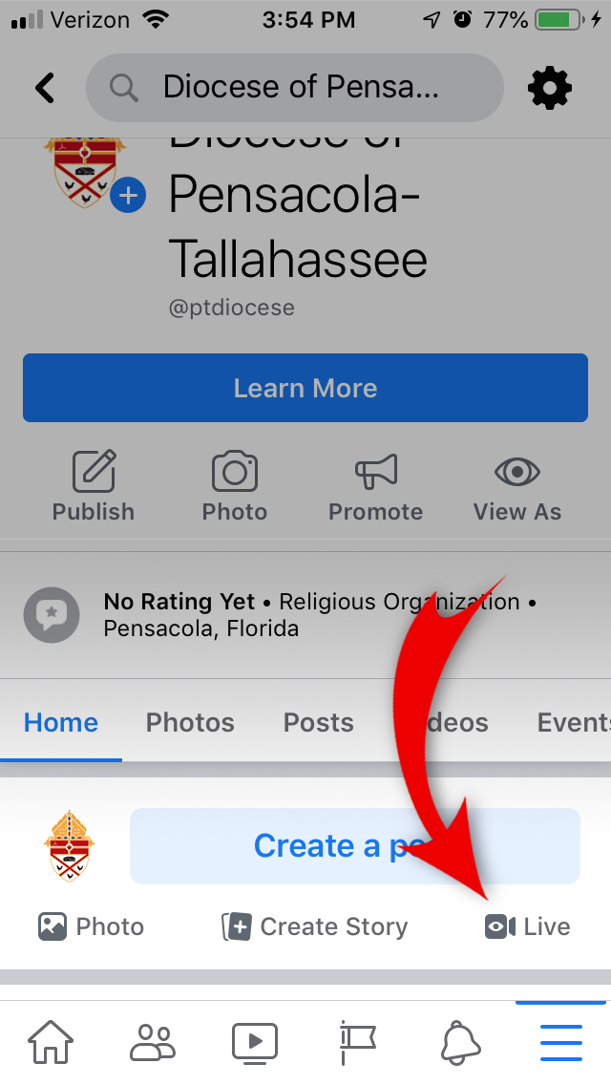

Slide 8
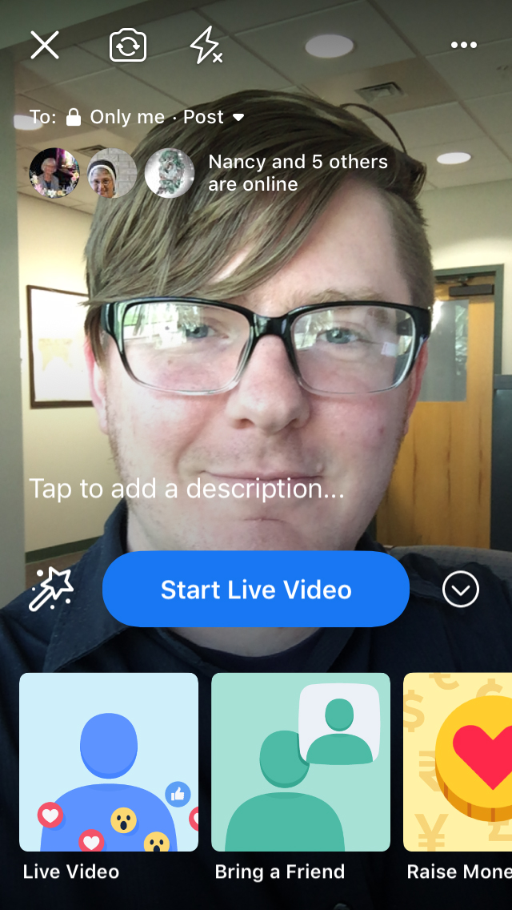

Slide 9
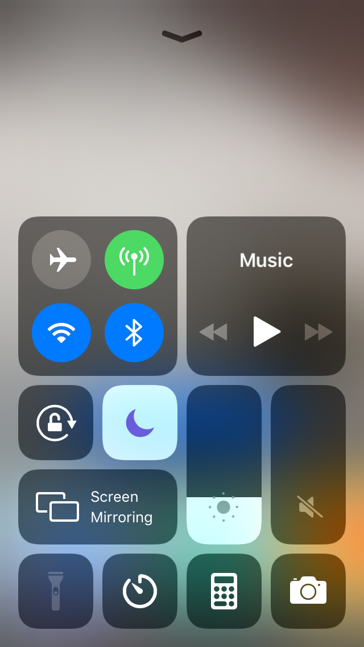

Slide 11
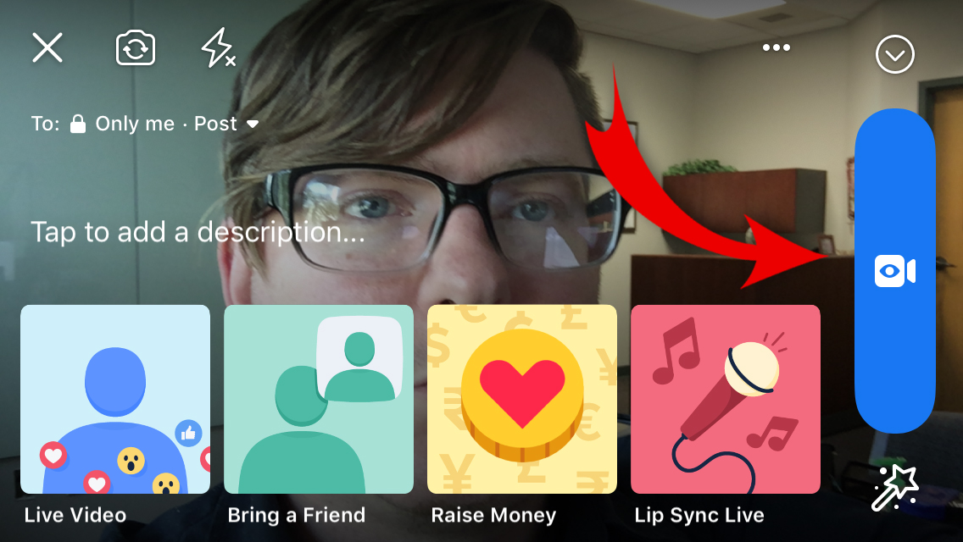

Slide 12
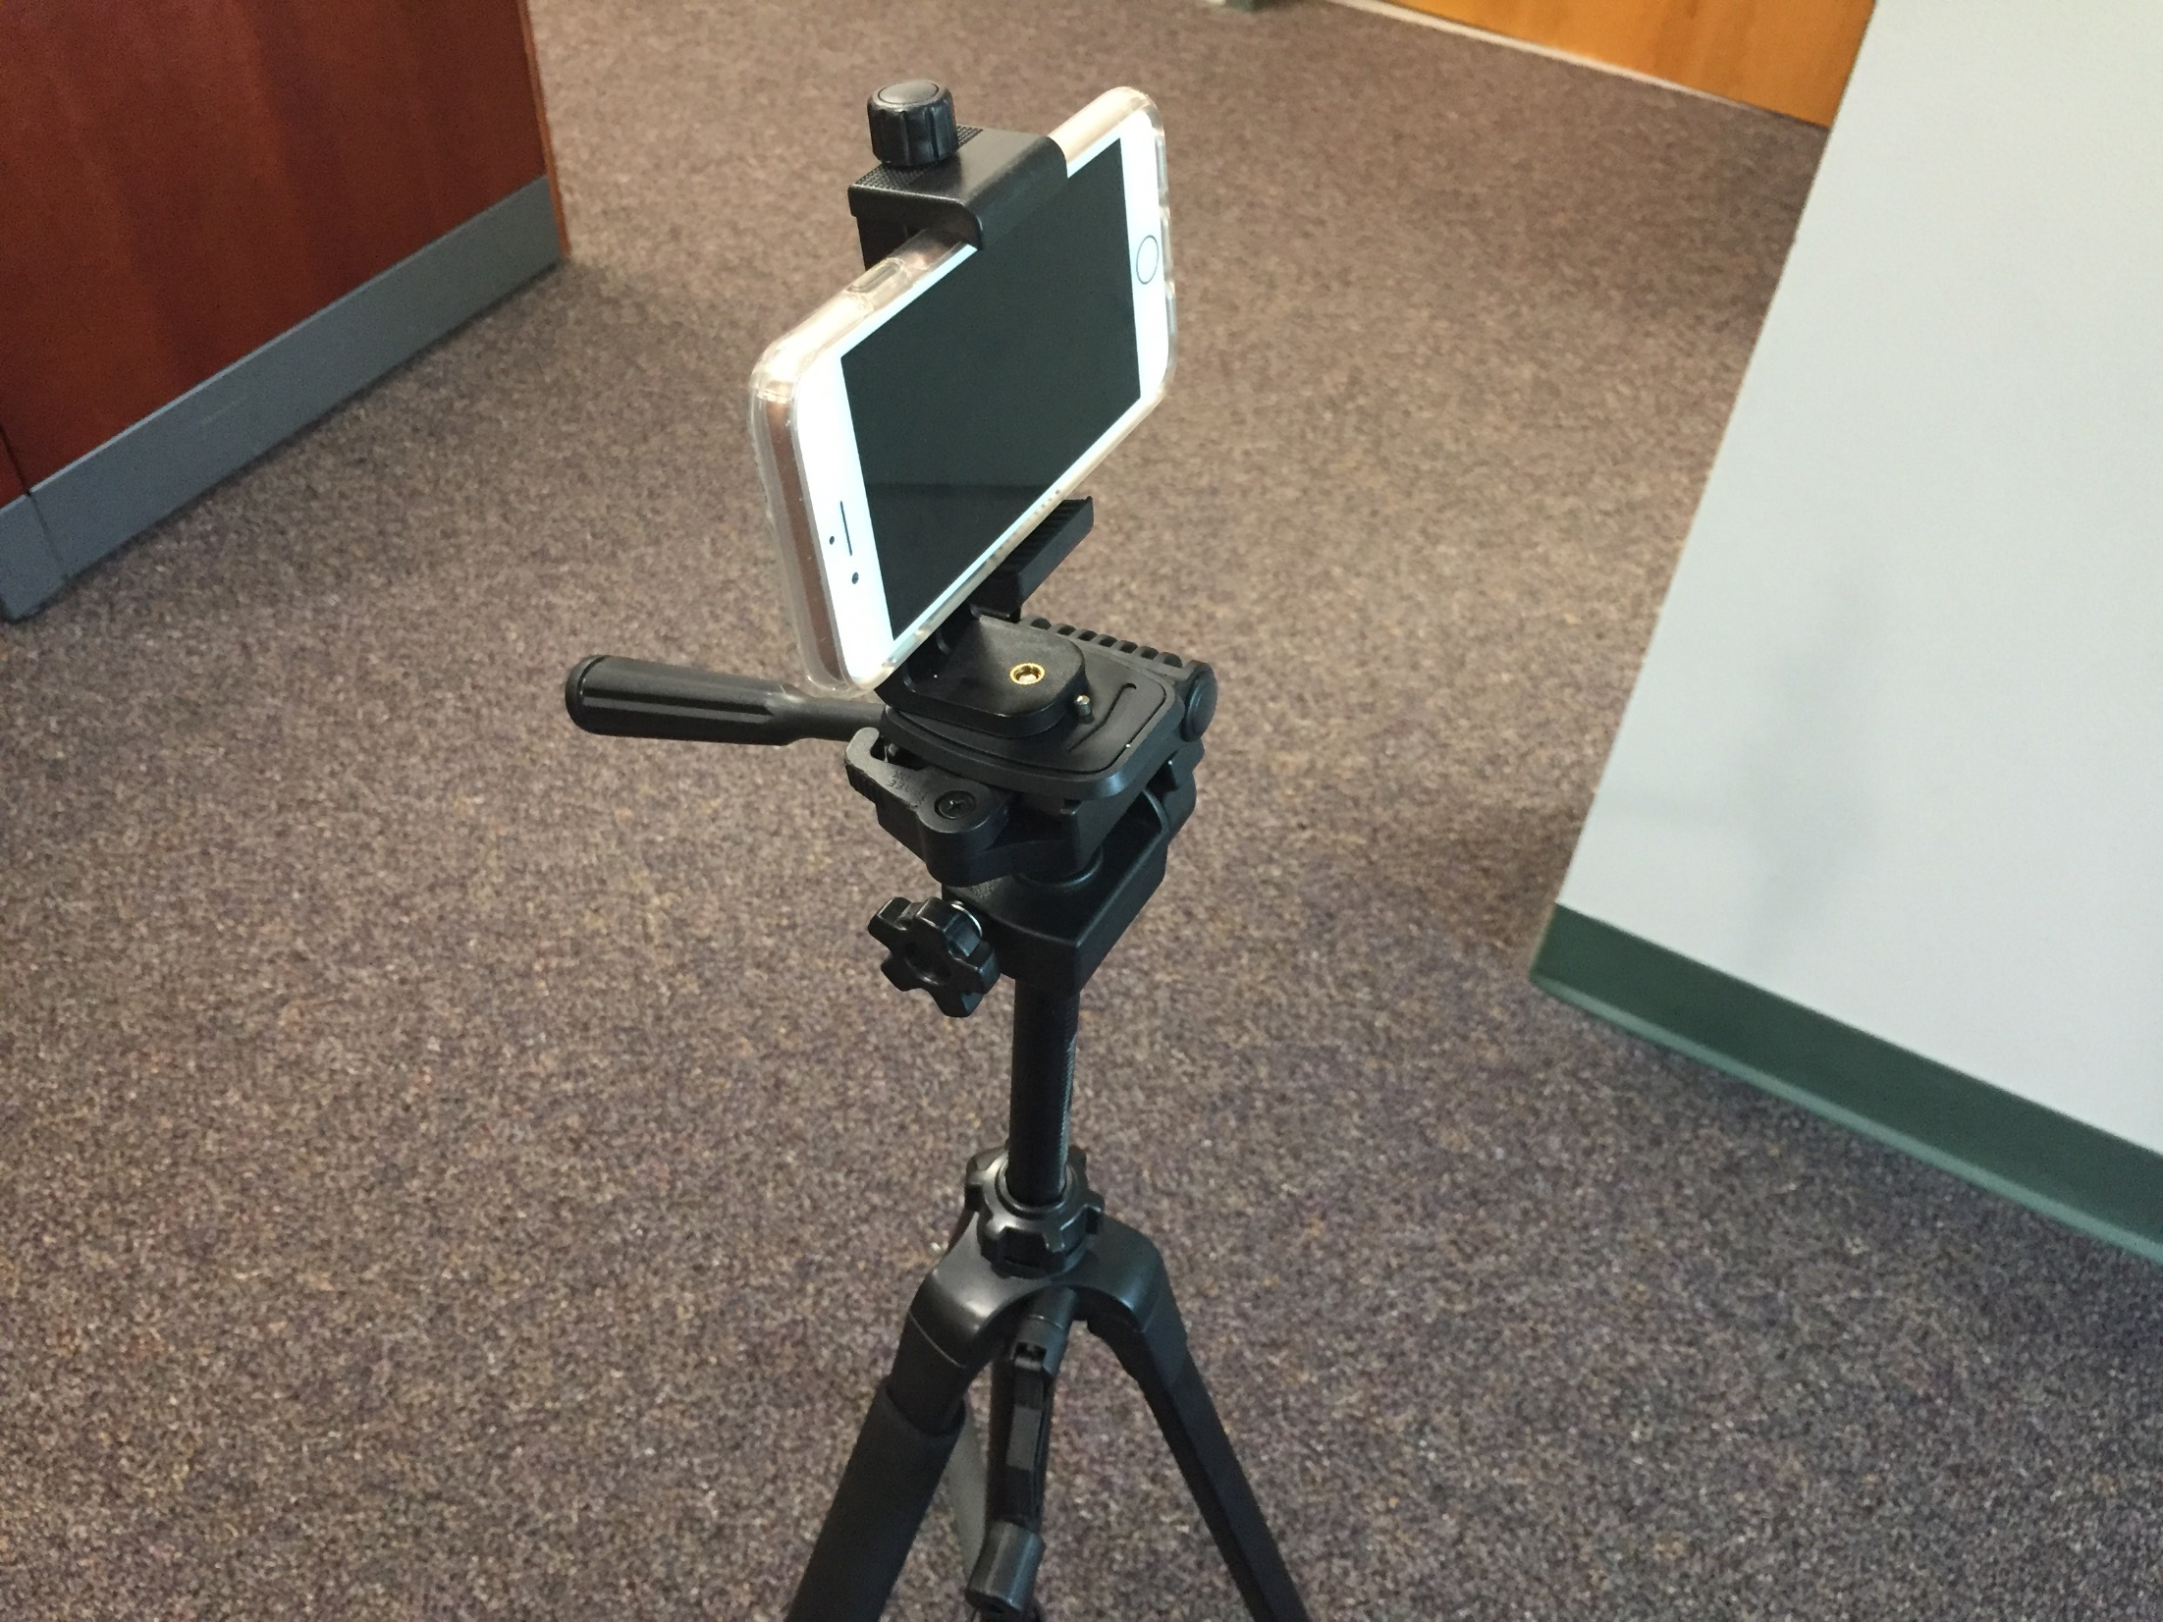

Slide 13
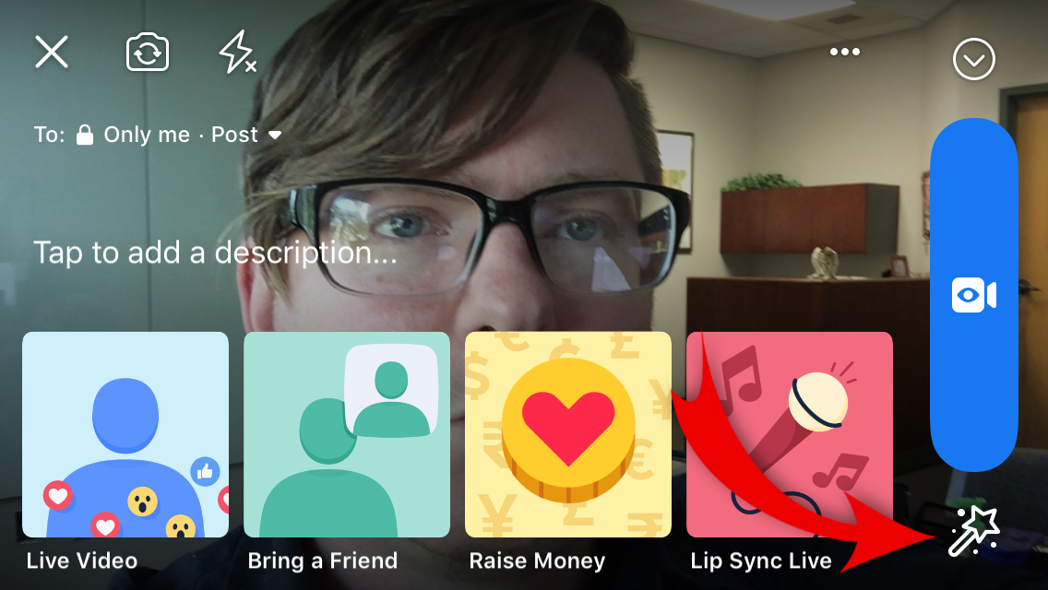

Slide 14
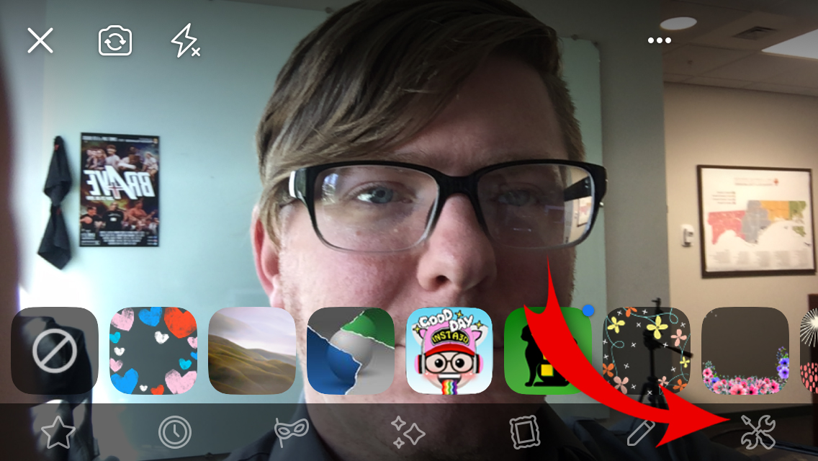

Slide 15
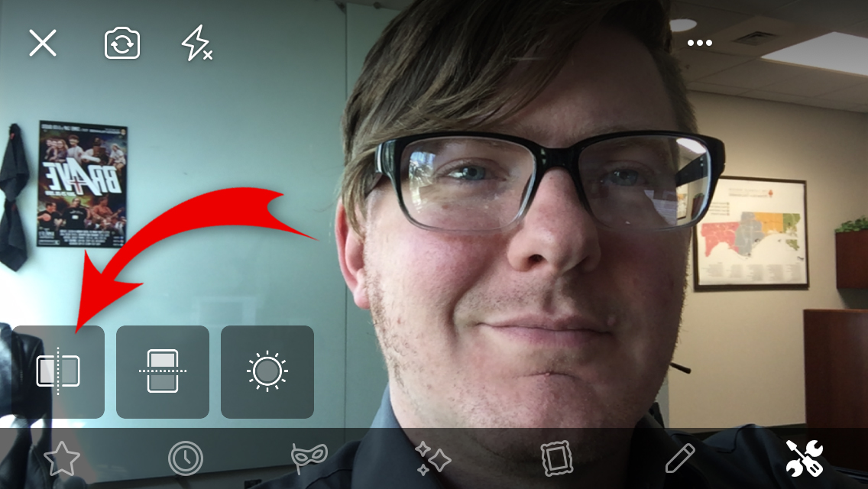

Slide 16
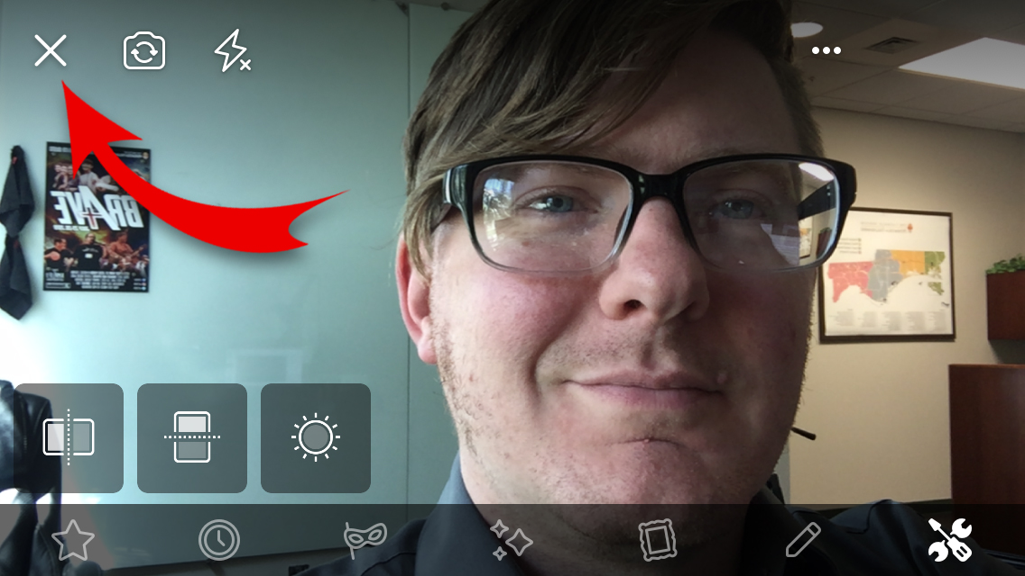

Slide 17
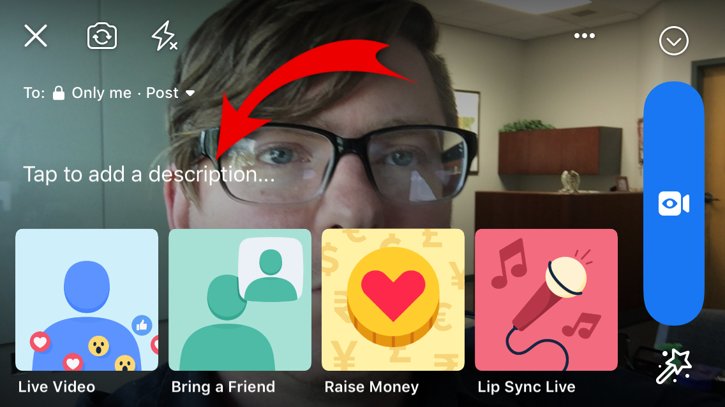

Slide 18
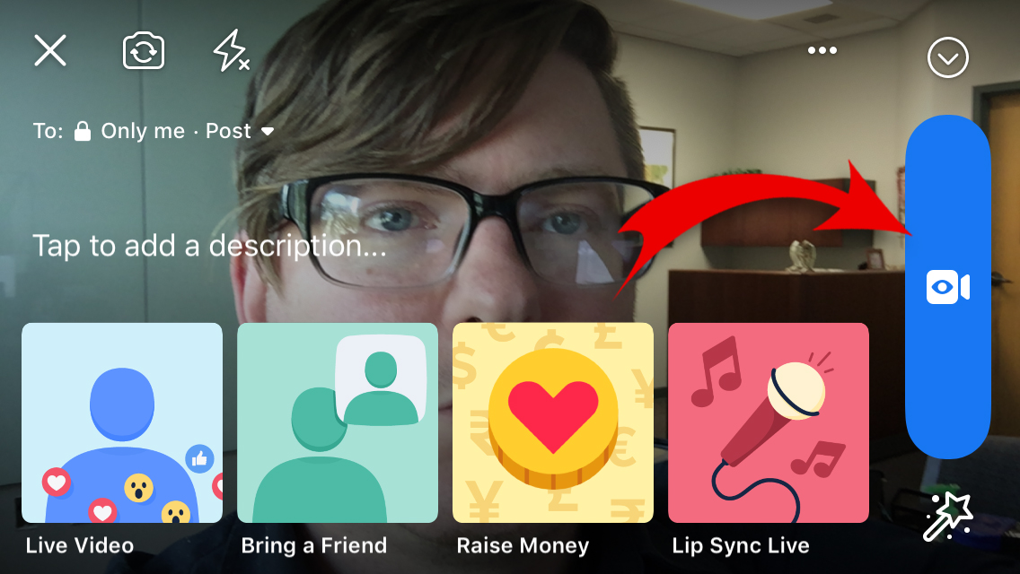

Slide 19
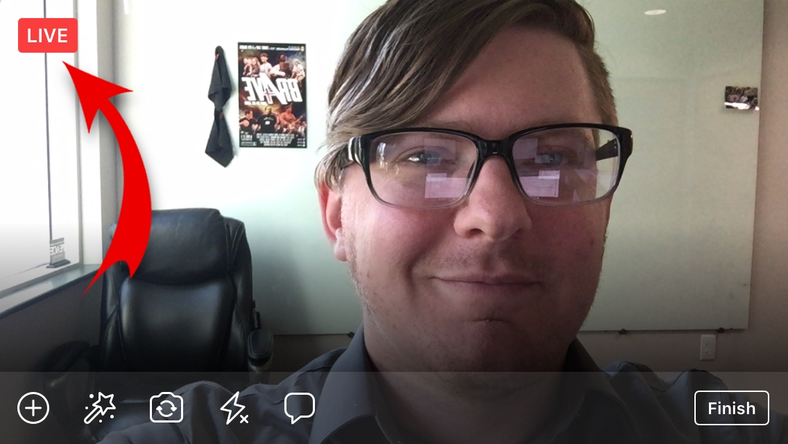

Slide 20
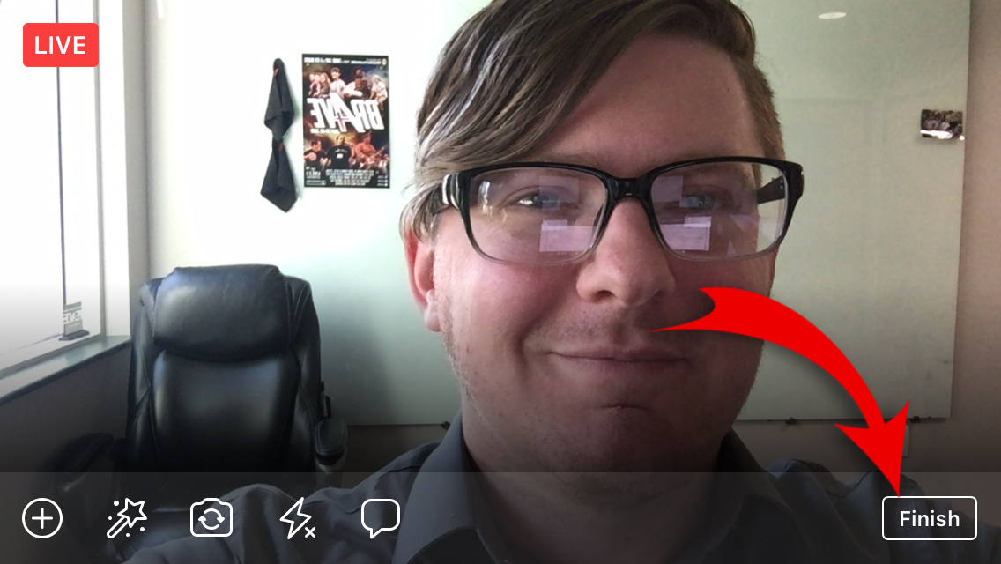

Slide 21
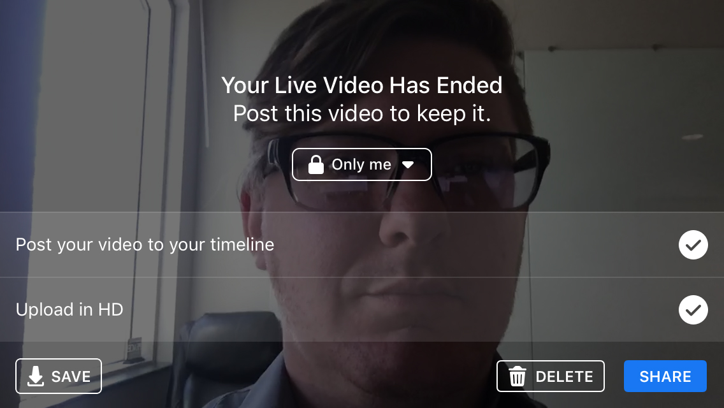

Slide 22
Livestreaming 101
What is Facebook Live?
Why use Facebook Live?
Pre-requisites to livestreaming
Facebook Live step by step walkthrough
A few extra trips and advanced options

Slide 23
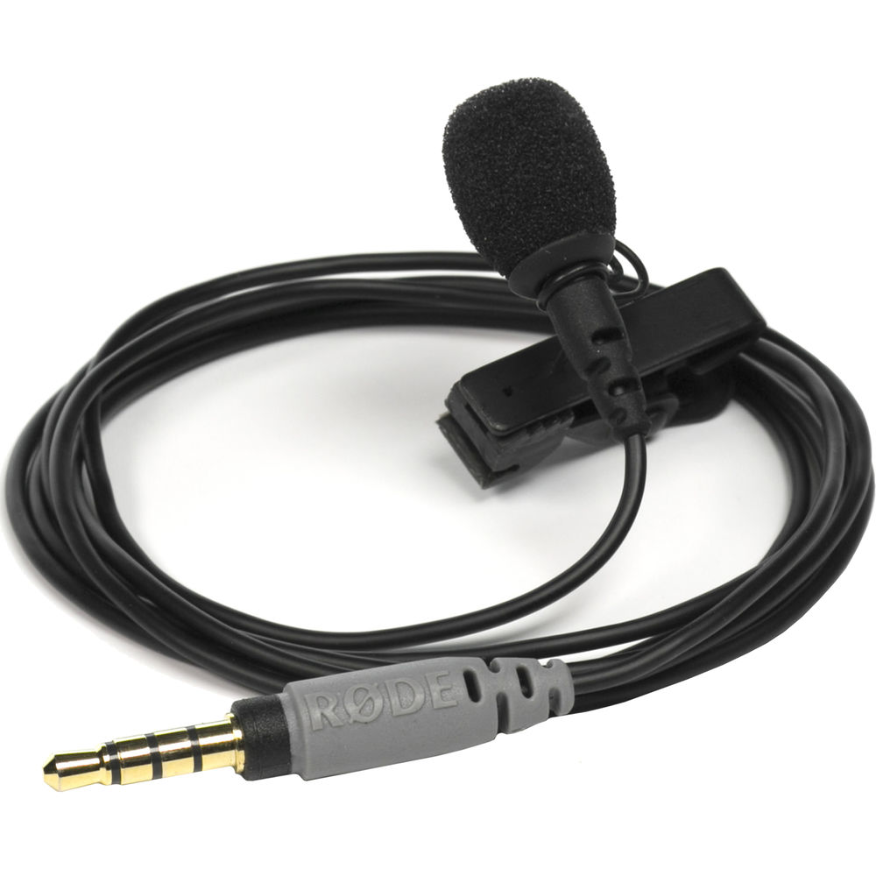

Slide 24
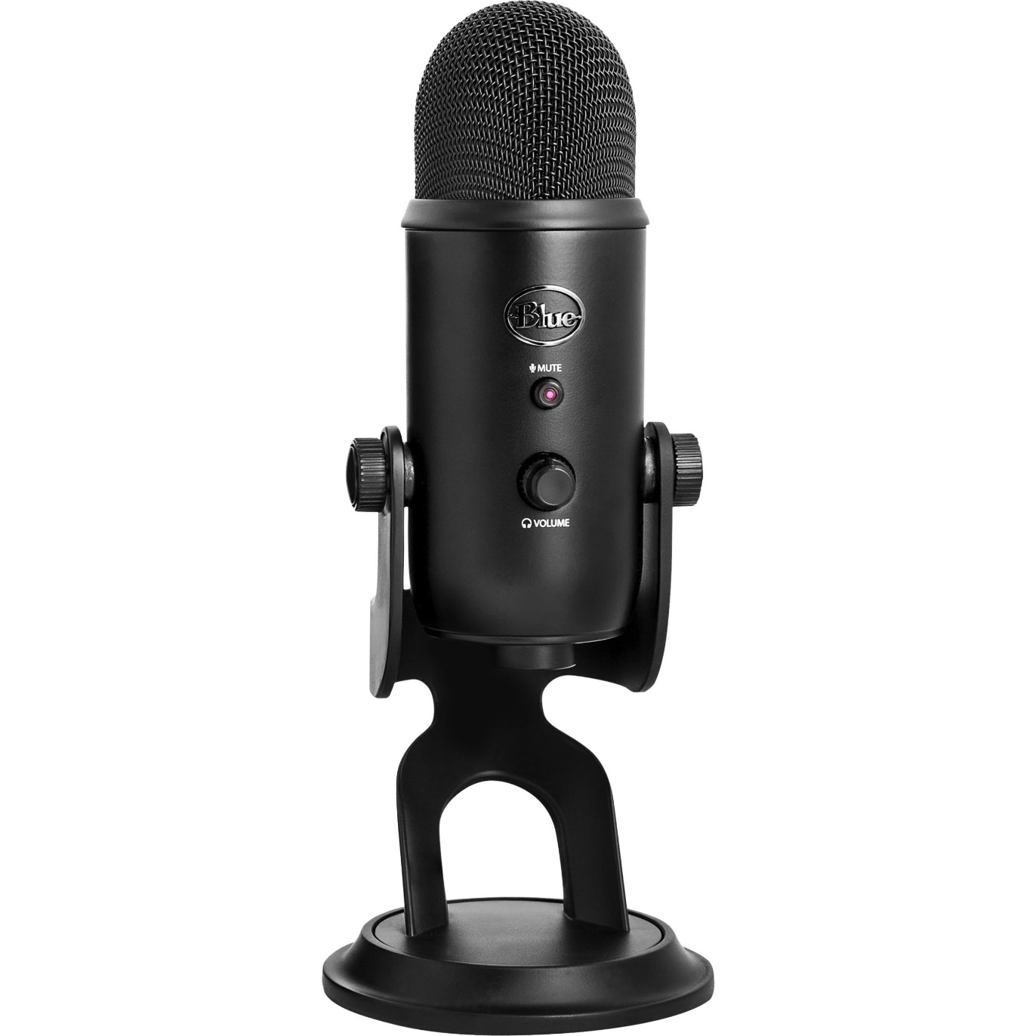

Slide 25
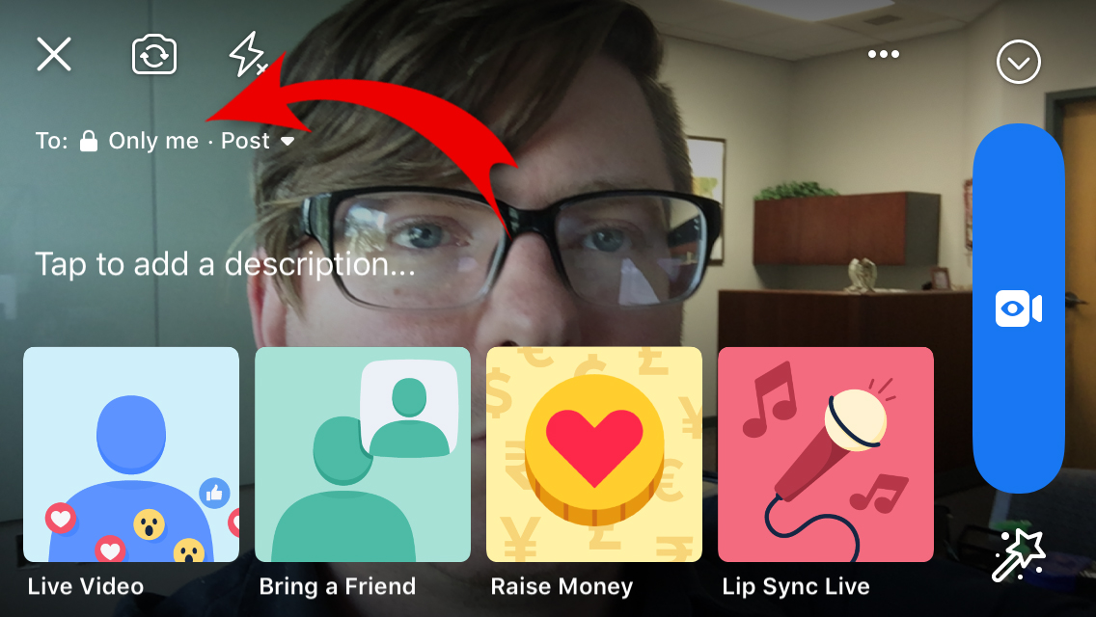

Slide 26
Livestreaming 101
What is Facebook Live?
Why use Facebook Live?
Pre-requisites to livestreaming
Facebook Live step by step walkthrough
A few extra trips and advanced options

Slide 27
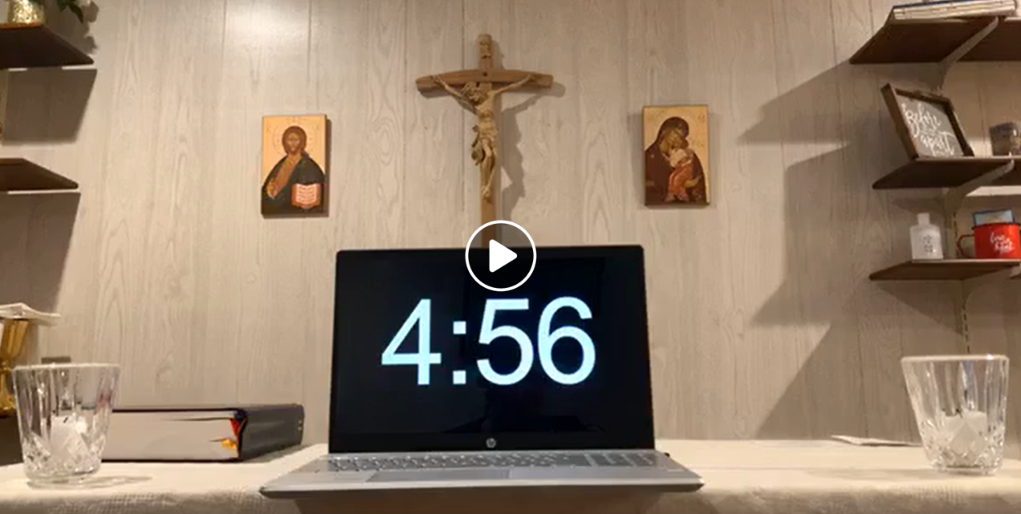
How to Engage Parishioners
Use a timer to countdown for Mass.
This allows people to prepare.
A timer informs people that Mass is about to start.
Participants can invite others to watch.

Slide 28
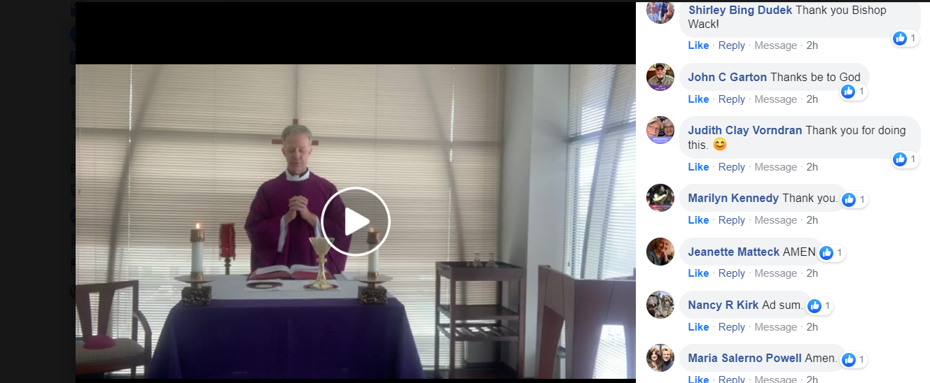
How to Engage Parishioners
Before Mass begins, allow parishioners to offer up any intentions.
Ask parishioners to virtually greet one another during the sign of peace.
Pray the Spiritual Communion Prayer during Communion.
After Mass, answer questions about the homily in the chat window.

Slide 29
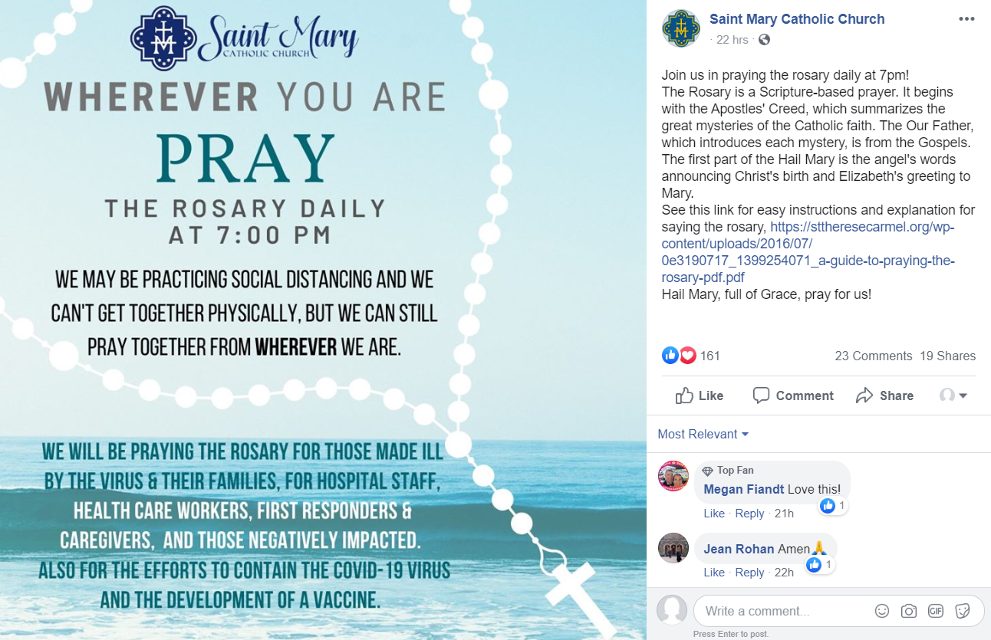
Other Ways to Live Stream

Slide 30
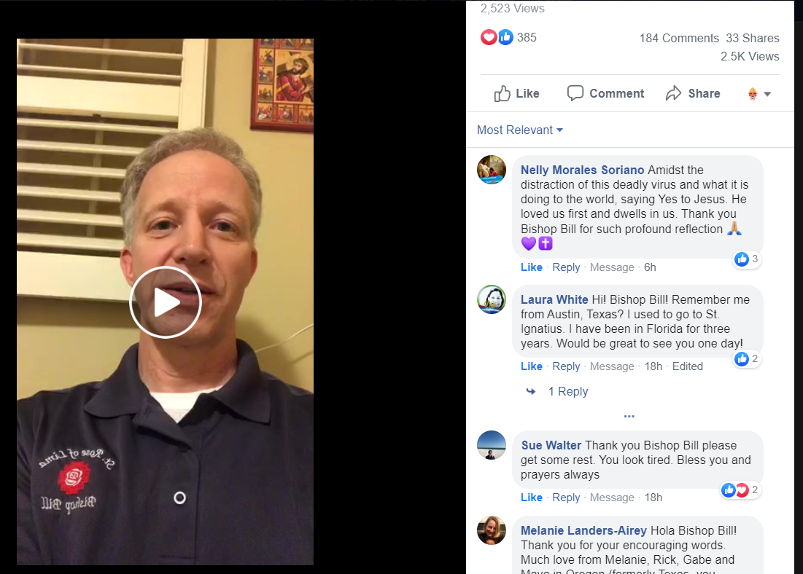
Other Ways to Live Stream
Or
Pray the Divine Mercy Chaplet
Give a daily devotional

