Slide 1

Payroll Protection Program Loans
Agenda:
Powerpoint Presentation
Q & A (send questions via message link, and as long as there are Questions, we’ll try to provide Answers)

Slide 2
Expressed Need for PPP Loans
Known Applications by Diocesan Entities = 60
Bishop’s Approval Not Yet Requested = 22
Number of Banks = 20

Slide 3
Q&A Published by SBA Based on 3rd Supplemental Interim Final Rule
31. Question: Do businesses owned by large companies with adequate sources of liquidity to support the business’s ongoing operations qualify for a PPP loan?
Answer: In addition to reviewing applicable affiliation rules to determine eligibility, all borrowers must assess their economic need for a PPP loan under the standard established by the CARES Act and the PPP regulations at the time of the loan application. Although the CARES Act suspends the ordinary requirement that borrowers must be unable to obtain credit elsewhere (as defined in section 3(h) of the Small Business Act), borrowers still must certify in good faith that their PPP loan request is necessary.

Slide 4
Q&A Published by SBA Based on 3rd Supplemental Interim Final Rule
31. Question: Do businesses owned by large companies with adequate sources of liquidity to support the business’s ongoing operations qualify for a PPP loan?
Answer: In addition to reviewing applicable affiliation rules to determine eligibility, all borrowers must assess their economic need for a PPP loan under the standard established by the CARES Act and the PPP regulations at the time of the loan application. Although the CARES Act suspends the ordinary requirement that borrowers must be unable to obtain credit elsewhere (as defined in section 3(h) of the Small Business Act), borrowers still must certify in good faith that their PPP loan request is necessary. Specifically, before submitting a PPP application, all borrowers should review carefully the required certification that “[c]urrent economic uncertainty makes this loan request necessary to support the ongoing operations of the Applicant.”

Slide 5
Q&A Published by SBA Based on 3rd Supplemental Interim Final Rule
31. Question: Do businesses owned by large companies with adequate sources of liquidity to support the business’s ongoing operations qualify for a PPP loan?
Answer: In addition to reviewing applicable affiliation rules to determine eligibility, all borrowers must assess their economic need for a PPP loan under the standard established by the CARES Act and the PPP regulations at the time of the loan application. Although the CARES Act suspends the ordinary requirement that borrowers must be unable to obtain credit elsewhere (as defined in section 3(h) of the Small Business Act), borrowers still must certify in good faith that their PPP loan request is necessary. Specifically, before submitting a PPP application, all borrowers should review carefully the required certification that “[c]urrent economic uncertainty makes this loan request necessary to support the ongoing operations of the Applicant.” Borrowers must make this certification in good faith, taking into account their current business activity and their ability to access other sources of liquidity sufficient to support their ongoing operations in a manner that is not significantly detrimental to the business. For example, it is unlikely that a public company with substantial market value and access to capital markets will be able to make the required certification in good faith, and such a company should be prepared to demonstrate to SBA, upon request, the basis for its certification.

Slide 6
Q&A Published by SBA Based on 3rd Supplemental Interim Final Rule
31. Question: Do businesses owned by large companies with adequate sources of liquidity to support the business’s ongoing operations qualify for a PPP loan?
Answer: In addition to reviewing applicable affiliation rules to determine eligibility, all borrowers must assess their economic need for a PPP loan under the standard established by the CARES Act and the PPP regulations at the time of the loan application. Although the CARES Act suspends the ordinary requirement that borrowers must be unable to obtain credit elsewhere (as defined in section 3(h) of the Small Business Act), borrowers still must certify in good faith that their PPP loan request is necessary. Specifically, before submitting a PPP application, all borrowers should review carefully the required certification that “[c]urrent economic uncertainty makes this loan request necessary to support the ongoing operations of the Applicant.” Borrowers must make this certification in good faith, taking into account their current business activity and their ability to access other sources of liquidity sufficient to support their ongoing operations in a manner that is not significantly detrimental to the business. For example, it is unlikely that a public company with substantial market value and access to capital markets will be able to make the required certification in good faith, and such a company should be prepared to demonstrate to SBA, upon request, the basis for its certification.
Lenders may rely on a borrower’s certification regarding the necessity of the loan request. Any borrower that applied for a PPP loan prior to the issuance of this guidance and repays the loan in full by May 7, 2020 will be deemed by SBA to have made the required certification in good faith.

Slide 7
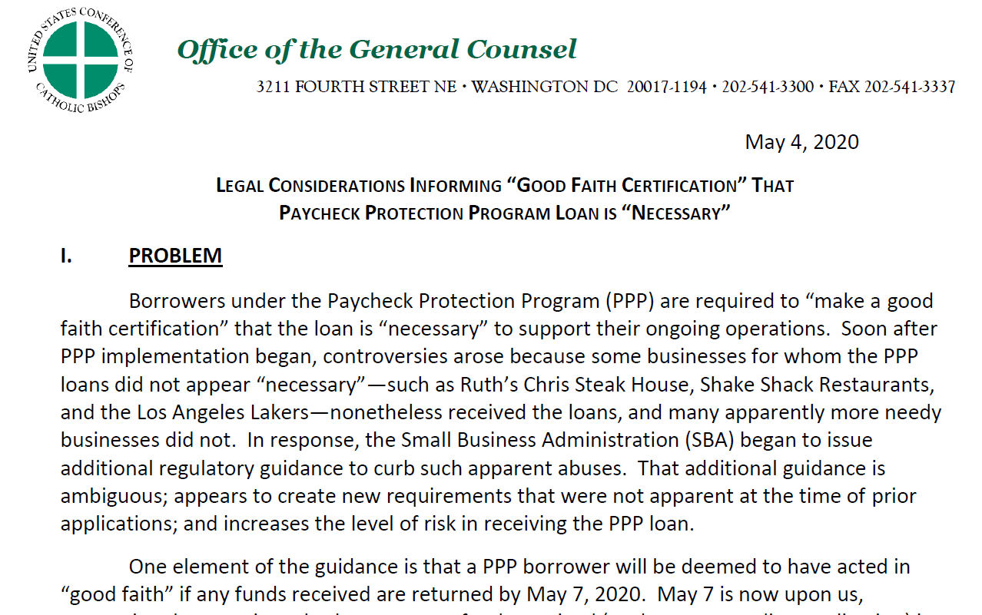
Guidance From the USCCB General Counsel

Slide 8
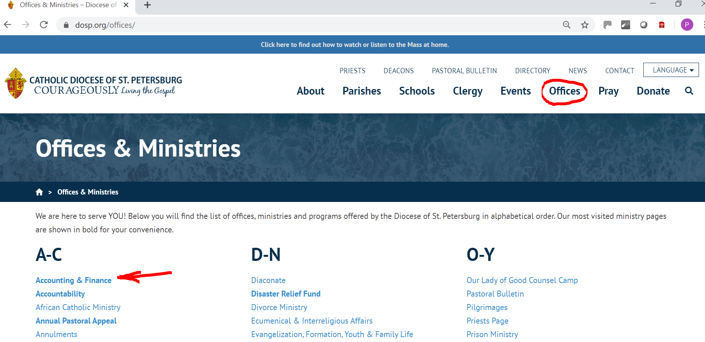
Guidance From the USCCB General Counsel

Slide 9
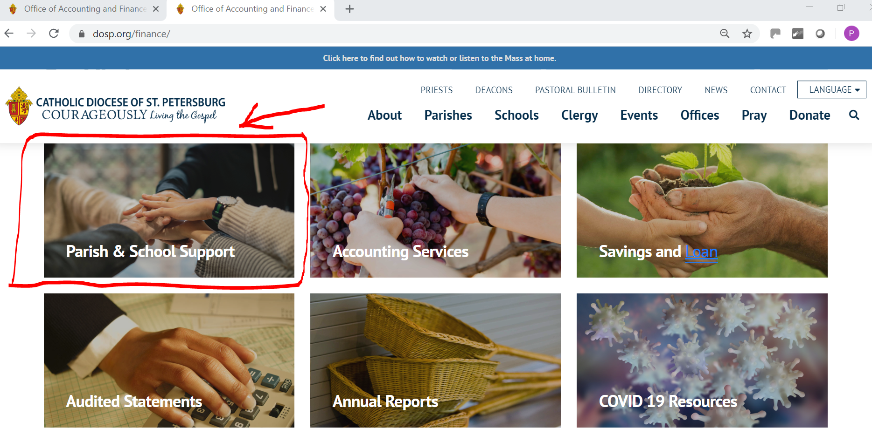
Guidance From the USCCB General Counsel

Slide 10
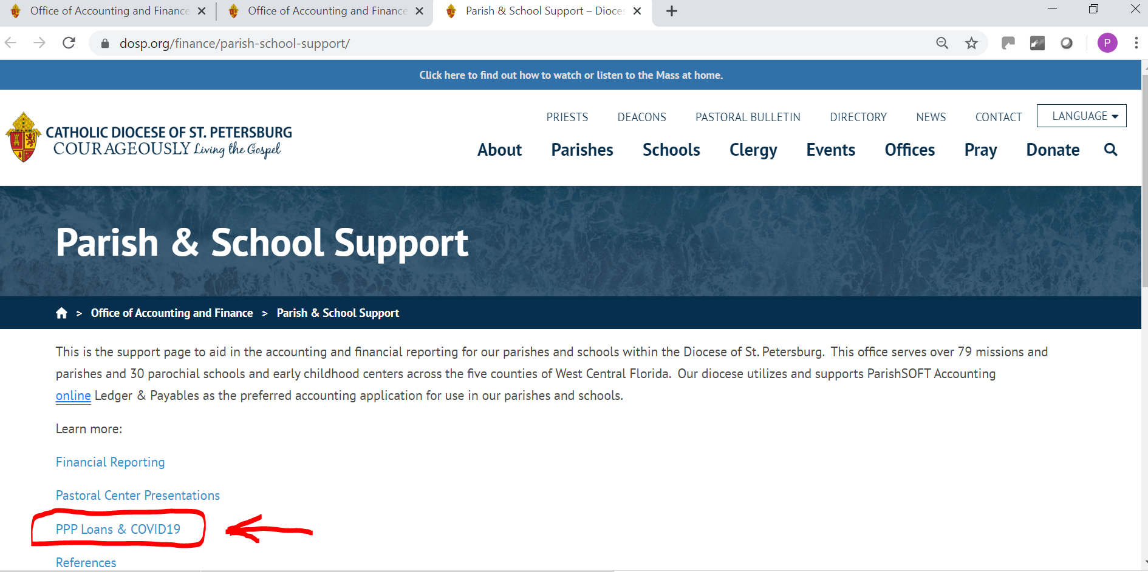
Guidance From the USCCB General Counsel

Slide 11
Guidance From the USCCB General Counsel

Slide 12
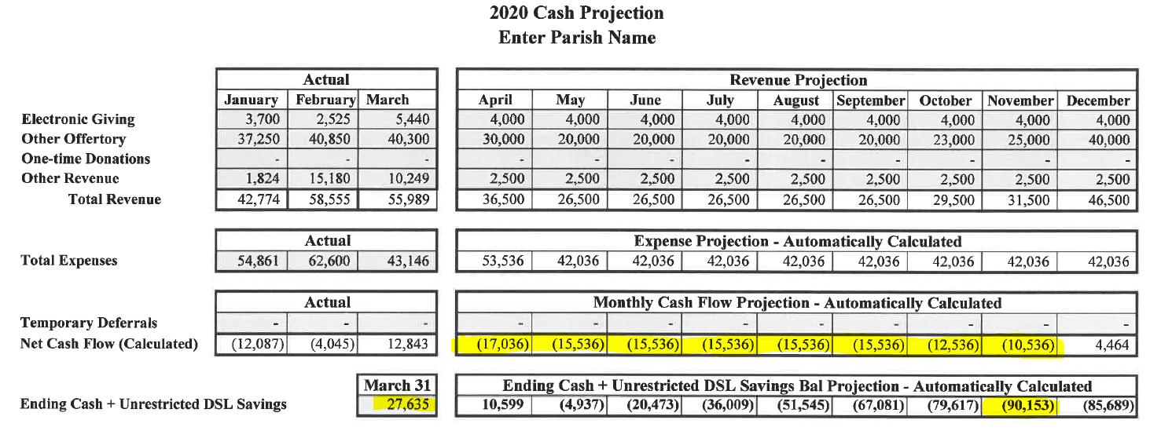
$27,635 of Cash and $118,000 of Deficits Projected – Probably Eligible
31. Question: Do businesses owned by large companies with adequate sources of liquidity to support the business’s ongoing operations qualify for a PPP loan?
Answer: In addition to reviewing applicable affiliation rules to determine eligibility, all borrowers must assess their economic need for a PPP loan under the standard established by the CARES Act and the PPP regulations at the time of the loan application. Although the CARES Act suspends the ordinary requirement that borrowers must be unable to obtain credit elsewhere (as defined in section 3(h) of the Small Business Act), borrowers still must certify in good faith that their PPP loan request is necessary.

Slide 13
$1.5mil Cash and Deficits Offset by Cost Reductions – Probably Not Eligible

Slide 14
$800,000 Cash and $419,000 of Deficits – You Decide Eligibility

Slide 15
Guidance Published by Holland & Knight
Borrowers who want to obtain loan forgiveness must use the loan proceeds for specific costs:
  payroll costs and benefits
  mortgage interest (not operating or W/C loans)
  rent
  utilities

Slide 16
Guidance Published by Holland & Knight
Forgiveness is available if the proceeds are:
used primarily (75 percent or more) to cover payroll costs over the eight-week period following when the loan is made, with any remaining amounts used for the qualifying costs above, and
employee count and compensation levels are maintained for the eight-week period after funds are disbursed.

Slide 17
Forgivable Portion of PPP Loan
To be calculated on the 8-week period beginning the day proceeds are deposited in your bank account:
1. Utilities, rent, and interest expense ____________________
2. Payments of wages, health insurance and pension ____________________
3. Add them together ____________________
4. Divide #2 by #3. Is it at least 75%? ____________________
5. Enter total “loan proceeds” ____________________
6. Enter the amount from #3 ____________________
7. Subtract #6 from #5 ____________________

Slide 18
First Step in Calculating Non-Forgivable Portion of PPP Loan
To be calculated on the 8-week period beginning the day proceeds are deposited in your bank account:
1. Utilities, rent, and interest expense 25,000
2. Payments of wages, health insurance and pension 75,000
3. Add them together 100,000
4. Divide #2 by #3. Is it at least 75%? 75%
5. Enter total “loan proceeds” 100,000
6. Enter the amount from #3 100,000
7. Subtract #6 from #5 -0-

Slide 19
Second Step – Adjustment Based on FTEs

Slide 20
Second Step – Adjustment Based on FTEs
Documentation verifying the number of full-time equivalent employees on payroll as well as the dollar amounts of payroll costs, covered interest payments, covered rent payments, and covered utilities for the eight-week period following this loan will need to be provided to the lender.
Note: “covered” payments are defined.

Slide 21
Loan Approval Request Form
Pastor or President’s Acknowledgement:
I understand that the above loan is to be repaid in eighteen (18) monthly payments beginning in December, 2020 unless the lender determines that all requirements of the SBA and the CARES Act have been complied with, and it is my responsibility to meet those requirements or to repay the loan.
I understand that some portion of the above loan will not be forgiven if 75% of the proceeds are not spent on qualified payroll costs within eight weeks of receiving loan proceeds, or if any portion of the proceeds are not spent on qualified costs within eight weeks of receiving loan proceeds, or if payroll levels are not maintained at certain historical levels as defined by the CARES Act and the Small Business Administration’s interpretation of the CARES Act.
Acknowledged by:
Signature and Date: ________________________________________________ ________________________

Slide 22
Loan Approval Request Form

