Slide 1
Compliance with IRS end of year reporting Requirements January 7 & 8, 2021
And Jesus said,
“Give to Caesar what belongs to Caesar”
Mark 12:17

Slide 2
IRS Compliance Agenda January 7 & 8, 2021
Welcome/Opening Prayer
2019 AUP Review Recommendations
IRS Regulations and their impact on the parish/school
IRS forms W-9, 1096 & 1099-NEC
Contribution Statements
Q & A

Slide 3
Auditor Recommendations ACCEPTED BY Bishop
Recommendations came from auditors.
Forwarded by Financial Planning Committee to full Finance Council and Presbyteral Council.
Finance Council and Presbyteral Council both recommended adoption.
Bishop accepted recommendations from both Councils and asked that all bookkeepers and pastors receive additional instruction regarding 1099 requirements.

Slide 4
Payroll Controls
Payroll administrators have the ability to enter new employees and change pay rates.
Policy requires that changes only be made when approved by the pastor, principal, etc., but administrators still have system access that allows them to enter new employees and make rate changes.
Recommendation is for the Pastoral Center to report all new employees and all pay rate changes to each pastor, principal, etc. every month within which they occur at the entity.

Slide 5
Auditor Recommendations ACCEPTED BY Bishop
Recommendations based on results of Agreed Upon Procedure Reviews:
Improve compliance with IRS regulations on Form 1099 by conducting thorough training of bookkeepers, business managers, and pastors.
Encourage pastors to review all payrolls and bank reconciliations.
Recommendations based upon Pastoral Center audit:
Implement a control over changes to pay rates.

Slide 6
Auditor Recommendations ACCEPTED BY Bishop
Typical Compliance Issues:
“Vendor reimbursements” are actually 1099 payments.
Employee and volunteer reimbursements must have proper documentation.
Stole fees and stipends paid or required by the parish are income and must be reported under the rules for Form W-2 or Form 1099.
Visiting or occasional priests
Assigned priests
Employees cannot receive a 1099.

Slide 7
Auditor Recommendations ACCEPTED BY Bishop
Failure to comply with these
IRS Regulations can do
great harm to the Church.

Slide 8
Auditor Recommendations ACCEPTED BY Bishop
Failure to comply with these
IRS Regulations can do
great harm to the Church.
As stewards of Church resources, we cannot allow this to happen.

Slide 9
IRS Form 1099-NEC
GENERAL RULE: Nonwage payments (payments not qualifying for reporting on Form W-2) of $600 or more in a calendar year must be reported on Form 1099.

Slide 10
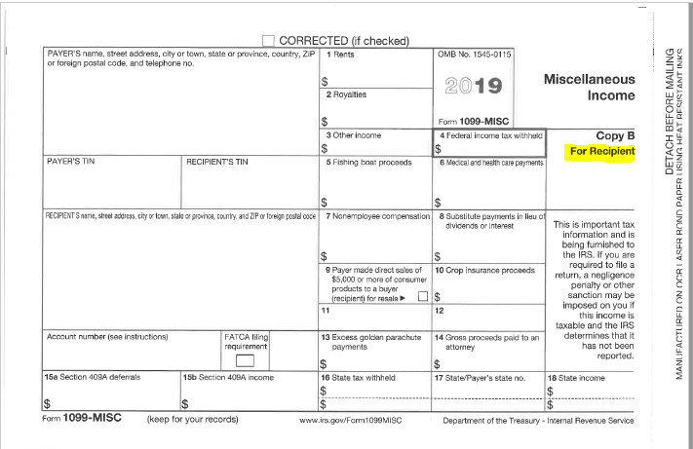
reporting form for 2019 1099-misc - Copy B

Slide 11
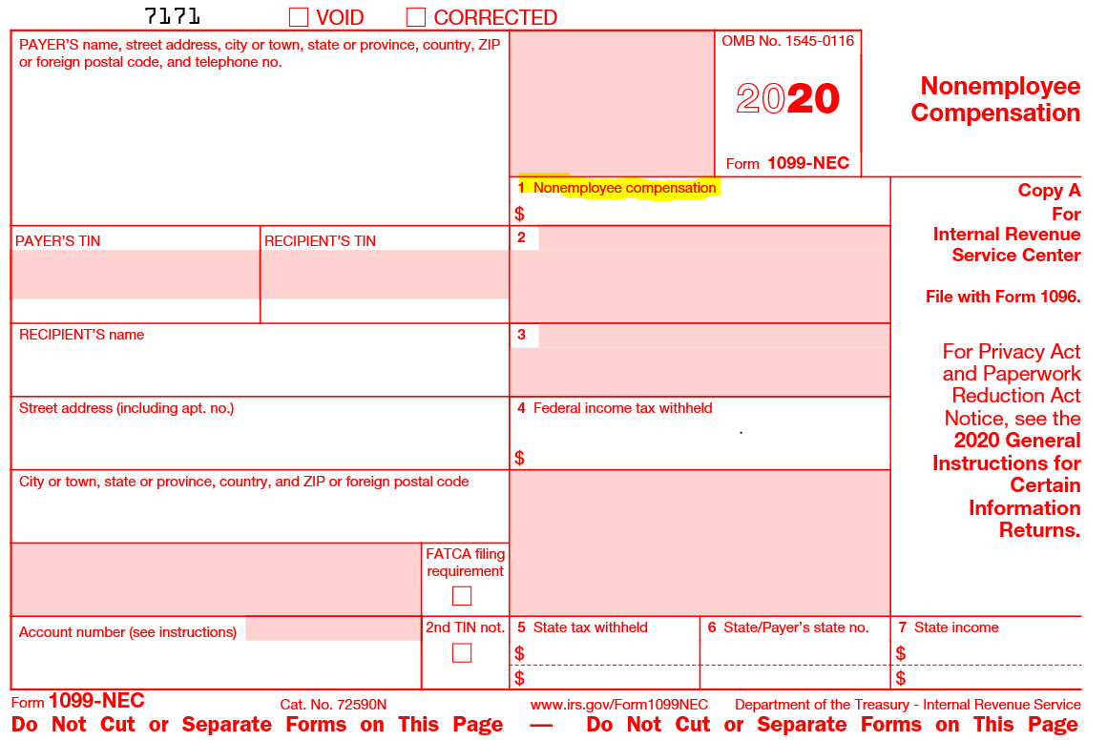
New reporting form for 2020 1099-Nec - Copy A

Slide 12
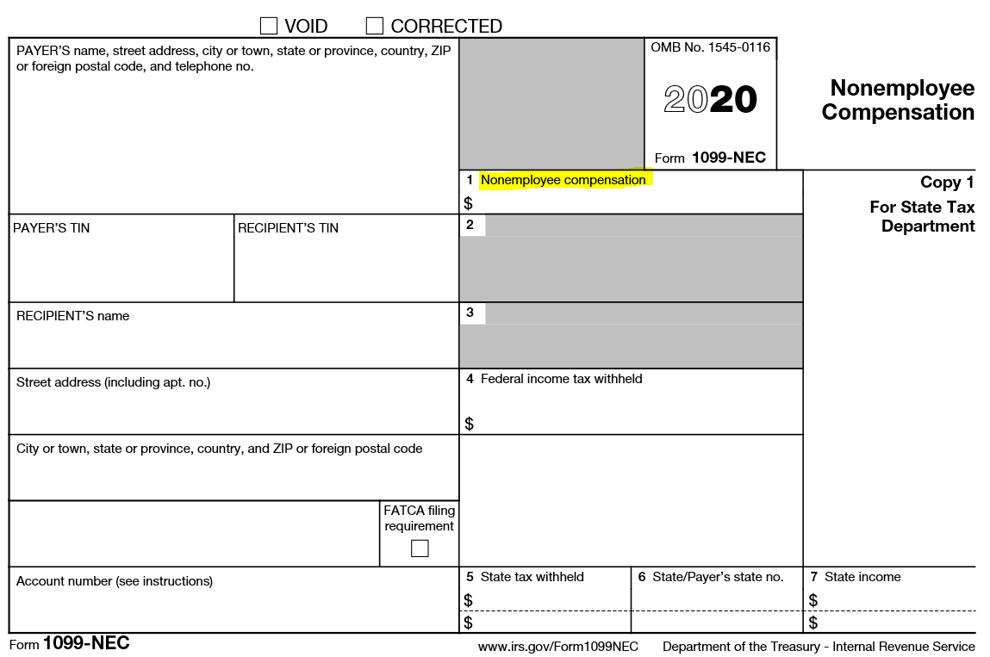
New reporting form for 2020 1099-Nec - Copy B

Slide 13
Why the change in forms?
2019 IRS Form 1099-Misc:
Upper right hand corner - Miscellaneous Income
2020 IRS Form 1099-NEC:
Upper right hand corner - Nonemployee Compensation
Does the Payee/Vendor meet the IRS requirements to be a nonemployee?
Yes? or No? Employee? Or Nonemployee?

Slide 14
IRS Form 1099-NEC
Exceptions:
Vendors who provide a signed Form W-9 with their FEIN attesting they are exempt from Form 1099 Reporting (e.g. corporations).
Employee reimbursements paid under a qualified accountability plan (i.e. with proper documentation).

Slide 15
Who are 1099 vendors?
Per IRS Guidance:
Q: Who qualifies as a “1099 Vendor”?
A: Vendors who:
Are not employees and do not receive a Form W-2.
Are not treated like employees.
Are not supervised by the reporting entity.
Have an investment in their business.
Have multiple clients/customers.
Pay self-employment taxes.
1099 Vendors must provide a signed Form W-9 with their TIN.

Slide 16
Who are 1099 vendors?
According to the IRS, evidence falls into 3 categories:
Behavior Control
Financial Control
Type of Relationship

Slide 17
Who are 1099 vendors?
Behavior Control:
Subject to instruction:
When and where to do the work.
What tools or equipment to use.
What workers to hire or to assist with the work.
Where to purchase supplies and services.
What work must be performed by a specified individual.
What order or sequence to follow.

Slide 18
Who are 1099 vendors?
Behavior Control:
Employer has the right to control how the work is achieved.
Training provided by the business to the worker (regarding work methods, not orientation to the organization).

Slide 19
Who are 1099 vendors?
Financial Control:
Extent of unreimbursed business expenses.
Extent of worker’s investment.
Extent to which the worker makes their services available to others in the market/business world
How the business pays the worker (hourly wages or salary vs. flat fee for service or time and material.
Ability to achieve a profit or loss.

Slide 20
Who are 1099 vendors?
Type of Relationship:
Written contracts.
Employee benefits for the worker?
Permanence of the relationship:
Specific time period or project = Contractor
Continue indefinitely = Employee
Extent to which services performed by the worker are a key aspect of the regular business of the entity.

Slide 21
Who are 1099 vendors?
Difficulty in Applying IRS Rules:
Musicians – regular and occasional.
Lawn & landscaping vendors.

Slide 22
IRS Form 1099-NEC
Penalties:
$50 per information return if you correctly file within 30 days of the due date; maximum penalty $545,500 per year ($191,000 for small businesses).
$100 per information return if you correctly file more than 30 days after the due date but by August 1; maximum penalty $1,637,500 per year ($545,500 for small businesses).
$270 per information return if you file after August 1 or you do not file required information returns; maximum penalty $3,275,500 per year ($1,091,500 for small businesses).
$270 x 50 vendors = $13,500 each year not reported

Slide 23
IRS Form 1099-NEC
Q: How do I make it work?
A: No payments should be made to a vendor without a completed, signed, W-9 on file.
“I am ready to cut your check, but I need a W-9.”
“I can give them a check, Father, but I need a W-9 first.”
“I understand we don’t expect to pay them $600, but I need a W-9 and if we don’t pay them $600 we won’t give them a 1099.”

Slide 24
Independent Contractors & IRS Reporting
All vendors:
Form W-9 required before payment
Setting up a new vendor in Parishsoft
Data Source: W-9
Auditing vendors for missing information prior to printing Form 1099’s
What to file with the IRS:
Form 1099–NEC
Deadline: furnish Copy B to each payee by January 31
Should be postmarked no later than January 31
Form 1096 (Summary/Transmittal)
Deadline: File Form 1096 along with all 1099-NEC (copy A) forms with the IRS by February 28
Preparing & Printing Form 1099 using Parishsoft Ledger & Payables

Slide 25
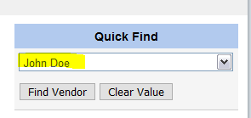
IRS Form 1099-NEC
CORRECTING PARISHSOFT 1099 VENDOR FILES
Find the Vendor
Enter the Vendor Name in Quick Find

Slide 26
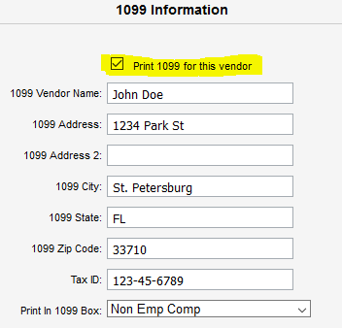
IRS Form 1099-NEC
Choose 1099/Checks Option
Check “Print 1099 for this vendor” box

Slide 27
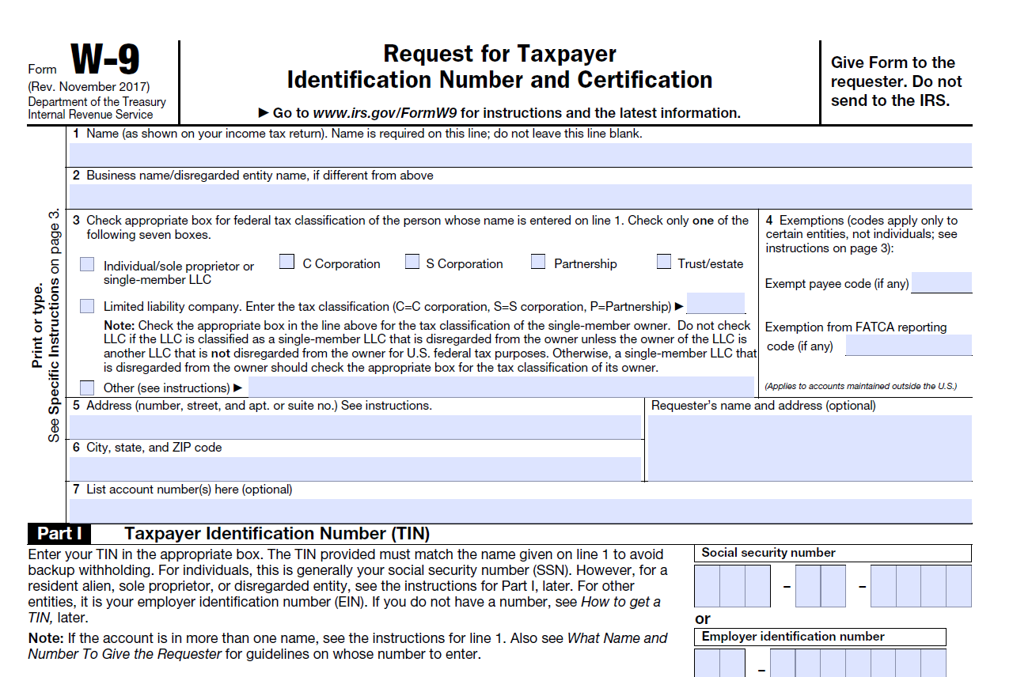
Independent Contractors & IRS Reporting

Slide 28
Independent Contractors & IRS Reporting

Slide 29
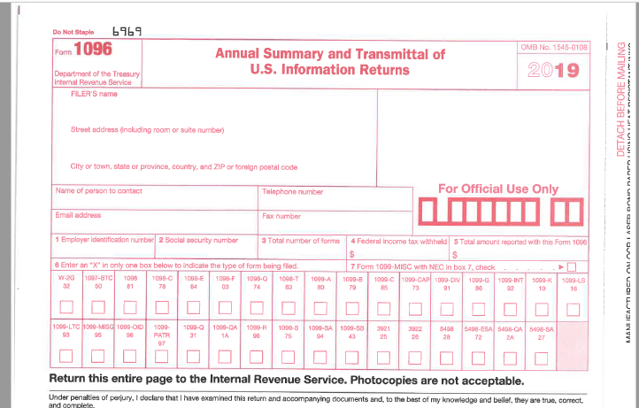
Independent Contractors & IRS Reporting

Slide 30
Independent Contractors & IRS Reporting

Slide 31
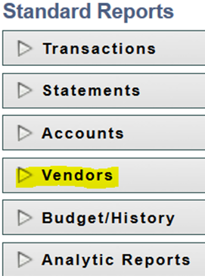
Preparing Form 1099-NEC’s using Parishsoft Ledger & Payables
From the Entry Screens Bar select:
From the Standard Reports Screen Select:

Slide 32
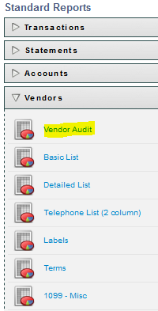
Preparing Form 1099’s using Parishsoft Ledger & Payables
From the Entry Screens Bar select:
From the Standard Reports Screen Select:

Slide 33
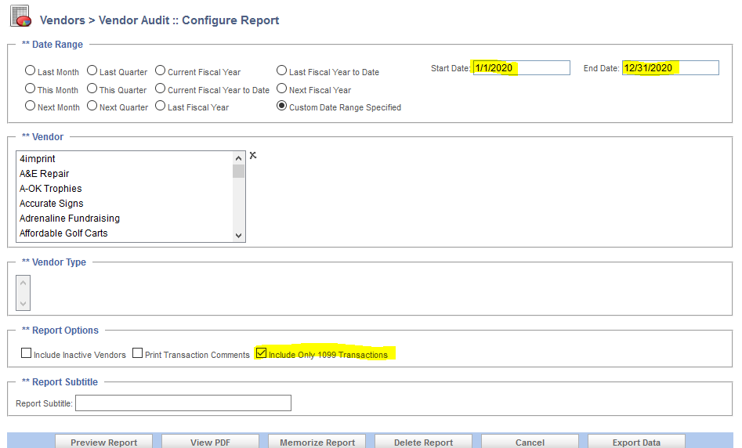
Preparing Form 1099’s using Parishsoft Ledger & Payables
Generating 1099 Vendor Audit Report
This report assumes you have the 1099 box option selected in Vendor Information (Directions shown in previous slides)

Slide 34
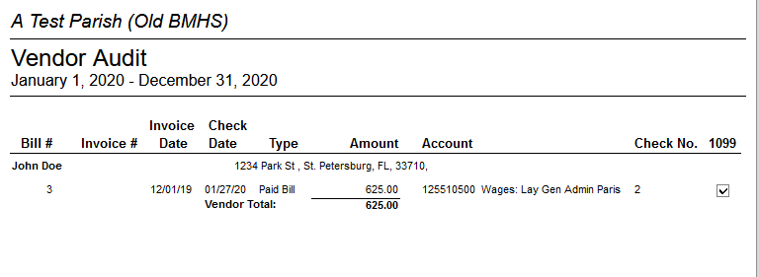
Preparing Form 1099’s using Parishsoft Ledger & Payables
Vendor Audit Report

Slide 35
Preparing Form 1099’s using Parishsoft Ledger & Payables
Printing 1099-NEC Forms
From the Entry Screens Bar select:
From the Standard Reports Screen Select:

Slide 36
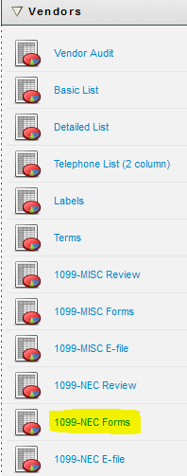
Preparing Form 1099’s using Parishsoft Ledger & Payables
From the Vendor Drop Down Screen Select:

Slide 37
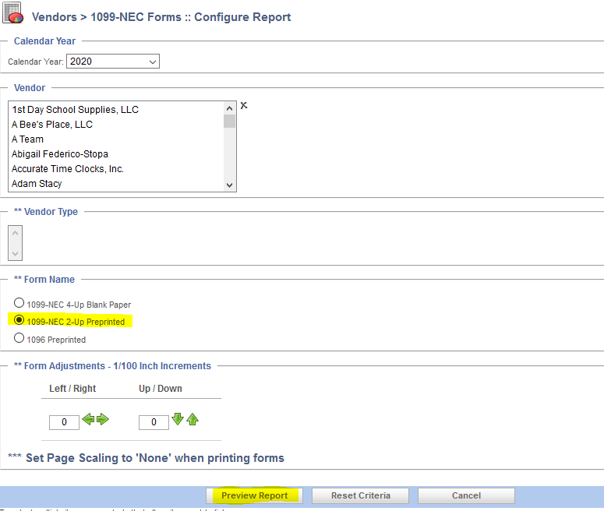
Preparing Form 1099’s using Parishsoft Ledger & Payables

Slide 38
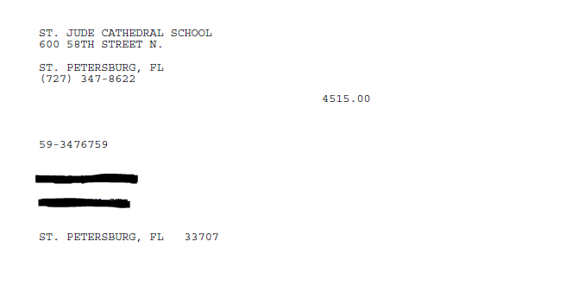
Preparing Form 1099’s using Parishsoft Ledger & Payables
Preview of 1099-NEC

Slide 39
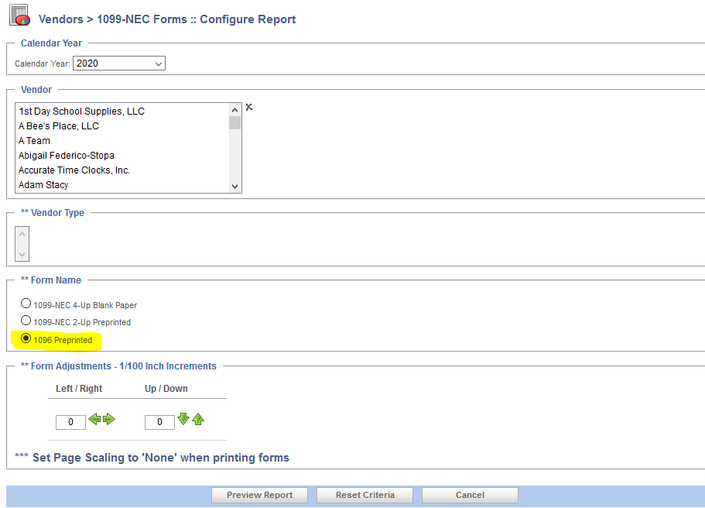
Preparing Form 1099’s using Parishsoft Ledger & Payables

Slide 40
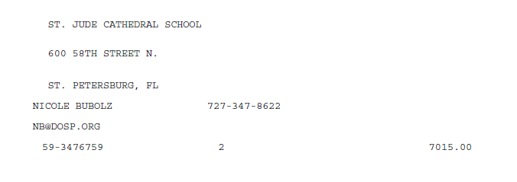
Preparing Form 1099’s using Parishsoft Ledger & Payables
Preview of 1096 -NEC

Slide 41
Contribution Statements
IRS Regulations
Importance of Thanking Donors
Parishsoft Process

Slide 42
Irs regulations for Contribution Statements
A donor cannot claim a tax deduction for any contribution of cash, check or other monetary gift unless:
The donor maintains a record of the contribution in either a bank record or,
Has received a written communications from the parish/school showing the name of the charity, date of contribution and amount
A donor can’t claim a tax deduction for any single contribution of $250 or more unless the donor obtains a written acknowledgement from the parish/school
The acknowledgement should contain:
The name of parish/school
Date of contribution
Amount of Cash Contribution
Description, but not the value, of non-cash contributions
A statement that no goods or services were provided in return for the contribution

Slide 43
Irs regulations for Contribution Statements
Quid Pro Quo Contributions:
Defined: A Donation made by a donor in exchange for goods or services
A donor may only take a contribution deduction to the extent that the contribution exceeds the fair market value of the goods and services the donor receives in return for the contribution
Example:
A donor gives a payment of $100 and, in return, receives a ticket valued at $40
Only $60 of the donation is deductible
Best Practice: Mail Contribution Statements to all parishioners and visitors
Benefits vs. Cost

Slide 44
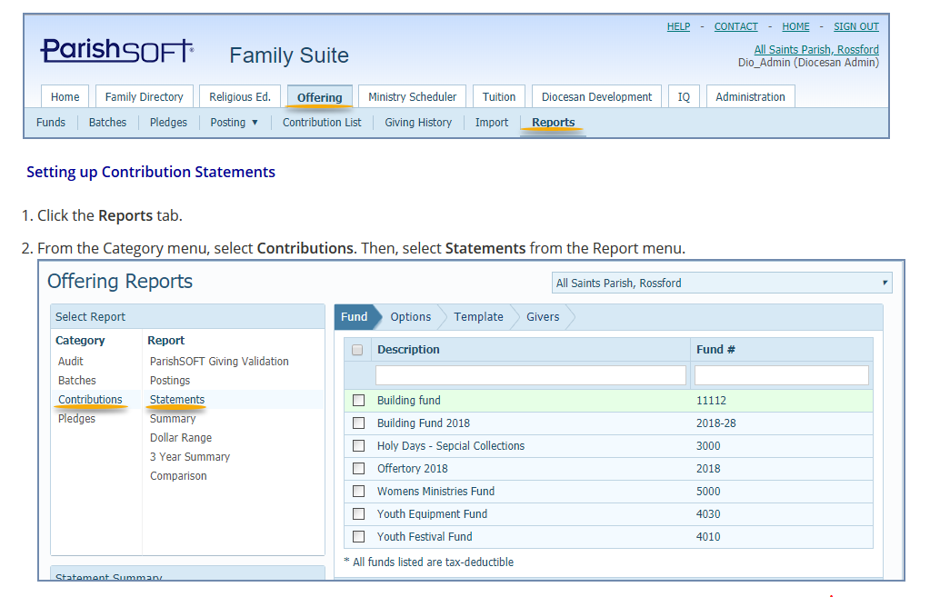
preparing Contribution Statements in parishsoft family suite

Slide 45
preparing Contribution Statements in parishsoft family suite

Slide 46
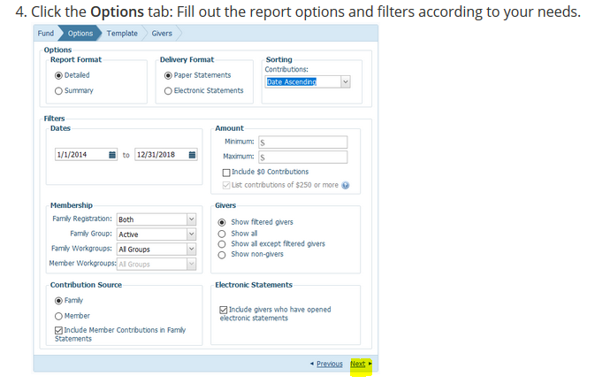
preparing Contribution Statements in parishsoft family suite

Slide 47
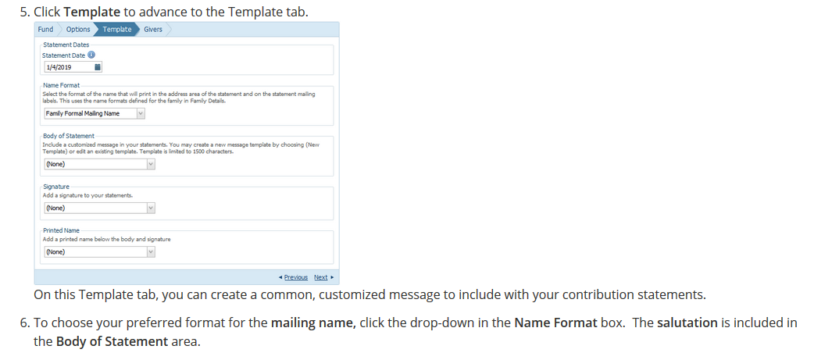
preparing Contribution Statements in parishsoft family suite

Slide 48
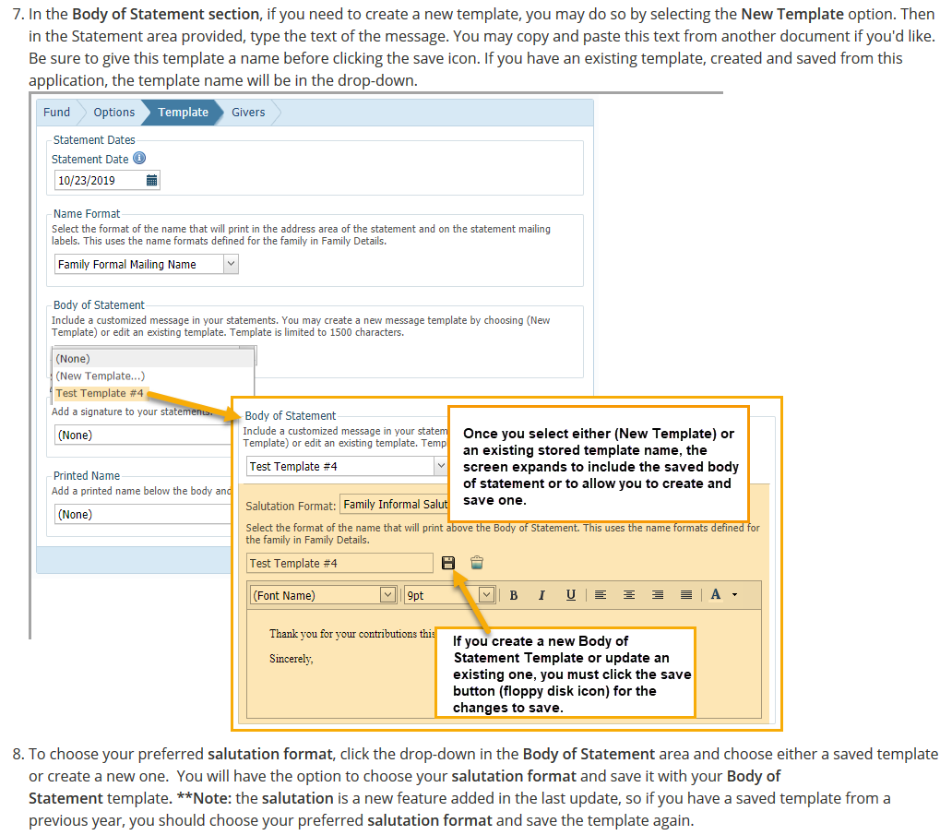
preparing Contribution Statements in parishsoft family suite

Slide 49
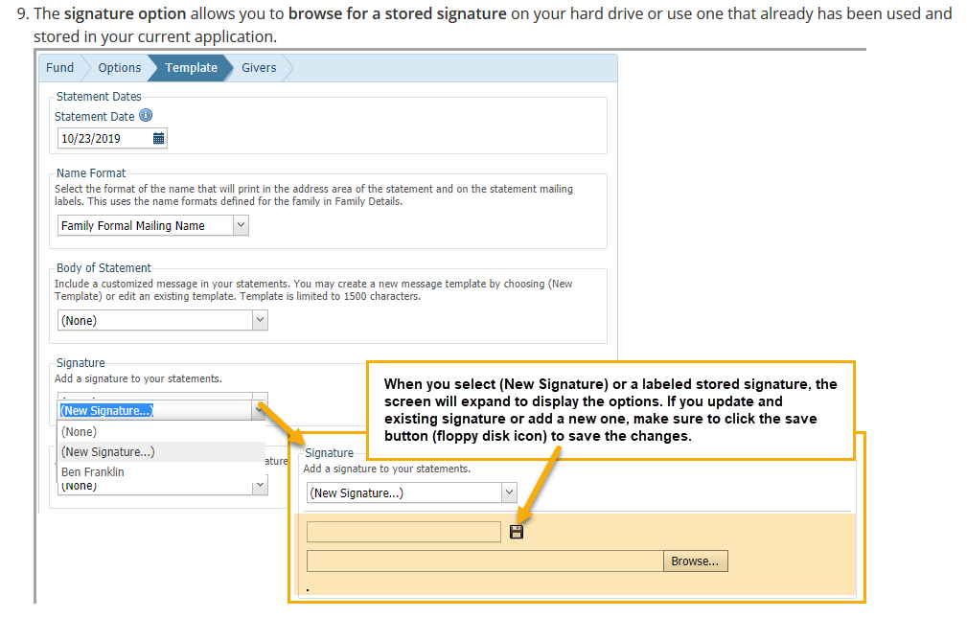
preparing Contribution Statements in parishsoft family suite

Slide 50
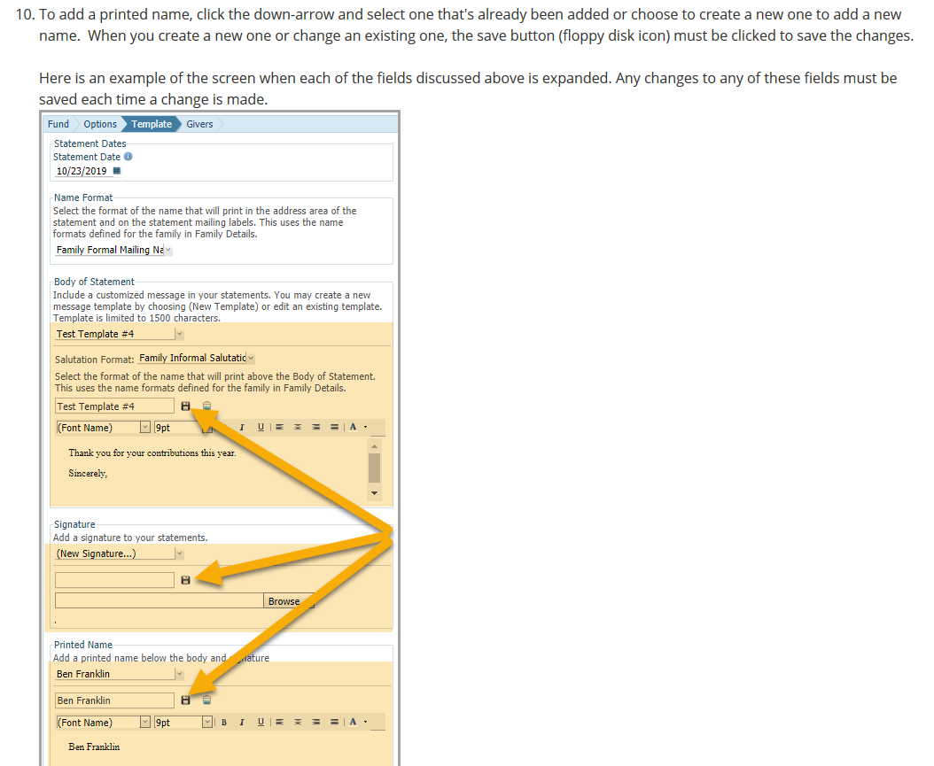
preparing Contribution Statements in parishsoft family suite

Slide 51
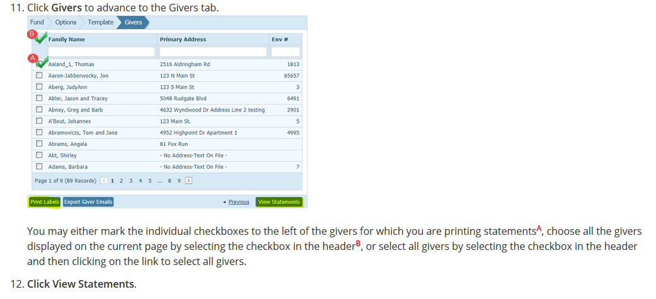
preparing Contribution Statements in parishsoft family suite

Slide 52
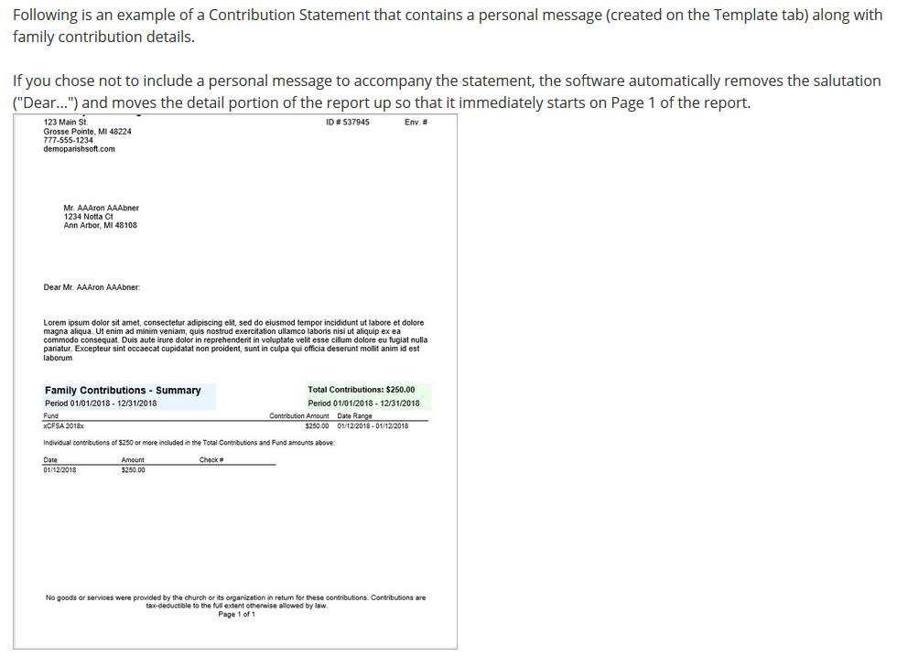
preparing Contribution Statements in parishsoft family suite

Slide 53
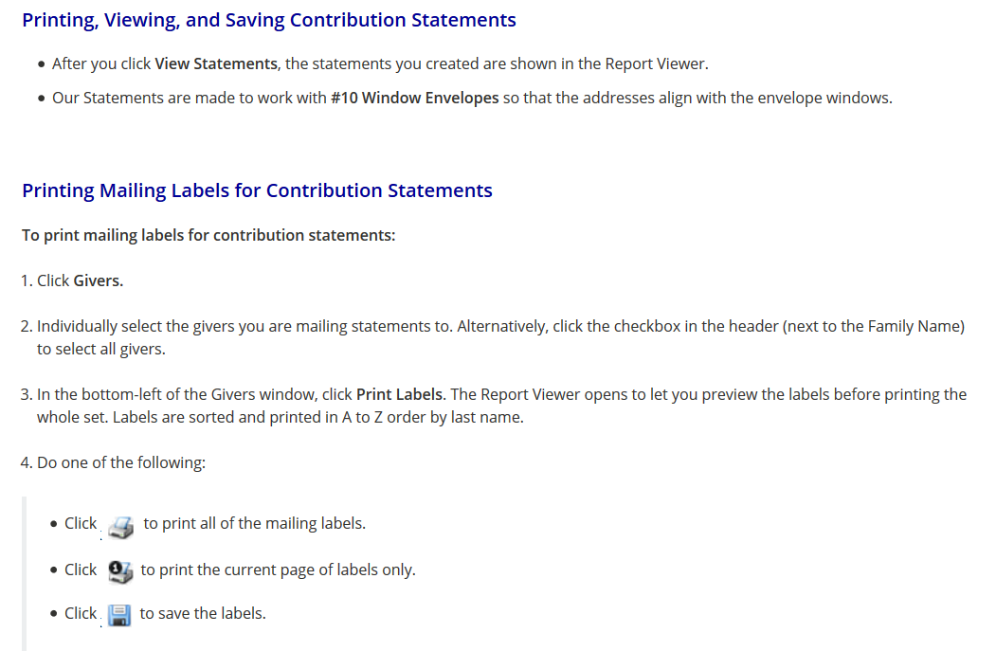
preparing Contribution Statements in parishsoft family suite

Slide 54
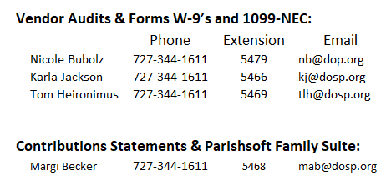
Accounting & Finance Assistance

