Slide 1
PPP Loan Forgiveness and More!
As of 01-27-2021

Slide 2
Topics for Today:
APA versus Assessment Coding for Campaigns
The Emmaus Foundation (DOSP’s Catholic Foundation)… Did you know?
Round 1 PPP Loan Forgiveness
Round 2 PPP Loan Opportunities
PPP Questions for the Loan Officer (Amy St. Hart, Vice President- Commercial Lender, Republic Bank)

Slide 3
Opening and Housekeeping
Prayer by Phil Signore, Executive Director, Finance
Questions throughout – Please use the chat box to ask questions and please refrain from responding to others within the chat so that we can follow along and not lose the questions.
If you have a question you want to ask rather than type, please raise your Zoom hand.
Based on the Topics for Today list, please refrain from asking questions about topics further down the list.

Slide 4
Parish Checks for APA vs. Assessment

Slide 5
APA
Assessment
Annual campaign to raise funds to pay assessment before payments from parish are due
Individual donations / loose cash/check received at parish from an individual
Calculated portion allocated to each parish to support diocesan ministry
Payments from parish revenue to cover balance between APA donations and assessment total

Slide 6
APA
Assessment
Annual campaign to raise funds to pay assessment before payments from parish are due
Individual donations / loose cash/check received at parish from an individual
Calculated portion allocated to each parish to support diocesan ministry
Payments from parish revenue to cover balance between APA donations and assessment total
Processing
Accounting

Slide 7
APA
Assessment
Processing
Accounting
Thank you, tax receipt, reminders
Must include list of donors with full name, address, amount of donation and type/detail
Memo Line: APA (Year)
Payment against balance
Should include/reference Invoice from Accounts Receivable
Memo Line: Assessment (Year)

Slide 8
Catholic Foundation
Did you know…

Slide 9
Did you know…
The Catholic Foundation
has been serving the people of the Diocese of St. Petersburg for 23 years.

Slide 10
Did you know…
The Catholic Foundation
is a separate charitable entity,
incorporated as
the Emmaus Foundation, Inc.

Slide 11
Did you know…
The mission of the Catholic Foundation is to support the work of Christ in the Diocese of St. Petersburg by securing gifts, providing donor services and managing financial resources to benefit people assisted by all parish and diocesan ministries.

Slide 12
Did you know…
Annual impact information can be found on our website at
catholicfoundation.org

Slide 13
Did you know…
We are entrusted to
accept and grow legacy gifts
to the best of our ability.

Slide 14
Did you know…
During the last two years, our team has worked to
expand our
products,
funds and services
to better serve the needs of parishes, schools, ministries and donors.

Slide 15
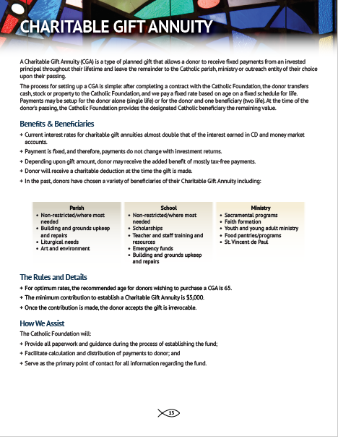
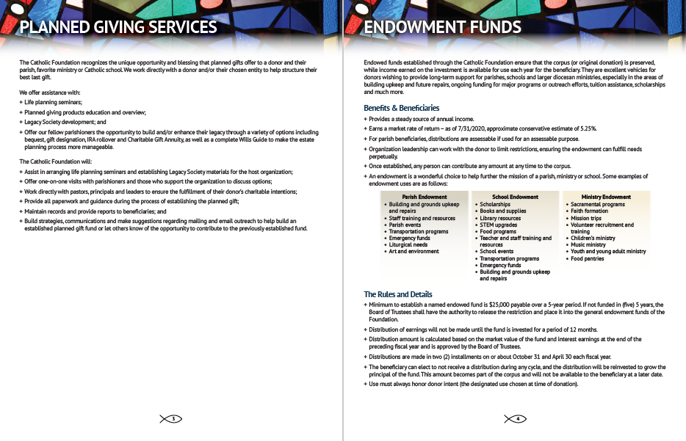

Slide 16
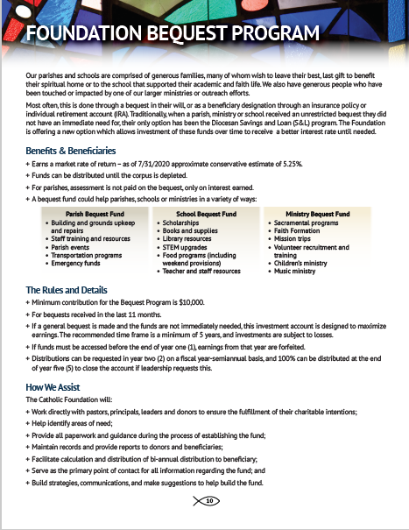
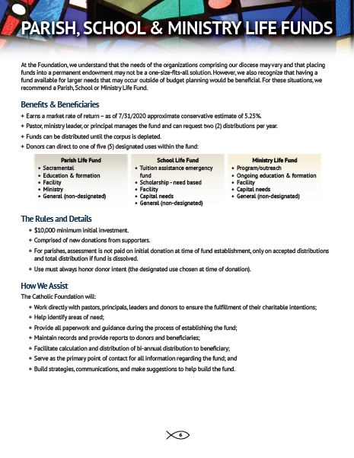
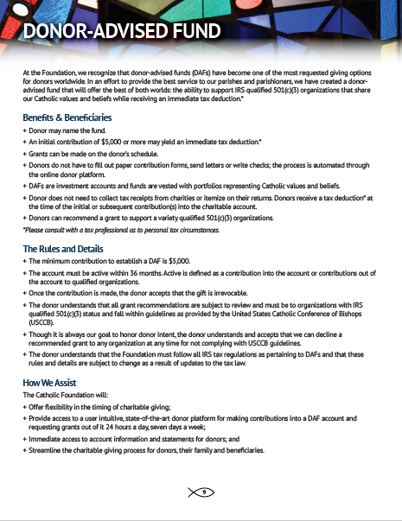

Slide 17
Established for a parish, school or diocesan ministry through a realized, unrestricted bequest.
Invested in a professionally managed, diversified portfolio
The beneficiary can opt to receive distributions or roll the earnings back in for more investment power.
Ideally leave the fund for at least five (5) years to allow solid growth.
If an emergency occurs, the beneficiary leadership can request the account closed after one (1) year.
New gifts of at least $5,000 to open
Donor directs to one of five (5) designated uses for their intended parish, school or ministry beneficiary
Invested in a professionally managed, diversified portfolio
The beneficiary can opt to receive distributions or roll the earnings back in for more investment power.
Ideally leave the fund for at least five (5) years to allow solid growth.
If an emergency occurs, the beneficiary leadership can request the account closed after one (1) year.
Launched November 1, 2020
Allows donors to make a gift now and decide where to send grants later.
Allows donors the ability to
make multiple contributions
support a variety of not-for profit organizations that share our Catholic values and beliefs over multiple years – INCLUDING PARISHES.
Immediate tax deduction.

Slide 18
Overview of Services
Available online!

Slide 19
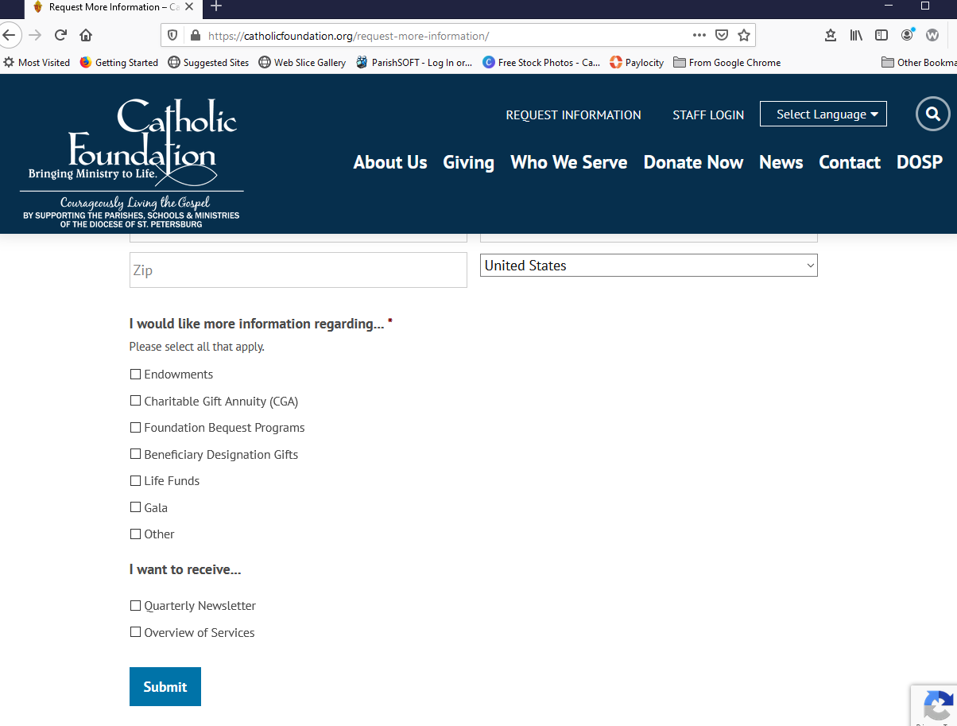

Slide 20
Questions/Interested?
foundation@dosp.org
727-274-0220

Slide 21
Round 1 PPP Loan Forgiveness

Slide 22
The Great News for PPP Loan Forgiveness
Originally the deadline for Borrowers to apply for Forgiveness was October 31, 2020. It was subsequently revised to the following:
A Borrower may submit an application for Forgiveness any time before the maturity date of the Loan (although Loan payments will begin 10 months after the last day of the Covered period) and the same forms will be posted once the expiration date is extended. Currently the form has an expiration date of 7/31/2021.
On Tuesday, January 19, 2021, the US Small Business Administration (SBA) and Treasury published updated Paycheck Protection Program (PPP) Loan Forgiveness guidance and forms, including a one-page application for Borrowers that received a PPP Loan of $150,000 or less.
In total, the DOSP applied for and received 81 PPP Loans and 45 of them meet this threshold of $150,000 or less.
For the other 36 Loans, the deadline is still not on the immediate horizon, so there is no need to panic.

Slide 23
The Great News for PPP Loan Forgiveness (Continued)
Borrowers can qualify for Forgiveness of PPP Loans up to the full principal amount of the Loan and accrued interest if the Loan proceeds are used for forgivable purposes during the Borrower’s Covered period and employee and compensation levels are maintained or, if not, an applicable safe harbor or exemption applies.
At least 60 percent of the PPP Loan proceeds are required to be used for payroll costs to achieve full Forgiveness of the Loan.

Slide 24
The Covered Period
The Covered period started when the Loan was funded.
The Covered period began on the date the lender made the first disbursement of the Loan (i.e., the earlier of the date on the face of the check or the date the funds showed up in your account if deposited directly by the bank).
Borrowers who received Loans prior to June 5, 2020, can elect an 8-week Covered period or a 24-week Covered period. Borrowers who received Loans on June 5, or later will have a 24-week Covered period. We strongly recommend using a 24-week Covered Period since Forgiveness maybe supported strictly through Gross Payroll amounts as those costs for a 24-week timeframe would likely exceed your loan amount.
The Covered Period or Alternative Covered Period for any Borrower will end no later than December 31, 2020. The Alternative Covered Period is for Payroll tabulation purposes only.
For Borrowers with a bi-weekly or more frequent payroll period, an alternative payroll Covered period starting on the first day of its first pay period following Loan disbursement can be used.
Borrowers with a bi-monthly or less frequent payroll cycle will need to calculate payroll costs for the partial pay period by determining the amount incurred and paid during the selected Covered period (i.e., prorate).
This likely doesn’t apply to us, but just in case… If the Borrower is not able to operate or is operating at a limited capacity when the PPP Loan proceeds are received, the Borrower may choose to pay employees who are not able to work. This choice may be made to help the Borrower maximize Loan Forgiveness as current guidance States that not more than 40% of the Loan Forgiveness amount may be attributable to non-payroll costs.

Slide 25
Eligible Costs
The actual amount of Loan Forgiveness will depend, in part, on the total amount of payroll costs and other eligible costs paid during the Covered period.
There are reductions in the amount of Forgiveness based on the percentage of eligible costs attributable to non-payroll costs, any decrease in FTEs and decreases in salaries/wages per employee.
Eligible non-payroll costs cannot exceed 40% of the total Forgiveness amount. If salaries decrease by more than 25% for any employee who made less than $100,000 annualized in 2019 AND/OR if the number of FTEs decreases, the Forgiveness amount will be reduced unless safe harbors are met.

Slide 26
Eligible Costs (Continued)
A Safe Harbor is a provision that can be included in rules and laws to ensure that people don’t accidentally violate rules because of a technicality or situation that is outside of their control.
The safe harbors related to PPP loan forgiveness help businesses qualify for forgiveness, even if they don’t meet all of the criteria.
A goal of the PPP loan is to have you keep employees on payroll, rather than furlough or lay them off. If your business does have a reduction in full-time equivalent employees (FTEs), your PPP loan forgiveness amount may be reduced.
The Safe Harbor that applies to all the loans received by the DOSP is that you borrowed less than $2 million, so the SBA isn’t going to review documentation to support that the loan was necessary to support your business (Good Faith Certification Safe Harbor).

Slide 27
Eligible Costs (Continued)
Costs eligible for Forgiveness include:
Payroll costs including group insurance payments for vision, dental, disability and life insurance.
Rent on leases dated before February 15, 2020, excluding rent to related parties.
Utilities for service that began before February 15, 2020.
Covered operations expenditures which consist of payments for any business software or cloud computing service that facilitates business operations, product or service delivery, the processing, payment, or tracking of payroll expenses, human resources, sales and billing functions, or accounting or tracking of supplies, inventory, records and expenses.
Covered property damage costs related to vandalism or looting due to public disturbances that occurred during 2020 that was not Covered by insurance or other compensation.

Slide 28
Eligible Costs (Continued)
Costs eligible for Forgiveness include:
Covered supplier costs expenditures made by a Borrower to a supplier of goods for the following:
goods that are essential to the operations of the Borrower at the time at which the expenditure is made; and
procured pursuant to a contract, order, or purchase order
in effect at any time before the Covered Period with respect to the applicable Covered Loan; or
with respect to perishable goods, in effect before or at any time during the Covered Period with respect to the applicable Covered Loan.

Slide 29
Eligible Costs (Continued)
Costs eligible for Forgiveness include:
Covered worker protection expenditures (operating or capital) to facilitate the adaptation of the business activities of an entity to comply with requirements established or guidance issued by the Department of Health and Human Services, the Centers for Disease Control, or the Occupational Safety and Health Administration, or any equivalent requirements established or guidance issued by a State or local government, during the period beginning on March 1, 2020, and ending on the date on which the national emergency with respect to the COVID–19 expires related to the maintenance of standards for sanitation, social distancing, or any other worker or customer safety requirement related to COVID–19. Such expenditures include:
the purchase, maintenance, or renovation of assets that create or expand—(I) a drive- through window facility; (II) an indoor, outdoor, or combined air or air pressure ventilation or filtration system; (III) a physical barrier such as a sneeze guard; (IV) an expansion of additional indoor, outdoor, or combined business space; (V) an onsite or offsite health screening capability; or (VI) other assets relating to the compliance with the requirements or guidance as determined by the Administrator in consultation with the Secretary of Health and Human Services and the Secretary of Labor.

Slide 30
Eligible Costs (Continued)
Costs eligible for Forgiveness include:
the purchase of—(I) Covered materials described in section 328.103(a) of title 44, Code of Federal Regulations, or any successor regulation; (II) particulate filtering facepiece respirators approved by the National Institute for Occupational Safety and Health, including those approved only for emergency use authorization; or (III) other kinds of personal protective equipment, as determined by the Administrator in consultation with the Secretary of Health and Human Services and the Secretary of Labor; and such expenditures do not include residential real property or intangible property.

Slide 31
Payroll Costs
Payroll costs include all forms of cash compensation paid to employees, including tips, commissions, bonuses, and hazard pay. Note that forgivable cash compensation per employee is limited to $100,000 on an annualized basis.
Employer expenses for employee group health care benefits that are paid or incurred by the Borrower during the Covered Period or the Alternative Payroll Covered Period are included as payroll costs eligible for Loan Forgiveness. Payroll costs do not include expenses for group health care benefits paid by employees.
Insurance premiums paid or incurred during the Covered Period or Alternative Payroll Covered Period qualify as “payroll costs,” as long as the premiums are paid during the applicable period or by the next premium due date after the end of the applicable period.
Employer contributions for employee retirement benefits that are paid or incurred by the Borrower during the Covered Period or Alternative Payroll Covered Period qualify as “payroll costs” eligible for Loan Forgiveness.

Slide 32
Bi-weekly Payroll Cost Determination
Borrowers with a bi-weekly or more frequent payroll cycle can include the entire pay period that is incurred within the Covered Period or the Alternative Payroll Covered Period as long as the payroll is paid on or before the next regular payroll date.
These costs include the sum of gross salary, gross wages, gross tips, gross commissions, paid leave (vacation, family, medical or sick leave, EXCLUDING leave covered by the Families First Coronavirus Response Act), and allowances for dismissal or separation paid or incurred during the Covered Period.
You can only include compensation of employees who were employed by the Borrower at any point during the Covered Period and whose principal place of residence is in the United States.

Slide 33
Bi-weekly Payroll Cost Determination (Continued)
Example 1:
If the Borrower is using a 24-week Alternative Payroll Covered Period and received its PPP Loan proceeds on Monday, April 20, and the first day of its first pay period following its PPP Loan disbursement is Sunday, April 26, the first day of the Alternative Payroll Covered Period is April 26 and the last day of the Alternative Payroll Covered Period is Saturday, October 10. In no event may the Alternative Payroll Covered Period extend beyond December 31, 2020.
Example 2:
The Borrower received its Loan before June 5, 2020, and elects to use a 24-week Covered Period. The Borrower’s Covered Period runs from Monday, April 20 through Sunday, October 4. The Borrower has a biweekly payroll cycle, with a payroll cycle ending on Saturday, April 18. The Borrower will not make the corresponding payroll payment until Friday, April 24. While these payroll costs were not incurred during the Covered Period, they were paid during the Covered Period and are therefore eligible for Loan Forgiveness.

Slide 34
Bi-monthly or Less Frequent Payroll Cost Determination
If a Borrower disburses payroll twice a month or less frequently, it must calculate payroll costs for partial pay periods.
These costs include the sum of gross salary, gross wages, gross tips, gross commissions, paid leave (vacation, family, medical or sick leave, EXCLUDING leave covered by the Families First Coronavirus Response Act), and allowances for dismissal or separation paid or incurred during the Covered Period.
For each individual employee, the total amount of cash compensation eligible for Forgiveness may not exceed an annual salary of $100,000, as prorated for the Covered Period. For example, for an 8- week Covered Period, the maximum is $15,385, for a 24-week Covered Period, the maximum is $46,154.
You can only include compensation of employees who were employed by the Borrower at any point during the Covered Period and whose principal place of residence is in the United States.

Slide 35
Bi-monthly or less Frequent Payroll Cost Determination (Continued)
These costs also include the total amount paid by the Borrower for:
Employer contributions for employee group health, life, disability, vision, or dental insurance, including employer contributions to a self-insured, employer-sponsored group health plan, but excluding any pre-tax or after-tax contributions by employees.
Employer contributions to employee retirement plans, excluding any pre-tax or after-tax contributions by employees.
Employer State and local taxes paid by the Borrower and assessed on employee compensation (e.g., State unemployment insurance tax), excluding any taxes withheld from employee earnings.

Slide 36
PPP Loans of $150,000 or Less
For PPP Loans of $150,000 or less Borrowers can use the PPP Loan Forgiveness Application Form 3508S. This form requires the following:
Loan amount
disbursement date
employee totals
Covered period dates
amount of the Loan spent on payroll
amount of the Loan for which Forgiveness is being sought
Borrowers are not required to submit any supporting documentation with the Forgiveness application, but are mandated to maintain payroll, non-payroll, and other documents that could be requested during an SBA Loan review or audit.

Slide 37
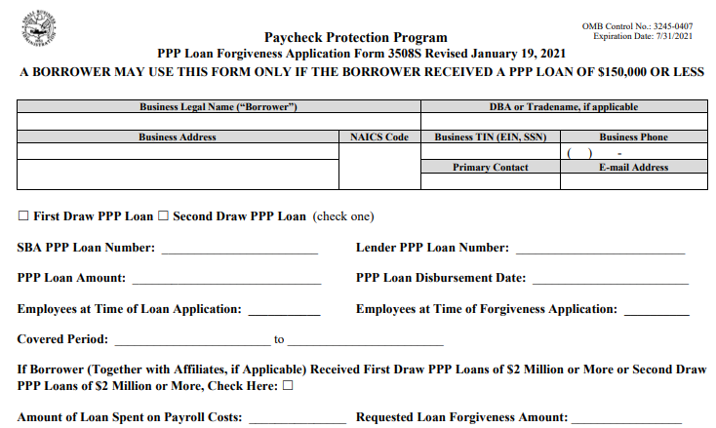
PPP Loans of $150,000 or Less (Continued)

Slide 38
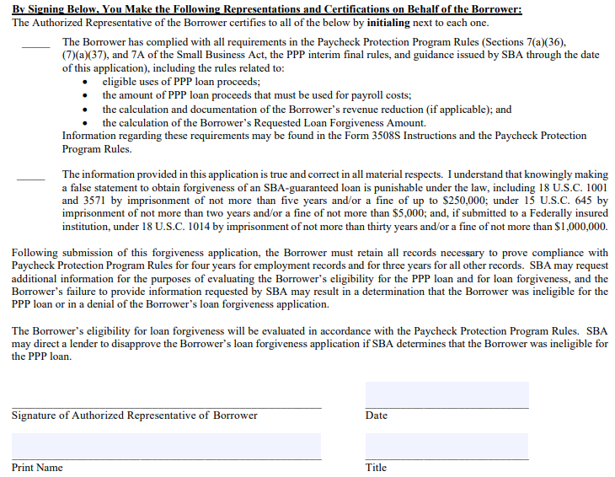
PPP Loans of $150,000 or Less (Continued)

Slide 39
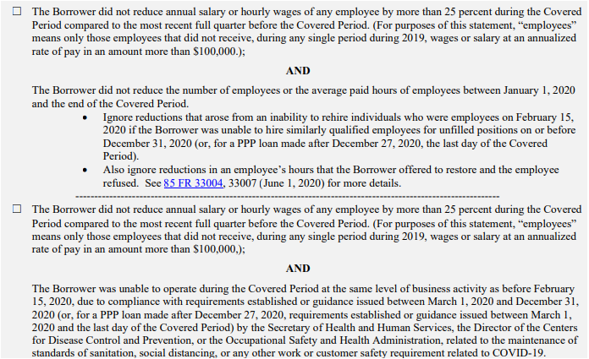
PPP Loans Over $150,000
For PPP Loans over $150,000 Borrowers must use either Form 3508 and Form 3508EZ. Borrowers must submit payroll and non-payroll documentation when applying for Loan Forgiveness with those forms. The instructions provide a list of the required documents (PPP -- Loan Forgiveness Application and Instructions -- Form 3508EZ (1.19.2021).pdf (sba.gov). We anticipate that DOSP entities will be able to use Form 3508EZ.
To use Form 3508EZ you must be able to check one of the two boxes below:

Slide 40
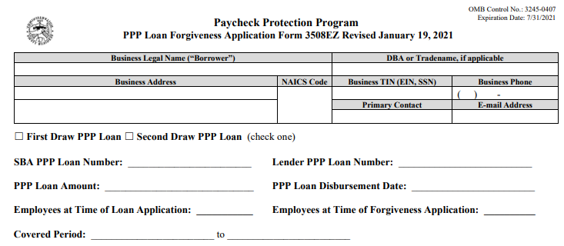
PPP Loans Over $150,000 – Form 3508EZ

Slide 41
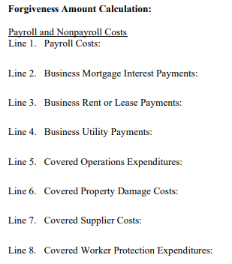
PPP Loans Over $150,000 – Form 3508EZ (Continued)

Slide 42
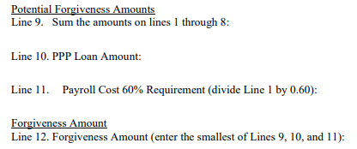
PPP Loans Over $150,000 – Form 3508EZ (Continued)

Slide 43
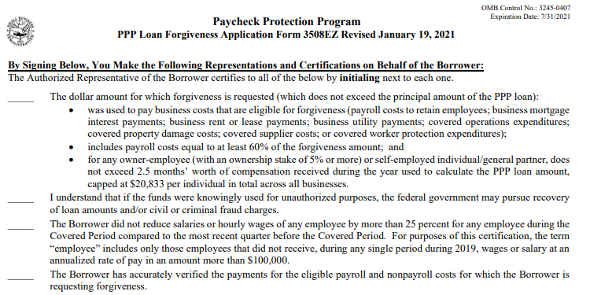
PPP Loans Over $150,000 – Form 3508EZ (Continued)

Slide 44
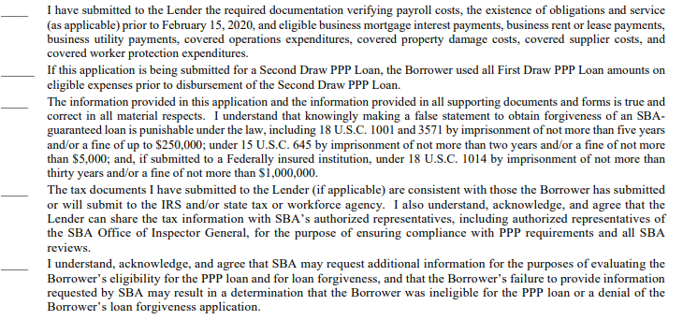
PPP Loans Over $150,000 – Form 3508EZ (Continued)

Slide 45
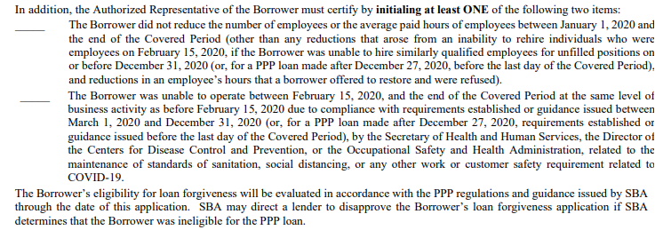
PPP Loans Over $150,000 – Form 3508EZ (Continued)

Slide 46
Round 2 PPP Loan OPPORTUNITIES

Slide 47
Paycheck Protection Program (PPP) – The Second Draw
On December 27, 2020, the Economic Aid to Hard-Hit Small Businesses, Nonprofits and Venues Act (the Act) became law as a part of the Consolidated Appropriations Act, 2021.
The Act provides $284.5 billion of additional funding for the Paycheck Protection Program (PPP) through the U. S. Small Business Administration (SBA).
Applications for any First Draw or Second Draw PPP Loans must be received by the SBA by March 31, 2021 and many Lenders are currently accepting applications.
Now that there is a PPP2, you may see the first round of PPP Loans referred to as the First Draw.
The Second Draw refers to any Loans received going forward if the entity received an original PPP Loan (First Draw).

Slide 48
Paycheck Protection Program (PPP) – The Second Draw (Continued)
Some lenders are requiring Borrowers to apply for their First Draw Forgiveness before they can apply for a Second Draw Loan.
This is not a SBA or Treasury requirement, as such, if your lender is requiring this, you may want to consider lenders that will process the Second Draw application without having to file for Forgiveness on the First Draw.

Slide 49
Paycheck Protection Program (PPP) – The Second Draw (Continued)
Back up…We Didn’t Apply for an Initial PPP Loan!!!
If you didn’t apply for a First Draw, you may be eligible to do that now.
Eligible entities who did not receive a First Draw PPP Loan in 2020 may now apply under the same basic terms as the previous round. This includes 501(c)(3) non-profit organizations (including faith-based organizations) if they were in operation on February 15, 2020 and had no more than 500 employees.
All employees, whether full-time, part-time or some other basis are included in determining eligibility.
First Draw eligible Loan amounts for Borrowers with employees are calculated as 2.5 times average monthly payroll costs up to $10,000,000.
The average monthly payroll cost can be based on calendar 2019, calendar 2020 or the 12-month period prior to the Loan application.
Payroll includes gross wages and tips; employer contributions to employee group health, life, disability, vision and dental insurance; retirement contributions; and State and local taxes assessed on employee compensation (i.e., SUTA).

Slide 50
Paycheck Protection Program (PPP) – The Second Draw (Continued)
The Act provides an opportunity for eligible hard-hit Borrowers to receive a second PPP Loan. The Loans are available to entities that have experienced a 25% reduction in gross receipts and for Borrowers with fewer employees than First Draw entities.
Entities may be eligible for a Second Draw if they were in operation on February 15, 2020, received a First Draw previously and meet the following criteria:
Employ 300 or fewer individuals based on headcount, including all full-time or part-time employees.
Experienced a 25% reduction in gross revenue between comparable quarters in 2019 and 2020.
Has used or will use all First Draw funds on eligible expenses on or before the expected date of the Second Draw Loan funding.
Note that the Borrower will be required to attest that they have used or will use the full amount of the First Draw funds on eligible expenses. This includes a requirement that the Borrower has spent at least 60% of first draw funds on payroll costs.

Slide 51
Paycheck Protection Program (PPP) – The Second Draw (Continued)
Second Draw Eligible Loan Amounts for Borrowers are calculated as 2.5 times average monthly payroll costs up to $2,000,000. The methodology to calculate the amount is the same as for First Draw Loans:
The average monthly payroll cost can be based on calendar 2019, calendar 2020 or the 12-month period prior to the Loan application date.
Payroll includes gross wages and tips; employer contributions to employee group health, life, disability, vision and dental insurance; retirement contributions; and State and local taxes assessed on employee compensation (i.e., SUTA).
To be eligible for a Second Draw, there is a 25% revenue reduction criteria. Borrowers in operation all four quarters of 2019, must compare gross receipts during the first, second, third, or fourth quarter in 2020 to the same quarter in 2019 to determine if there was a 25% or greater revenue reduction. The SBA has Stated that only calendar quarters are to be used for this calculation. To simplify, Borrowers can choose to use annual 2020 gross receipts compared to 2019 to simplify the calculation.
The decline in revenue must be substantiated by quarterly income Statements or bank Statements. This substantiation must be provided at the time of application for Second Draws over $150,000 and at the time of the Forgiveness request for Second Draws of $150,000 or less.

Slide 52
Paycheck Protection Program (PPP) – The Second Draw (Continued)
Gross Receipts are defined as all revenue in whatever form received or accrued. For nonprofits this includes the following:
Contributions
Gifts
Grants
Dues or assessments
Sales or receipts from unrelated business activities
Sale of assets
Investment income (e.g., interest, dividends, rents, and royalties)
Gross Receipts does not include First Draw Loan proceeds. Additionally, Gross Receipts are not to be reduced for any associated costs or expenses.

Slide 53
Paycheck Protection Program (PPP) – The Second Draw (Continued)
The Act added many more types of Eligible Costs as it applies to Forgiveness of both First and Second Draws. These have been included in the section previously Covered on ROUND 1 PPP LOAN FORGIVENESS, specifically:
expanding allowable payroll costs to include group insurance payments for vision, dental, disability and life insurance.
Mortgage interest incurred before February 15, 2020 – Mortgage interest paid to related parties is not eligible for Forgiveness.
Rent on leases dated before February 15, 2020 – Rent to related parties is subject to limitations based on the amount of mortgage interest the related party pays during the Covered period.
Utilities for service that began before February 15, 2020.
Covered operations expenditures.
Covered property damage costs.
Covered supplier costs.
Covered worker protection expenditures.

Slide 54
When to Apply for Forgiveness
A Borrower can apply for Forgiveness once all the Loan proceeds have been used for which Forgiveness is being requested.
A Borrower can apply for Forgiveness any time up to the maturity date of the Loan.
If the Borrower does not apply for forgiveness within the 10 months after the last day of the Covered Period, then Loan payments are no longer deferred, and the Borrower will be required to begin making Loan payments to the Lender.

Slide 55
When to Apply for Forgiveness
Just as we were there for you when it was time to apply for First Draw Loans, we are ready to help you with applying for Forgiveness and applying for Second Draws. Just let us know!
You can contact us most efficiently at Cares@DOSP.org.
This e-mail box is monitored by Stephanie Boyle, Controller, and Susan Hales, Financial Reporting Manager, at the Pastoral Center.

Slide 56
PPP Questions for the Loan Officer

Slide 57
Amy St. Hart
Vice President- Commercial Lender
Republic Bank
6300 4th Street North
St. Petersburg, FL 33702
Cell: 727-488-1799
Office: 727-456-7613
AStHart@RepublicBank.com
www.republicbank.com
Have More Questions or Want to Pursue Your Next PPP Loan through Republic Bank?
Contact Amy…

