Slide 1



Prayer
The Best Form of Wireless Communication

Slide 2
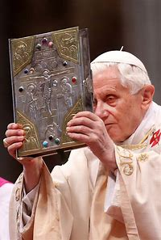
“Being Christian is not the result of an ethical choice or a lofty idea, but the encounter with an event, a person, which gives life a new horizon and a decisive direction”
Deus Caritas Est:

Slide 3
The Encounter With Christ
Prayer
The Word Sacraments

Slide 4

Deliverance from the Noon-Day Demon

Slide 5
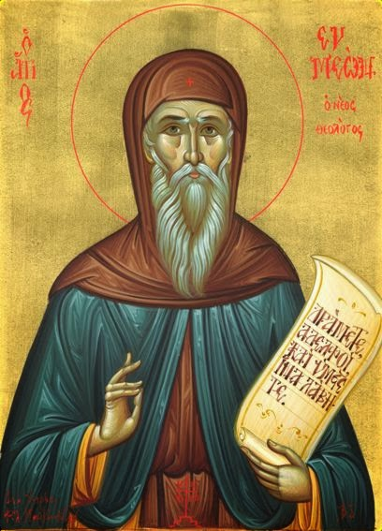
The demon of acedia (also called the noonday demon) … makes it seem that the sun barely moves and that the day is fifty hours long. Then he constrains the monk to look constantly out the windows, to walk outside [his room], to gaze carefully at the sun to determine how far it stands from the ninth hour (3 p.m. — the time when monks ate their only meal of the day). Evagrius Ponticus

Slide 6
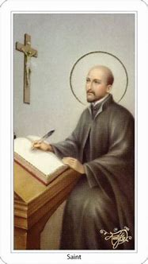
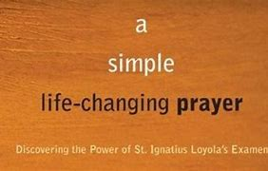

Slide 7
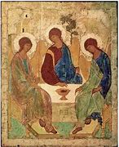
In the Name
Of
The Father
And
Of the Son
And
Of the Holy Spirit

Slide 8

Come, Holy Spirit,
fill the hearts of your faithful,
and enkindle in us the fire of your love.
Send forth your Spirit and we shall be created,
and you shall renew the face of the earth.
Amen.

Slide 9
Our Father…
Hail Mary…
Glory be…

Slide 10
Examen of Consciousness
Quickly reflect on the period since my waking from sleep
Ask the Holy Spirit to open your heart to the blessings of the morning hours.
Give Thanks

Slide 11
Examen of Consciousness
Quickly reflect on the period since my waking from sleep
Identify one gift or blessing received and reflect on how it shows God’s love for you.
Give Thanks

Slide 12
Examen of Consciousness
Quickly reflect on the period since my waking from sleep
How might I use this gift or blessing in God’s service?
Give Thanks

Slide 13
Examen of Consciousness
Quickly reflect on the remainder of the day.
What tasks are still ahead of me this afternoon?
Give Thanks

Slide 14
Examen of Consciousness
Quickly reflect on the remainder of the day.
What gift or blessing do I need?
Ask God for the gift needed!
Give Thanks

Slide 15
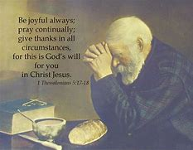

Slide 16
Prayer
The Best Form of Wireless Communication

