Slide 2
“Synod”
“Together”
“Journeying”

Slide 3
“Synod”
Towards an End
“Together”
“Journeying”

Slide 4
“For a Synodal Church”
Communion
Participation
Mission
Towards an End
“Together”
“Journeying”

Slide 5
How to “journey together” uphill?

Slide 6
How to “journey together” uphill?
“In the synodal Church the whole community, in the free and rich diversity of its members, is called together to pray, listen, analyze, dialogue, discern and offer advice on taking pastoral decisions which correspond as closely as possible to God's will.
(International Theological Commission: Synodality in the Life and Mission of the Church, #68)

Slide 7
Pray
Listen
Pastoral
Decisions
Holy Spirit
Advice
Discern
Analyze
Dialogue
How to “journey together” uphill?

Slide 8
Pray
Holy Spirit
Discern
Listen
PRAY LISTEN DISCERN

Slide 9
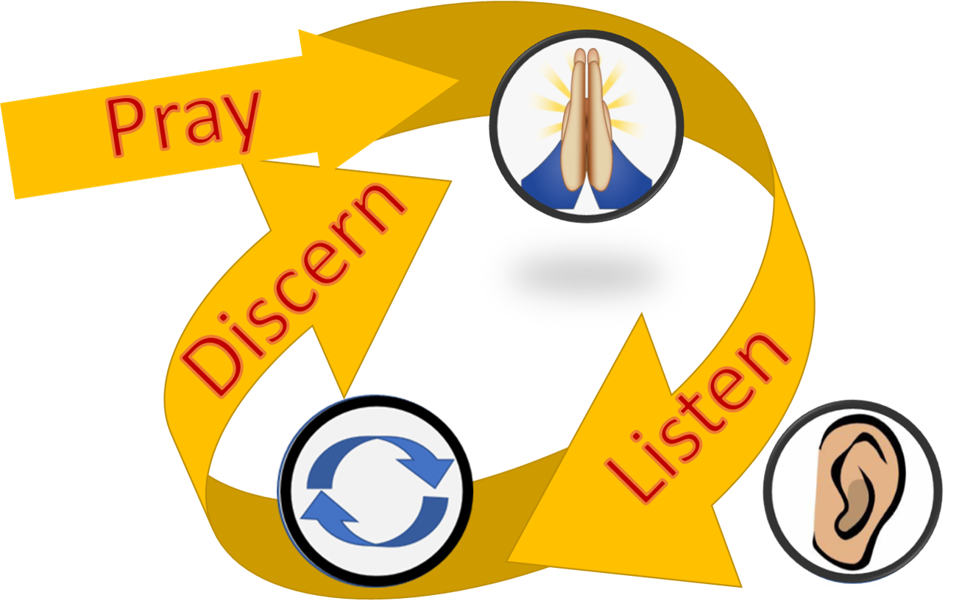
“For a Synodal Church”
Communion
Participation
Mission
Towards an End
“Together”
“Journeying”

Slide 10
Not new, but a Rediscovery of who we are as a Church.
“In this ecclesiological context, synodality is the specific modus vivendi et operandi of the Church, the People of God, which reveals and gives substance to her being as communion when all her members journey together, gather in assembly and take an active part in her evangelizing mission..”
modus vivendi et operandi
(International Theological Commission: Synodality in the Life and Mission of the Church, #6)

Slide 11
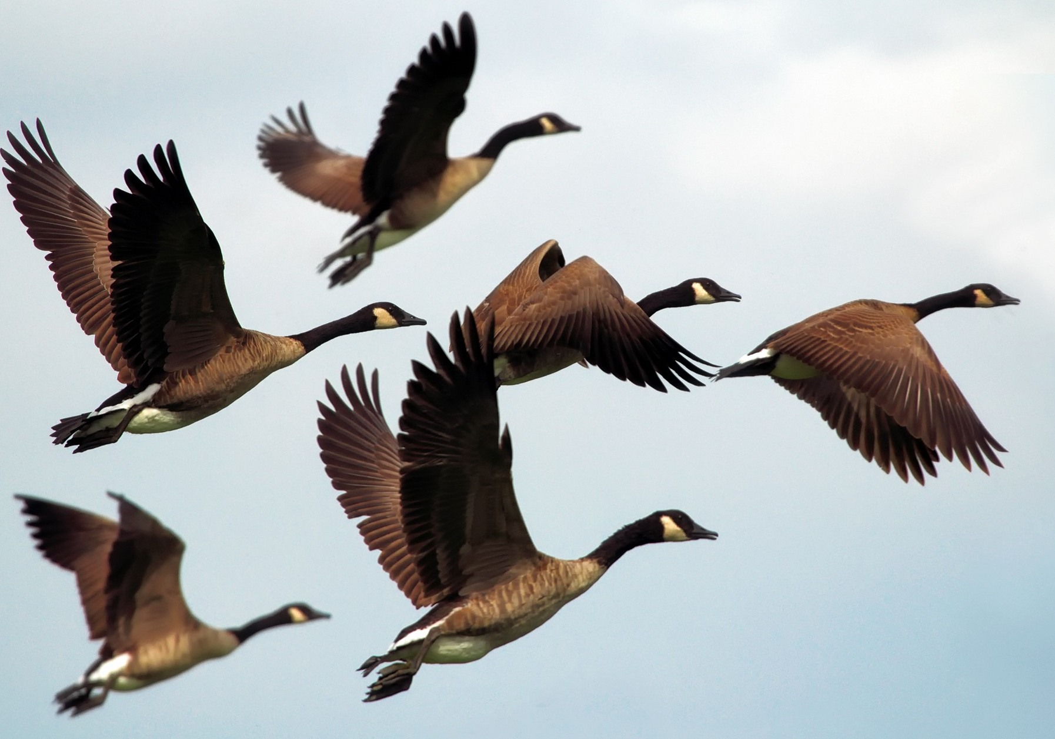
Example of Migratory Birds
On their own strength, snowbirds cannot fly from Canada to Florida. But they do have the ability to detect and mount the currents of the wind. They migrate by means of “wind-surfing.”
“The wind blows wherever it pleases. You hear its sound, but you cannot tell where it comes from or where it is going. So, it is with everyone born of the Spirit.” (Jn. 3:8).
Holy Spirit
Discernment is the ability to detect and mount the currents of the Holy Spirit, to “wind-surf” as to fulfill our mission and arrive to our destination.

Slide 12
Fundamental Questions
[1] “How is this “journeying together” happening today in your particular Church?
[2] What steps does the Spirit invite us to take in order to grow in our “journeying together”?
[Preparatory Document # 26]
Synodal Dynamic
modus vivendi et operandi

Slide 13
Three levels on which synodality is an “essential dimension of the Church”:
Synodal Dynamic
The level of the style with which the Church ordinarily lives and works (…)
The level of ecclesial structures and processes (…) expressed in an institutional way (…)
The level of synodal processes and events (…) [Prep. Doc, no. 27].
modus vivendi et operandi

Slide 14
Purpose: 10 Promises
The purpose of the Synod, and therefore of this consultation, is not to produce documents, but:
“[T]o plant dreams, draw forth prophecies and visions,
allow hope to flourish,
inspire trust,
bind up wounds,
weave together relationships,
awaken a dawn of hope,
learn from one another,
and create a bright resourcefulness that will enlighten minds,
warm hearts,
give strength to our hands.”
FRANCIS, Address at the Opening of the Synod of Bishops on Young People (3 October 2018).

