Slide 1
Higgins Hall, March 10, 2022
Cathedraticum…
and
Catholic Ministry Appeal.

Slide 2
The New Assessment Agenda March 10,2022
Welcome/Opening Prayer
Introductions
Budget Guidance Memorandum FY 22-23
The Catholic Ministry Appeal
Accounting for:
Cathedraticum
Self invoicing
Payment of monthly invoice amount due
Catholic Ministry Appeal
Donations received at the parish
Discussion

Slide 3
timing of The Catholic Ministry Appeal
Catholic Ministry Appeal:
The annual Ministry Appeal is a January through December campaign each year to fund designated ministries of the Diocese of St Petersburg.
The parish’s 2022 campaign goal is based on the FY 2020-2021’s amounts recorded in 8 General Ledger revenue accounts less up to $100,000 of Catholic schools’ support to determine Assessable Revenue.
The proceeds of the campaign fund FY 2022-2023.
The assessment rate is 14.0% of Assessable Revenue.

Slide 4
full participation
What does a “Best Efforts” campaign really mean?
https://www.dosp.org/wp-content/uploads/2021/08/Definition-of-Best-Effort-for-CMA-FINAL-Updated.pdf

Slide 5
full participation
What does a “Best Efforts” campaign really mean?
The Pastor, staff, and campaign volunteers actively participate in all Catholic Ministry Campaign Training Sessions.
Prior to launch, the parish sets a goal to achieve 30% participation in the 2022 appeal or 10% more than the participation achieved for APA 2021 (whichever is greater).
Develop a parish plan to achieve the participation goal and regularly revisit the plan for updates. Plan your work and work your plan.
Send a personalized letter of support and endorsement from the pastor to each parish family asking for their participation.
Promote the appeal to parishioners using the materials provided by the diocese.

Slide 6
full participation
What does a “Best Efforts” campaign really mean (cont.)?
On the designated weekends (pre-in pew, in-pew and follow up), deliver appropriate messages to explain the Catholic Ministry Appeal and to communicate the expectation that each family or individual participate by filling out and returning a commitment card.
Send friendly reminders to parishioners from whom you have not received a completed commitment card.
Conduct robust in-pew appeals for pledges & contributions
Provide time during Mass for testimonials from a person receiving assistance from diocesan shared ministry.
Mail a thank-you letter or card from the pastor to parishioners who have returned a commitment card. A heartfelt thank you goes a long way towards assuring campaign success.

Slide 7
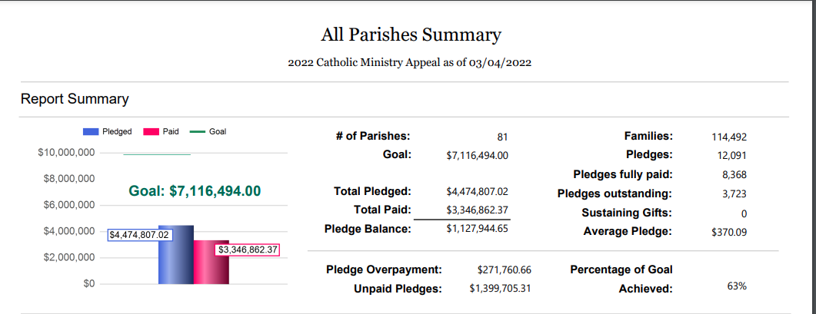
Catholic Ministry Appeal: Results as of 03/04/2022

Slide 8
timing of The cathedraticum
The Cathedraticum is based on Assessable Net Revenue from July 1, 2022 through June 30, 2023
The Cathedraticum is to pay for the cost of the Bishop’s office, and assessments from the larger Church for FY 2023 including:
FCC
FCCB
USCCB
Support of the Holy See
Parishes will self-invoice using the custom ParishSoft report which calculates 2.0% of Assessable Net Revenue less school support up to $100,000. Payments are due the 15th of the following month.

Slide 9
Assessable revenue accounts Summary

Slide 10
Assessable revenue accounts by Functional Account Code

Slide 11
Assessable revenue accounts by Functional Account Code

Slide 12
Assessable revenue accounts by Functional Account Code

Slide 13
Assessable revenue accounts by Functional Account Code

Slide 14
Assessable revenue accounts by Functional Account Code

Slide 15
Assessable revenue accounts by Functional Account Code

Slide 16
The New Assessment: Donation Exclusions
If transactions are recorded in subaccounts of functional account 4160 they will be assessed. If you use the following “New G/L Accounts” and transfer any account balances to these new accounts, they will not be assessed:

Slide 17
JE to move a donation to a non-Assessable Rev. Account

Slide 18
JE to move a donation to a liability Account

Slide 19
Reduction in Assessable revenue for school support
Assessable Revenue is reduced by the sum of all school support entered in the above G/L accounts up to a maximum of $100,000

Slide 20
Cathedraticum invoicing
Generating the Cathedraticum monthly invoice:
Step 1: From the parish’s Parishsoft home page select “Ledger Report Writer”
:

Slide 21
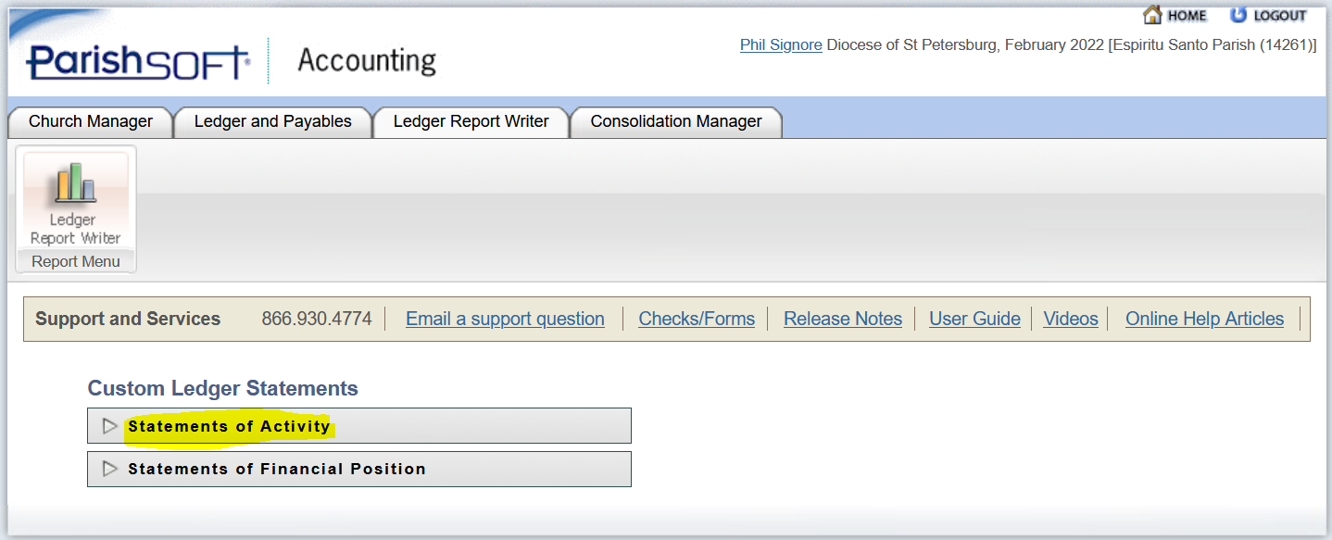
Cathedraticum Invoicing
Generating the Cathedraticum monthly invoice:
Step 2: From the Custom Ledger Statements List select:

Slide 22
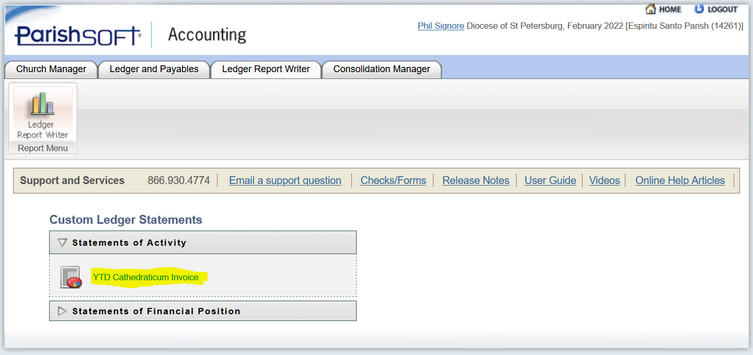
Cathedraticum Invoicing
Generating the Cathedraticum monthly invoice:
Step 3: Select “YTD Cathedraticum Invoice” from the list of custom reports:

Slide 23
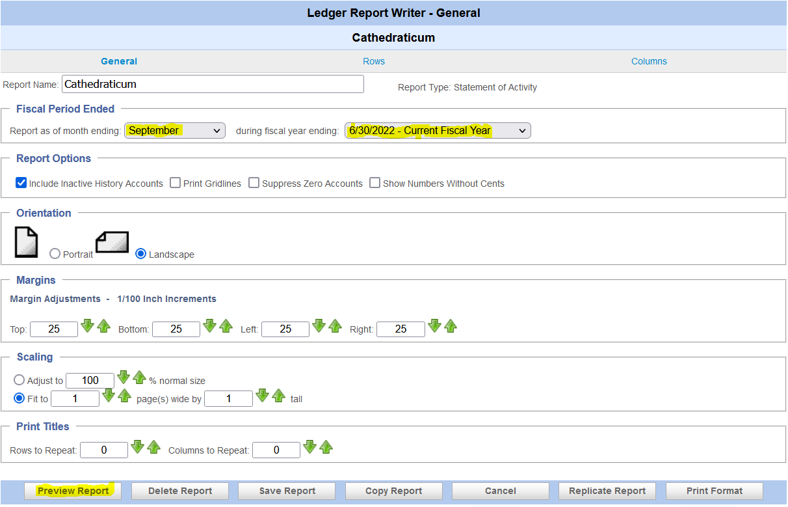
Cathedraticum Invoicing

Slide 24
Cathedraticum Invoice
Let’s look at the invoice produced by the custom report.

Slide 25
Cathedraticum Invoice
Importance of best practice accounting:
Use the revenue accounts provided.
You are encouraged to post to the subaccounts including Electronic Giving.
Timeliness of recording deposits made.
Deposits should be recorded in the G/L no later than 3 days after deposit.

Slide 26
Catholic ministry Appeal Donations received
Checks received at the parish for the Catholic Ministry Appeal are to be mailed directly to DOSP attention of the Campaign Processing Office.
For checks received from donors who have designated specific amounts (“SPLIT CHECKS”) for Offertory, Catholic Ministry Appeal, etc. and for loose cash donations to the Appeal, code them to the new Contributions to be Paid account.

Slide 27
Catholic ministry Appeal Donations received
Activating the new liability account:

Slide 28
Catholic ministry Appeal Donations received by Parish

Slide 29
Catholic ministry Appeal Donations received by parish

Slide 30
Catholic ministry Appeal Donations received by parish
When split checks, envelope cash, electronic and loose cash contributions are received at the parish the best practice is to:
Use the Deposits module to record contributions received and deposited in the operating account.
The portion of the deposit related to the Catholic Ministry Appeal is to be recorded as a liability in G/L account Contributions: CMA 1230001 by type of deposit.

Slide 31
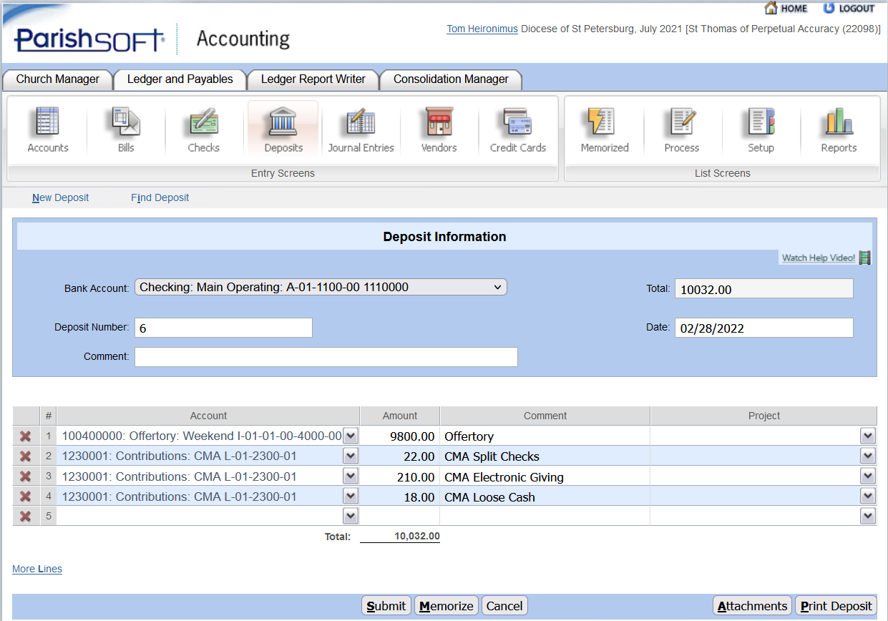
Catholic ministry Appeal Donations received by parish

Slide 32
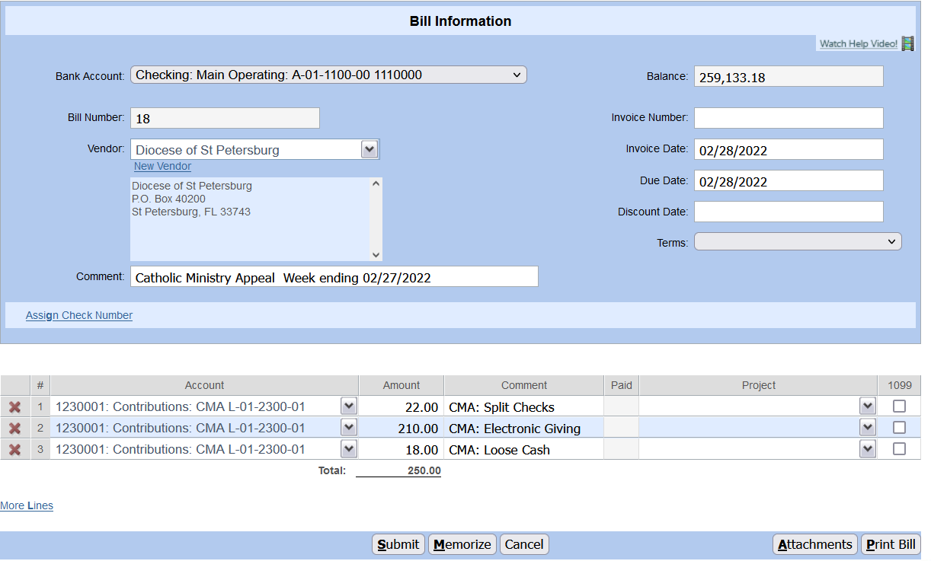
Catholic ministry Appeal Donations received by parish

Slide 33
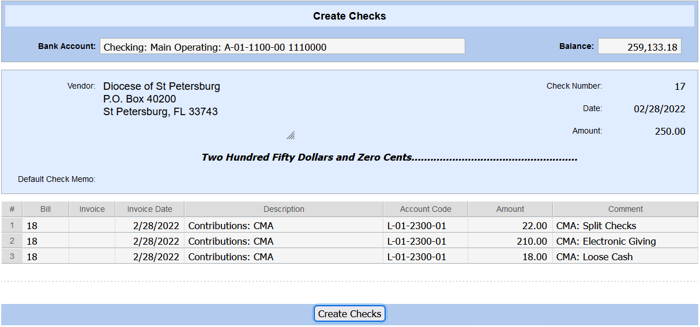
Catholic ministry Appeal Donations received by parish

Slide 34
Electronic Giving
Discussion
Success Stories

