Slide 2
156 Synod Sessions
6,500 participants
207 responses to online survey
19 individual letters to the Bishop
Diocesan Phase Participation:
November 4, 2021 – April 11, 2022

Slide 3
Special Discernment Sessions for:
Deacons
Religious
Youth & Young Adults
University Students
Migrant Workers
Prisoners
Homeless
Sick & Homebound
Diocesan Phase Participation:
November 4, 2021 – April 11, 2022

Slide 4
Special Discernment Sessions for:
Catholics who experience same-sex attraction
Family members of the former
Non-Catholic Christians (including
a schismatic community)
Those who claim no religious affiliation
Diocesan Phase Participation:
November 4, 2021 – April 11, 2022

Slide 5
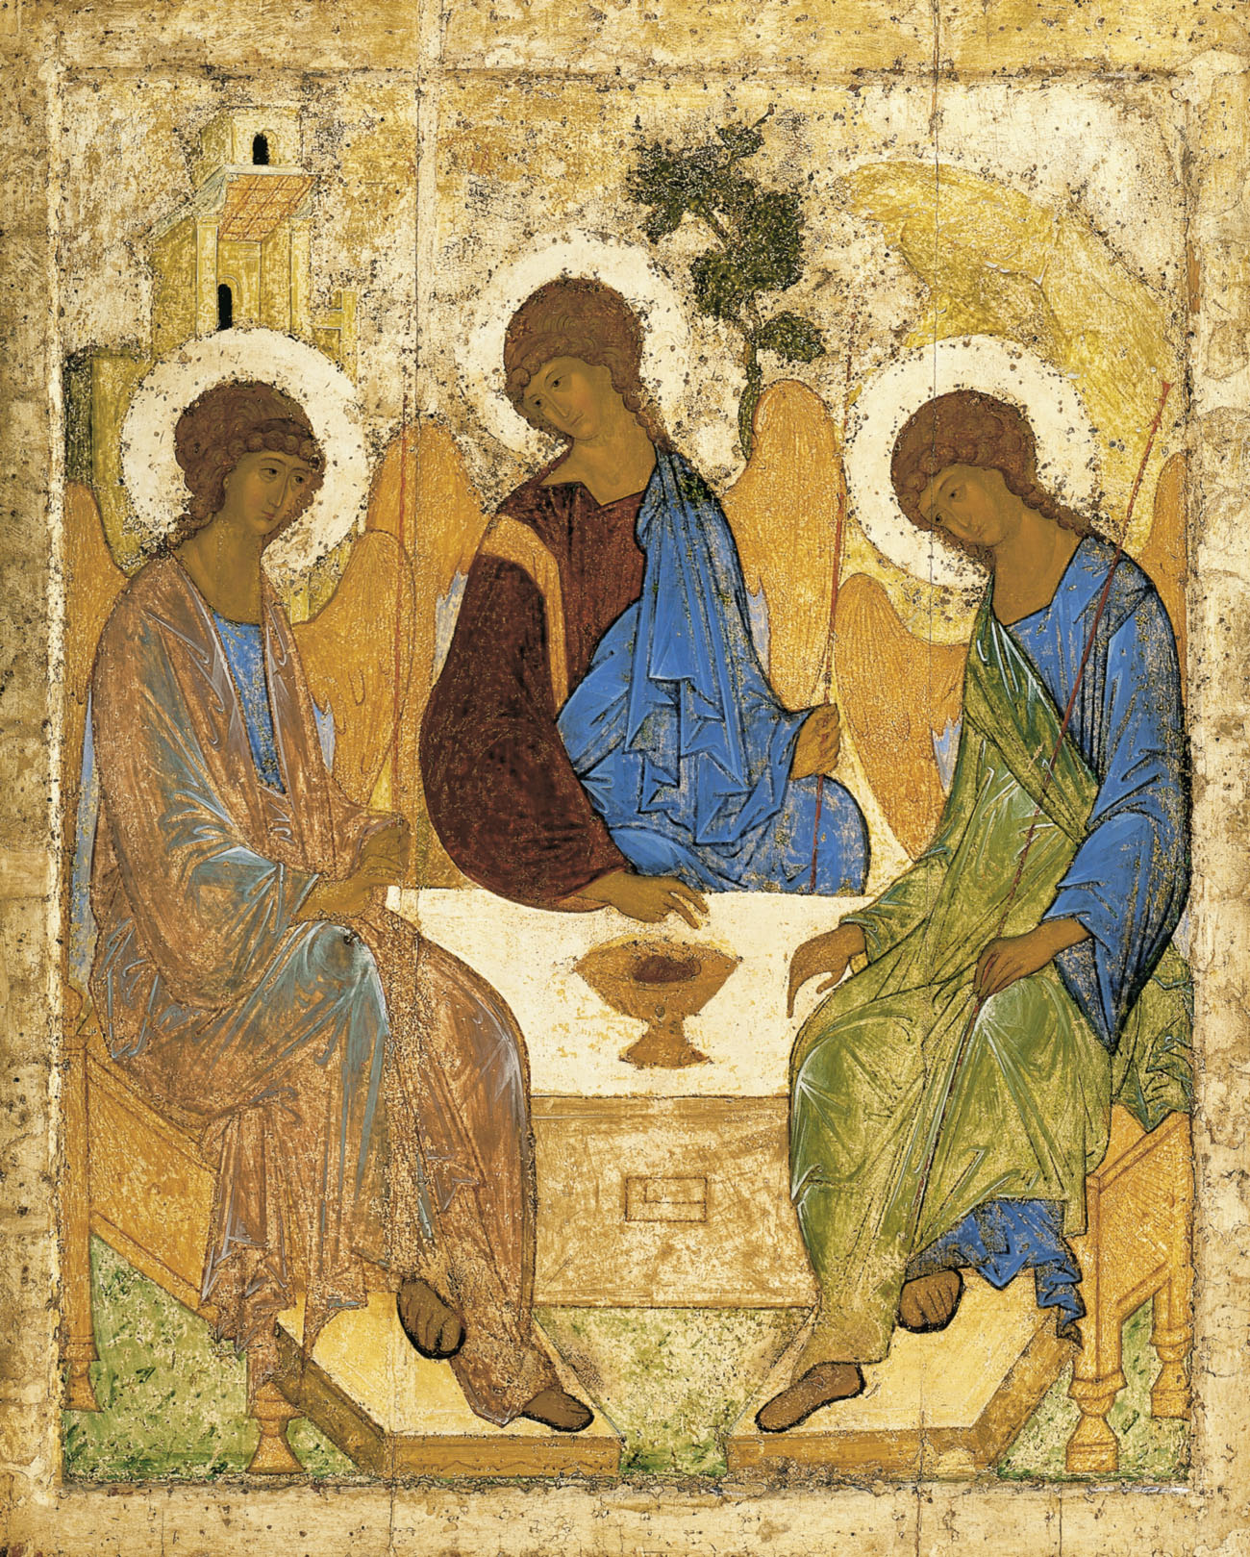
Consensus from the Synod Sessions centered on Two
Questions developed from the “FUNDAMENTAL QUESTION”:
What are we (the Church) doing well?
What is the Holy Spirit leading the Church to do better?
Criteria for inclusion into Results – ideas and feedback mentioned as consensus in 2 or more Deanery Synod Sessions or 3 or more Parish Synod Sessions
Notes:
The story of the Lord visiting Abraham in the form of three men or “angels” who predicted that in their old age, Sarah and Abraham will have a son and Abraham’s descendants will form a great nation.
In this story, we see Abraham rush to his visitors, washing their feet and providing food and drink. He practiced great hospitality and God showed him favor.
This 15th century Icon by Andrei Rublev entitled Trinity and depicting Genesis 18 is one of the most stimulating and accessible images of God in our tradition. A copy hangs in the lobby of our parish office to help us be mindful to always extend hospitality, as we never know when we will be entertaining angels.

Slide 6
What are we (the Church) doing well? How is this “journeying together” happening today in your local Church?
Abundance of opportunities to the faithful for prayer and for service
Clergy who listen to their flocks and their concerns with attention and care
Generosity of the Church’s charitable works and ability to participate in them.
Notes:
The story of the Lord visiting Abraham in the form of three men or “angels” who predicted that in their old age, Sarah and Abraham will have a son and Abraham’s descendants will form a great nation.
In this story, we see Abraham rush to his visitors, washing their feet and providing food and drink. He practiced great hospitality and God showed him favor.
This 15th century Icon by Andrei Rublev entitled Trinity and depicting Genesis 18 is one of the most stimulating and accessible images of God in our tradition. A copy hangs in the lobby of our parish office to help us be mindful to always extend hospitality, as we never know when we will be entertaining angels.

Slide 7
What are we (the Church) doing well? How is this “journeying together” happening today in your local Church?
Beautiful liturgy and music
Good homilies
Excellent Catholic schools,
Wide array of opportunities offered for formation, especially for adults and through engaging Scripture
Successful ministries of outreach, especially to the homebound,
Notes:
The story of the Lord visiting Abraham in the form of three men or “angels” who predicted that in their old age, Sarah and Abraham will have a son and Abraham’s descendants will form a great nation.
In this story, we see Abraham rush to his visitors, washing their feet and providing food and drink. He practiced great hospitality and God showed him favor.
This 15th century Icon by Andrei Rublev entitled Trinity and depicting Genesis 18 is one of the most stimulating and accessible images of God in our tradition. A copy hangs in the lobby of our parish office to help us be mindful to always extend hospitality, as we never know when we will be entertaining angels.

Slide 8
What are we (the Church) doing well? How is this “journeying together” happening today in your local Church?
Sense of community, hospitality, and diversity that pervades parish life
Success of small groups in supporting participants to live out their faith
Inspiring leadership of Pope Francis and Bishop Parkes.
Notes:
The story of the Lord visiting Abraham in the form of three men or “angels” who predicted that in their old age, Sarah and Abraham will have a son and Abraham’s descendants will form a great nation.
In this story, we see Abraham rush to his visitors, washing their feet and providing food and drink. He practiced great hospitality and God showed him favor.
This 15th century Icon by Andrei Rublev entitled Trinity and depicting Genesis 18 is one of the most stimulating and accessible images of God in our tradition. A copy hangs in the lobby of our parish office to help us be mindful to always extend hospitality, as we never know when we will be entertaining angels.

Slide 9
What consensus emerged regarding what the Holy Spirit calls the Church to do better?
“What steps does the Spirit invite us to take in order to grow in our ‘journeying together’”?
5 Themes Emerged
Notes:
The story of the Lord visiting Abraham in the form of three men or “angels” who predicted that in their old age, Sarah and Abraham will have a son and Abraham’s descendants will form a great nation.
In this story, we see Abraham rush to his visitors, washing their feet and providing food and drink. He practiced great hospitality and God showed him favor.
This 15th century Icon by Andrei Rublev entitled Trinity and depicting Genesis 18 is one of the most stimulating and accessible images of God in our tradition. A copy hangs in the lobby of our parish office to help us be mindful to always extend hospitality, as we never know when we will be entertaining angels.

Slide 10
5 Themes Emerged
Theme #1: Outreach and evangelization, especially to Youth, Young Adults and those who are connected with the Church
Theme #2: Failure to Listen and Poor Communication
Theme #3: Lack of Sense of Community nor a Sense of Unity in the Community
Notes:
The story of the Lord visiting Abraham in the form of three men or “angels” who predicted that in their old age, Sarah and Abraham will have a son and Abraham’s descendants will form a great nation.
In this story, we see Abraham rush to his visitors, washing their feet and providing food and drink. He practiced great hospitality and God showed him favor.
This 15th century Icon by Andrei Rublev entitled Trinity and depicting Genesis 18 is one of the most stimulating and accessible images of God in our tradition. A copy hangs in the lobby of our parish office to help us be mindful to always extend hospitality, as we never know when we will be entertaining angels.

Slide 11
5 Themes Emerged
Theme 4: Lack of Engagement with Scripture, ecumenism and a Need for Vocations, greater attention to the role of and leadership opportunity for women & pastoral sensitivity for and outreach to Catholics who experience same-sex attraction
Notes:
The story of the Lord visiting Abraham in the form of three men or “angels” who predicted that in their old age, Sarah and Abraham will have a son and Abraham’s descendants will form a great nation.
In this story, we see Abraham rush to his visitors, washing their feet and providing food and drink. He practiced great hospitality and God showed him favor.
This 15th century Icon by Andrei Rublev entitled Trinity and depicting Genesis 18 is one of the most stimulating and accessible images of God in our tradition. A copy hangs in the lobby of our parish office to help us be mindful to always extend hospitality, as we never know when we will be entertaining angels.

Slide 12
5 Themes Emerged
Theme 5: More opportunities for the Sacrament of Reconciliation & More opportunities for Small Groups. Greater Clarity and appreciation of Catholic Moral and Social Teaching; Pastoral sensitivity for the divorced or Divorced & Civilly Remarried; Problem with Clericalism,
Threat of polarization in the Church
Notes:
The story of the Lord visiting Abraham in the form of three men or “angels” who predicted that in their old age, Sarah and Abraham will have a son and Abraham’s descendants will form a great nation.
In this story, we see Abraham rush to his visitors, washing their feet and providing food and drink. He practiced great hospitality and God showed him favor.
This 15th century Icon by Andrei Rublev entitled Trinity and depicting Genesis 18 is one of the most stimulating and accessible images of God in our tradition. A copy hangs in the lobby of our parish office to help us be mindful to always extend hospitality, as we never know when we will be entertaining angels.

Slide 13
Target Groups:
Hispanic Community: Need for Church Unity especially across divides of language & ethnicity
Need for more Spanish-speaking priests
Migrant Community: pastoral care, education and family support to assist in their witnessing to their faith and ability to evangelize
African American Catholics: Racism in society and the Church
Homebound: Outreach to them & to those grieving

Slide 14
Target Groups:
Youth: Greater, more pronounced sense of Community
Young Adults: Need for more formation & Greater accessibility, overcome judgmentalism in the Church and greater degree of courage, clarity and compassion by ecclesiastical leadership

Slide 15
On-line Survey
The themes of the synod session were also expressed plus
Greater attention to widows and widowers
More opportunities to participate in the Mass according to the 1962 Roman Missal

Slide 16
Preparing Final Report for Bishop’s Review
By mid-June: Issuing 2-page Executive Summary for parish bulletins
Placing Executive Summary and Full Bulletin at:
www.dosp.org/Synod
Turning in report to the USCCB no later than by June 30.
NEXT STEPS

Slide 17
IMMEDIATELY we are working on:
Transformational Parish Growth Summit addresses #1 Theme.
Fervently working on communication to our parishes and the faithful
Parish Consultative/Synodal Bodies
NEXT STEPS

Slide 18
THANK YOU FOR YOUR LEADERSHIP
Closing liturgy on June 14 at the Cathedral Chapel
General Intercessions at the parish level for the weekend Masses
Honorable Closure

