Slide 1
Calling Volunteers to Deeper Discipleship
Inviting, Forming, Sustaining and Retaining Ministry Volunteers
With Gratitude to the Center for Ministry Development and Joan Weber for sharing their work product for this presentation

Slide 2
Today’s Presentation
Explore how you can foster an environment of giftedness and stewardship
Suggest ways to develop a system for volunteer management
Consider ways to enhance current recruiting methods
Advocate for new ways of mentoring, training and sustaining volunteers

Slide 3
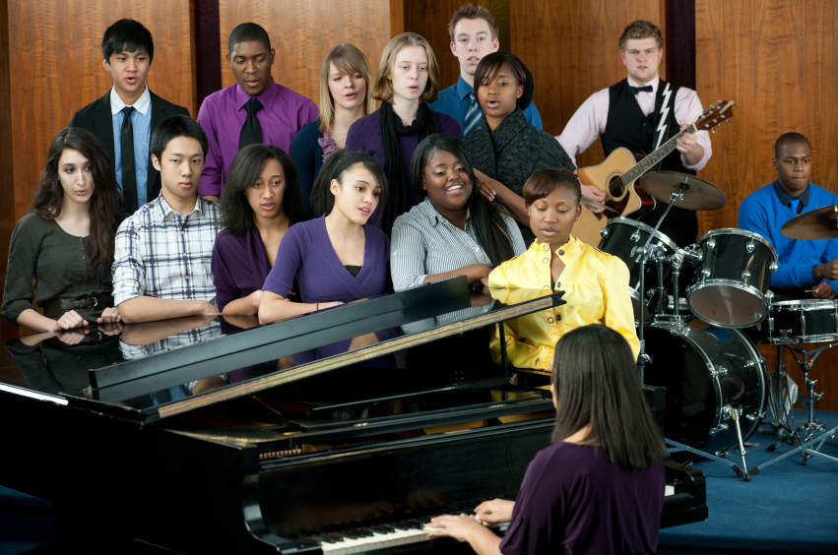
Point Number One—Kudos for Your Leadership!
The Ministry of Volunteer Management

Slide 4
Not the image of volunteering you want to project!

Slide 5
Attitude and Image to Project!

Slide 6
Volunteering is YES to Baptism!

Slide 7
Inspire with Mission: Following the example of our patrons Jesus, Mary, and Joseph, we are dedicated to prayer, community, and education. Our goal as disciples is to continue the work of Jesus in our neighborhood. We invite and welcome all to journey with us as members of God’s Holy Family.

Slide 8
Value and Honor Volunteers!

Slide 9
Valuing Volunteers has lots of pluses!
Diversity of skills, ideas, and experiences beyond paid staff
Differences in age, gender, color, and lifestyle that is a benefit to the parish and the ministry
Proclaims “We are the Church!”

Slide 10
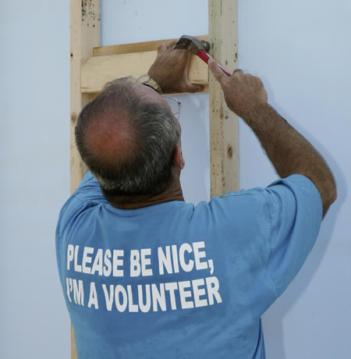
When do people willingly volunteer?
When We Give Them Meaningful Work.
When We Honor Their Time.

Slide 11
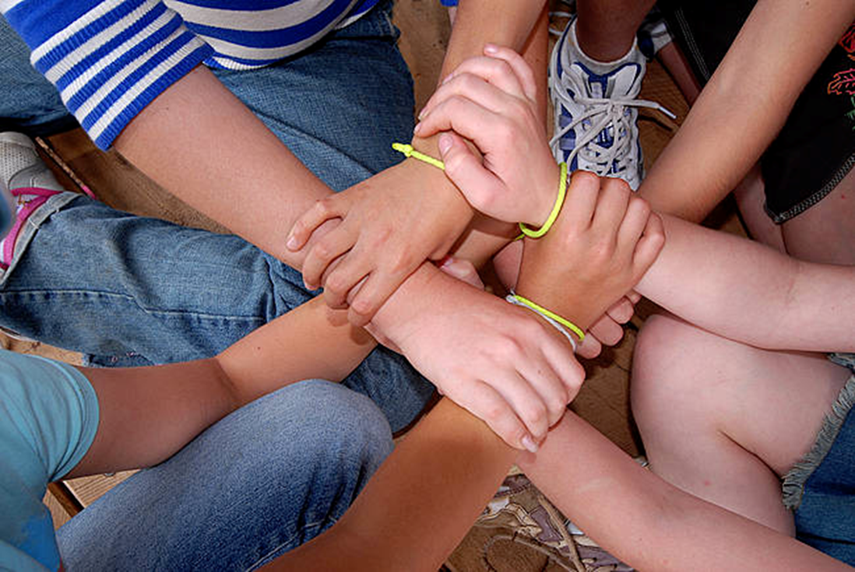
When do people willingly volunteer?
When We Have Good Relationships Between Staff & Volunteers
When They See the Value of Their Volunteer Work within Overall Ministry

Slide 12
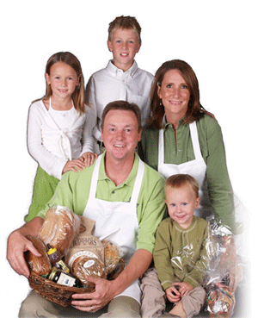
Motives for Volunteering:
Change the world
Resumé
Sense of achievement
Challenge
Increased responsibility
Recognition
Growth and development
Transferable skills
Way of practicing stewardship

Slide 13
Job Descriptions: Truth in Advertising!

Slide 14
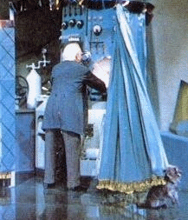
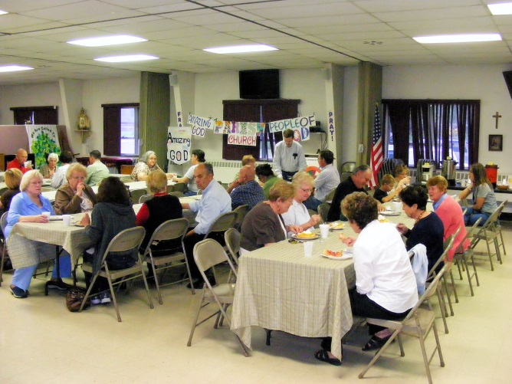
No Fooling—What Are You Asking For?
Aspects to Consider/Questions to Ask Yourself:
Is this a short-term, long-term or one-time “job”?
Is this only for individuals or can couples/families get involved?
Is the “job” on-site, off-site, from home, unusual hours,…?
Are there any special skills needed?
Does the “job” require direct contact with people, (small groups, large groups, in-person, on the phone, in their homes…)? or
Is this a “behind the scenes “job?”

Slide 15
“Job Descriptions” & Personal Invitation
Engaging job descriptions
Name reflects the value of the work
Clear about the tasks
Abilities/skills needed
Honest about commitment
Promise to train/support (and do it!!)
Benefits noted
Personal Invitation—Not Just “In the Bulletin”
You or—maybe not you (but in consultation with you)
Why you think their gifts and talents meet the need; not how desperate we are for…

Slide 16
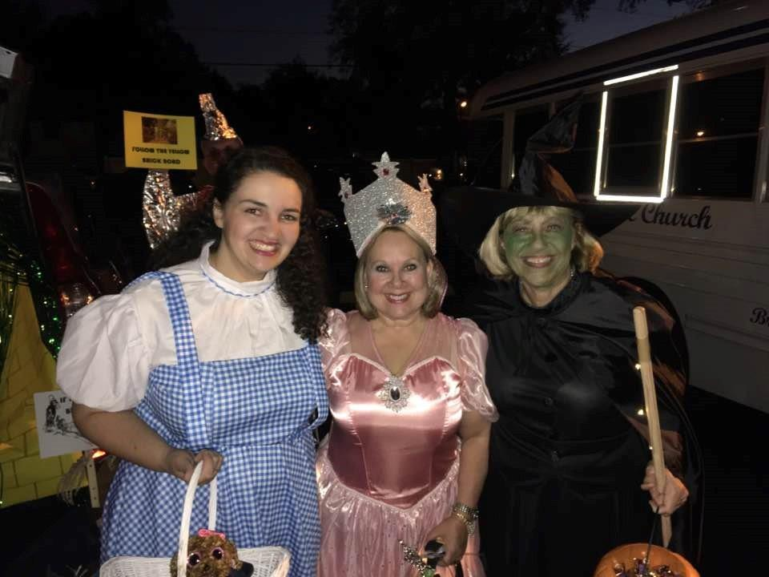
Who Has the Greatest Potential?

Slide 17
Seniors
Time to give
Need to be reminded they have wisdom to share
“Wisdom people”, not “old people”

Slide 18
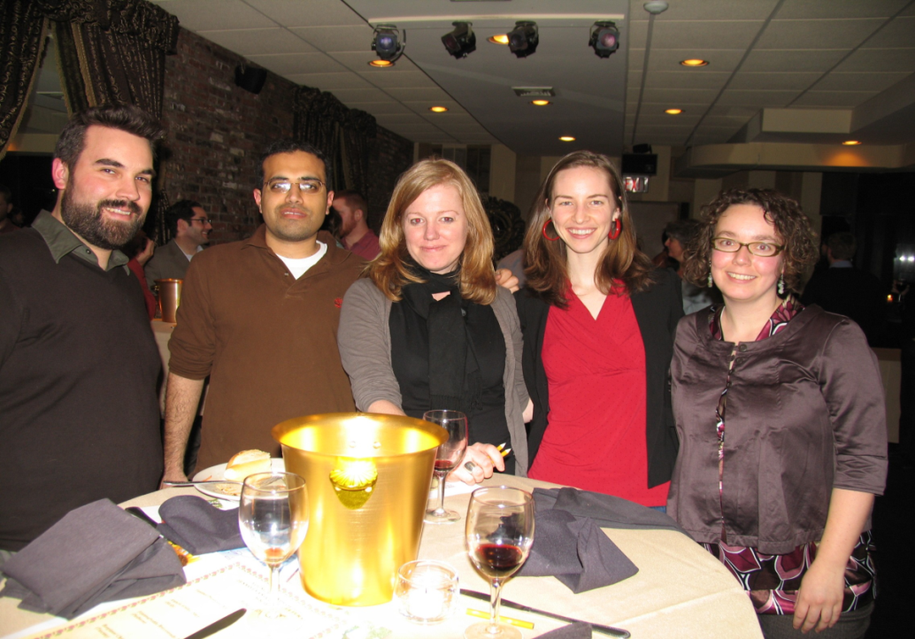
Young Adults
Are pragmatic—tell them why they should volunteer
Seek feedback
Require flexibility
Want to try before they buy

Slide 19
Recruiting Sins

Slide 20
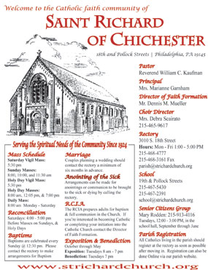
Relying Only on Bulletin announcements

Slide 21
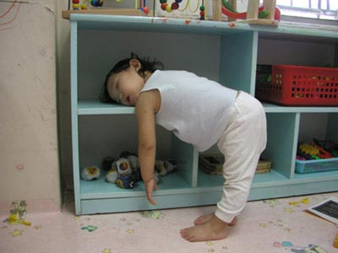
Going It Alone

Slide 22
Making People Sign for Life

Slide 23
Desperation--Any Warm Body!

Slide 24
Asking Busy People To Do Busy Work

Slide 25
Guilting People

Slide 26
Not Following Up When People Offer Their Gifts

Slide 27
Leading with a Negative
“I hate to ask you, but…”

Slide 28
Strategies for Recruitment
General
Specific
Targeted

Slide 29
Targeted Recruitment
NOT – “Who can we get to volunteer for our youth retreat? Who likes kids?”
ASK - “Who likes to cook?” “Who is on fire with their faith right now?” “Who is a good small-group leader?” “Who is a great prayer leader?”

Slide 30
Training, Forming & Sustaining Volunteers
For every volunteer
For every program
BIG picture—give the context in which they will be volunteering
Way you want ministry done is communicated to everyone who plays a role in your ministry
Mentoring is vital
Weave in prayer, faith-sharing and spiritual support
No micro-management
Increase responsibility
Give more decision-making power

Slide 31
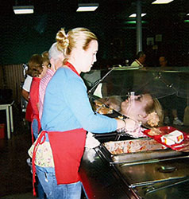
Training, Forming & Sustaining Volunteers
Add fun to work
Be the first to trust
Take human moments
Remember Prayer, Faith Sharing
Theological Reflection
Provide Training—local, diocesan, national
Create places and opportunities
for informal interactions—feedback and evaluation
Remember these are mutual—give and receive!
Schedule celebrations/social interaction
Be a cheerleader
Tangible Incentives

Slide 32
Show Gratitude Know That You Are Appreciated

