Slide 1

Business Manager workshop
March 8, 2019
Today’s Agenda:
Banking Proposal
Cash Handling & Credit Cards
Payroll Accounting
Budget Guidance
Health Insurance Preview

Slide 2

SunTrust Presents Customized Banking Solutions
Discussion Material
February 22, 2019

Slide 3

SunTrust Bank Exclusive Banking Program for
Diocese of St. Petersburg
No Cost Banking Package
for the
Diocese of St. Petersburg Participating Entities
Designated Relationship Team nnnnnnnnn
General Banking | Cash Processing
Online Cash Manager | Online Check Deposit
Online ACH Control | Fraud Control
ACH Origination | Earnings Credit
Convenient Branch Locations | Coordinated Implementation Plan

Slide 4
Branches Location Proximity
Branches Location Proximity
# of Diocese Locations | 137
Average Distance | 1.64 miles
Closest Branch | 0.06 miles
Furthest Branch | 6.82 miles
% under 3 miles away | 88.3%
St. Petersburg Dioceses & Related Entities | SunTrust Location | Distance (miles)
St. Paul Catholic Church | Carrollwood | 0.06
St. Paul ECC | Carrollwood | 0.06
Sacred Heart Catholic Church | SunTrust Financial | 0.13
Day Star - St Petersburg | Downtown St. Pete | 0.27
Prince of Peace Catholic Church | Sun City Center | 0.33
St. Anne Catholic Church | Ruskin | 0.34
Miserere Guild d/b/a/ Calvary Catholic Cemetery | North 49th Street | 0.35
Incarnation Catholic School | Hillsborough Square | 0.35
St. Mary, Our Lady of Grace Catholic Church | Downtown St. Pete | 0.37
Light of Christ Catholic Church | East Clearwater | 0.38
Light of Christ Early Childhood Center | East Clearwater | 0.38
Bethlehem Centre | Indian Rocks | 0.40
St. Jerome Catholic Church | Indian Rocks | 0.40
4

Slide 5

Dedicated Relationship Team to Address Your Dailey Deposit and Treasury Needs
Client Onboarding Lifecycle
Relationship Management
Understanding your corporate objectives and business requirements
Consulting with you about new and existing services, ensuring satisfaction, and delivering appropriate SunTrust specialists for your needs
Partnering with you to develop a customized treasury or payment solution
Keeping you informed about industry trends and new services
Responsible for understanding your business requirements and payment needs, and advising on relevant treasury and commercial card solutions
Relationship Management:
Jill Wilkinson/
Robyn Feenaughty
Onboarding and Implementation
Planning, coordinating, and executing implementations for all products and services
Partnering with you from receipt of initial request through the entire implementation process
Maintaining product and industry expertise to support Relationship Management
Providing product demonstrations, technical expertise on product usage and integration, and advising on industry-specific needs
Leading implementation processes and providing ongoing management of treasury and commercial card programs
Ongoing Support Services:
Jeremy Cumbie
Onboarding and Implementation
Ongoing Support Services
Providing ongoing client support and ensuring you fully benefit from your SunTrust treasury solutions
Coordinating day-to-day communication to ensure that you receive high quality customer service
5

Slide 6


Setting Up Your Services
SunTrust gives each client a unique experience by providing an individualized implementation process just for them
Step 2:
Open Accounts
Step 3:
Execute TM Agreements
Step 4:
Conduct Q&A Session
Step 5:
Implement Services
Step 1:
Verify Account Services
 | Engage schools and parishes to confirm services and account service specs by account | Provide Deposit Resolution and other legal documentation Set-up bank accounts (once all documents are received) | Provide TM Agreements for review and signoff by client Enter formal implementation requests | Provide guidance and timeline for testing and implementation Engage your operational experts to ensure all service requirements are captured prior to implementation | Conduct status meetings Implement services Coordinate testing within SunTrust Provide training, as needed, to ensure a smooth transition
 | Discuss account needs and expectations to provide confirmation to SunTrust team Provide Treasury specifics back to SunTrust team for implementation | Letter from Diocese Chancellor Names and titles of Authorized Signers Name, address, contact information, DOB, copy of driver’s license and SS# for controlling person | Signoff on all Agreements Identify Security Administrators for user access: Online Cash Manager Online Check Deposit ACH Fraud Control | Identify operational experts that understand how you use the systems today Identify any technology support that may be required to facilitate your service set up | Prepare and provide test files based on defined schedule Provide test results and modifications needed

Slide 7


Online Cash Manager – Key Modules
$
Online Bill Pay m
Online Statements
View, print, and download your statements – up to 18 months of history available
View, print and save images of paid check transactions, deposit tickets and deposited items – up to 18 months of history available
Company System Administrator (CSA) has the ability online to select a statement delivery preference of ‘Online Only’ or ‘Online and Paper’ for DDA Statements
Transaction
Reporting
Real-Time
Balances
ACH Origination
Stop Payments
Bill Pay
Fraud Inspector
User Permissions
Alerts & Reminders
Images
Mobile
Banking
Online Statements
Simplify payments to vendors by paying all of your bills from one secure site, while managing your billing information from one convenient screen
Eliminate the expense of stamps, checks, and envelopes
Online
Cash
Manager
Fraud Inspector
ACH Services m
  A list of paid checks from the previous business day is displayed on a dedicated screen in the Fraud Inspector service, including any available images
  Review the transactions displayed prior to 2:00 p.m. ET each day and direct return of any suspected fraudulent items
  The request will process, and the funds should return to your account in one business day
Initiate electronic disbursements and collections
  Set up recipients, and create payment templates to reduce data entry and errors for future payments
  Pay on a one-time basis or set up a recurring payment schedule
  Review any Notifications of Change (NOC) or Returns in an easy-to-access report within Online Cash Manager

Slide 8
Online Check Deposit Services
Spend more time on strategic tasks rather than traveling to the bank to make deposits
In-House Depository
Process and send deposits from your place of business
Receive same-day credit for check deposits submitted by 10:30PM ET on bank business days
Additional Information at Your Disposal
Capture remittance coupons or key-enter additional data associated with captured checks
Search images associated with deposits for 90 days after transmission
Automated Features
Using Courtesy Amount Recognition (CAR), check amounts in your deposit are auto-recognized and captured with a high degree of accuracy
Checks not identifiable are presented for review and input
OCD reconciles the total dollar amount of items scanned to your input deposit total
Security
Access requires a unique user ID and password
Deposits are submitted via a secure, direct connection to SunTrust
OCD uses 128-bit SSL for all electronic communications

Slide 9


Online Check Deposit - Deposit Process Workflow
Online Check Deposit
Efficiently process your deposit items by completing a few basic steps
Payments Received
Prepare Deposit
Log On
Batch checks (and remittance coupons)
Run a list
Enter User ID and Password
Online Check Deposit System
Online Check Deposit System
(1)
Review the deposit
Adjust to balance, if necessary
Confirm the deposit
Select account
Enter deposit amount
Place checks (and remittance coupons) in scanner
Transmit Images
Scan/Image
Checks and Coupons
(2)
E-mail
Confirmation
Log Off
Secure Checks
SunTrust
Receive Confirmation of Deposit Submission
Bundle checks
Note the destruction date
After your company’s designated retention period, destroy checks

Slide 10
Recommended Fraud-Prevention Solutions
Online ACH Fraud Control
(included in package)
Minimize Costs - Prevent losses before they occur so you save the time, effort and costs associated with recovering lost funds
Improve Control - Review potentially unauthorized incoming ACH transactions, accept legitimate transactions and return unauthorized transactions online
Receive email alerts notifying you of a decision on a pending transaction requiring verification, establish authorizations from companies you do business with regularly, set flexible parameters, such as maximum dollar amount and expiration date or take no action, and rejected electronic transactions are automatically returned
Fraud Inspector
(included in package)
  Review Transactions - A list of paid checks from the previous business day is displayed on a dedicated screen in the Fraud Inspector service, including any available images
  Decision - Review the transactions displayed prior to 2:00 p.m. ET each day and direct return of any suspected fraudulent items
  The request will process, and the funds should return to your account in one business day
Positive Pay
(fee based on volume)
  Reduce Losses to Fraud – Without Positive Pay, you may not have the necessary tools to identify fraudulent transactions. Additionally, significant time and expense may be required to recover funds
  Minimize Clerical Workload - By notifying your staff of exceptions and providing the right information, Positive Pay reduces workload and potential loss due to fraud
  Timely Reporting – receiving reported exceptions and having immediate access to the check images lets you make pay or return decisions quickly and more easily
10

Slide 11
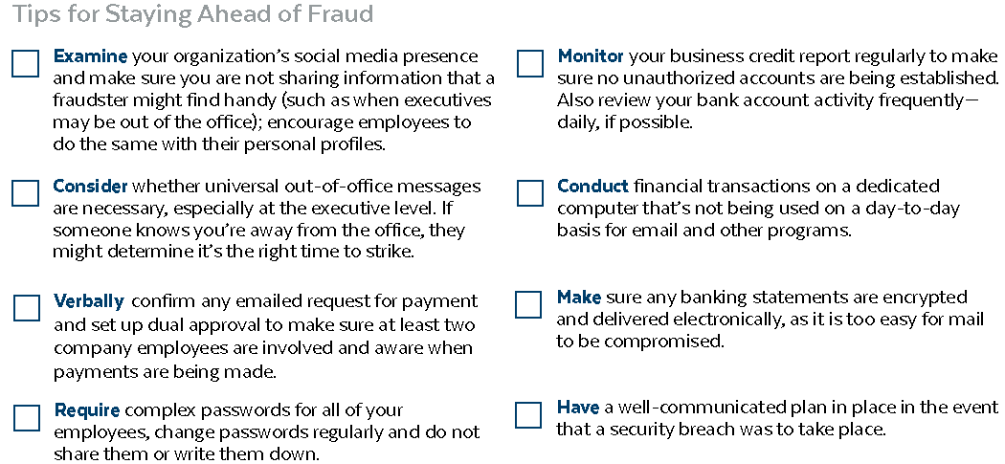
Are You Prepared to Combat Fraud?
Technology is a double-edged sword for today’s businesses. While advancements can boost efficiency and increase the speed of doing business, they also introduce risks. And as technology becomes more advanced, aspiring fraudsters follow suit.
Nearly half of global organizations say they’ve been victims of fraud or economic crime during the past two years—up from 36 percent in 2016.
1) Not only can this have a financial impact; fraud can also hurt employee morale and brand strength.
2) Are you and other leaders at your business doing all that you can to combat fraud?
Tips for Staying Ahead of Fraud
11

Slide 12
Best Practice: Offertory Processing
Basic requirements for written policies and procedures:
Reliance on parishioners/volunteers in all phases of the process
Segregation of duties
Timeliness of processing and deposit
Use of tamper-evident, plastic bags with bag control procedures at every step in the revenue process
Verification of bank deposits by multiple individuals
Recording revenue in the general ledger within 24 hours of deposit
Use of donations for their intended purpose
Monthly reconciliation of all bank accounts in time to notify the bank of any discrepancies within their stated grace period, generally less than 30 days from date of bank statement

Slide 13
Payroll accounting
Payroll Demonstration
by
Nicole Bubolz

