Slide 1
Financial Stewards’ Conference
St Paul’s Catholic Church - Tampa
May 2, 2017

Slide 2
Stewardship conference agenda
Prayer
Opening Remarks
Required Financial Reporting Review
Best Practice Accounting
Bishop Parkes on Stewardship
Lunch
Best Practice Accounting (continued)
Calculation of Parish Assessment/APA Goal
Human Resources
Listening Session
Closing Prayer

Slide 3
Finance & Accounting Team
Tom Heironimus & Karla Jackson
Margi Becker
Stephanie Boyle
Jeanne Age & Janice Van der Henst
Rob Rogers & Melissa Armstrong
Susan Hales & Barbara Desmangles
Giselle Johnson & Terri Wiles
Valerie Burns

Slide 4
Finance & Accounting Team
Parish & School Services:
Tom Heironimus
727-344-1611 X5469
tlh@dosp.org
Financial Applications Administrator:
Margi Becker
727-317-4551
mab@dosp.org

Slide 5
Finance & Accounting Team
Billing:
Janice Van der Henst
727-317-4554 (direct line)
jhv@dosp.org
Savings & Loan:
Rob Rogers
727-317-4553 (direct line)
rpr@dosp.org

Slide 6
BUDGET GUIDANCE
Group Health Insurance continues under review. For budgeting purposes, plan on the employer’s monthly health insurance premium for eligible employees to increase by 10%.

Slide 7
BUDGET GUIDANCE
Group Health Insurance continues under review. For budgeting purposes, plan on the employer’s monthly health insurance premium for eligible employees to increase by 10%. 6.5%.
Lay employees: $668/month
Clergy: $1198/month

Slide 8
BUDGET GUIDANCE
Workers’ Compensation Insurance will decrease for the coming year:
All Office/Clergy/Professional employees 0.75% of annual wages
All other employees 6.00% of annual wages

Slide 9
BUDGET GUIDANCE
Workers’ Compensation Insurance will decrease remain unchanged for the coming year:
All Office/Clergy/Professional employees 0.75% 1.0% of annual wages
All other employees 6.00% 8.0% of annual wages

Slide 10
BUDGET GUIDANCE
The Unemployment Compensation (Re-employment) Insurance rate will decrease to 1.5% of the first $7,000 of W-2 wages

Slide 11
BUDGET GUIDANCE
The Unemployment Compensation (Re-employment) Insurance rate will decrease to 1.5% remain unchanged at 2.0% of the first $7,000 of W-2 wages

Slide 12
Health Insurance changes
DOSP is self-insured.
Health Insurance Fund lost $2.4million in FY 2016.
Changes already implemented are expected to save $900k but the Health Insurance Fund is expected to lose $2million in FY 2017.

Slide 13
Invoicing
Improvements in Invoicing:
Invoices created within accounting system.
Each statement line item has a description.
An accurate aging is shown on statements (Assessment is not fully due until June).

Slide 14
Invoicing
Additional Improvements Coming:
Zero-balance items will be eliminated from statements.
Less invoices (more lines per invoice).
Emailed invoices and/or statements?

Slide 15
Financial reporting

Slide 16
Financial reporting
Financial reporting guidelines set forth in FINANCIAL GUIDELINES AND POLICIES MANUAL, Sections V. and VI. Are based on:
Church Canon #1287.1 requires both clerical and lay administrators to report to the Ordinary concerning their administration of any ecclesiastical goods assigned to their governance.
Church Canon #1287.2 requires all administrators to render an accounting to the faithful concerning the goods offered by the faithful to the Church.

Slide 17
Financial reporting important dates
Due dates for Financial Certifications for the remainder of the current fiscal year and FY 2017-2018:
9 months ending March 31, 2017: May 15, 2017
12 months ending June 30, 2017: August 31, 2017
3 months ending September 30, 2017: November 15, 2017
6 months ending December 31, 2017: February 15, 2018
9 months ending March 31, 2018: May 15, 2018
12 months ending June 30, 2018: August 31, 2018

Slide 18
Financial reporting important dates
The approved, 2017-2018 Operating Budget Certification is due by May 31, 2017.
The Internal Control Questionnaire is due within 120 days of fiscal year-end.
By October 31, 2017: 2016-2017 Internal Control Questionnaire
By October 31, 2018: 2017-2018 Internal Control Questionnaire
Note: Mail to the attention of Pastoral Center Finance and Accounting Office.

Slide 19
Financial reporting important dates
The Pastor’s Financial Governance Letter is due within 120 days of fiscal year-end.
By October 31, 2017: 2016-2017 Financial Governance Letter
By October 31, 2018: 2017-2018 Financial Governance Letter
Note: Mail to the attention of Pastoral Center Finance and Accounting Office.
It is recommended that summary Statements of Financial Position and Activities be published in the parish bulletin and posted on the parish’s website:
No later than 60 days after the end of each quarter
No later than October 28, 2017 an Annual Report for the prior year (see Pastor’s Governance Letter above).

Slide 20
School revenue accounting

Slide 21
School revenue accounting
If you expect $1,200,000 of tuition and fees for enrolled students in the school year, how much revenue should you recognize in:
July?
August?
June?

Slide 22
July P&L Report
Tuition Revenue $1,200,000
Operating Expenses 100,000
Net Surplus $1,100,000
 | Sep | Dec | Mar | Jun
Tuition Revenue | 1.2 | 1.2 | 1.2 | 1.2
Operating Expenses | 0.3 | 0.6 | 0.9 | 1.2
Net Surplus | 0.9 | 0.6 | 0.3 | -
Tuition Revenue | 1.2 | 1.2 | 1.2 | 1.1
Operating Expenses | 0.3 | 0.6 | 0.9 | 1.3
Net Surplus | 0.9 | 0.6 | 0.3 | (0.2)
Tuition Revenue | 1.2 | 1.2 | 1.2 | 1.2
Operating Expenses | 0.3 | 0.6 | 0.9 | 1.1
Net Surplus | 0.9 | 0.6 | 0.3 | 0.1

Slide 23
July P&L Report
Tuition Revenue
(1/12th of tuition & fees) $100,000
Operating Expenses 100,000
Net Surplus $ 0

Slide 24
July P&L Report
Tuition Revenue $ 0
Operating Expenses 100,000
Net Surplus ($100,000)

Slide 25
July P&L Report
Tuition Revenue (fees collected) $ 60,000
Operating Expenses 100,000
Net Surplus ($ 40,000)

Slide 26
Tuition Is Like an Oil Well

Slide 27
Tuition Is Like an Oil Well
As you begin to collect tuition you can estimate revenue for the year, and the more you collect, the better you can estimate, until you collect the last dollar in June, then you know exactly how much revenue you should recognize for the year.

Slide 28
Areas of Opportunity
Tuition revenue
Tuition assistance
Prepaid tuition and fees
Bad debt expense

Slide 29
School revenue accounting
Recommendations:
Tuition & Fees recognized over 10 months.
Tuition Assistance recognized over 10 months.
Tuition & Fees based on actual enrollment.
Recognize bad debts ASAP.

Slide 30
Bank Reconciliation

Slide 31
Bank Reconciliation
As of April 29, 2017
80% of Parish & School Operating Cash Accounts are reconciled for March, 2017
Parish Stipend Accounts:
55% of Parishes have reconciled Mass Stipends account through March, 2017
29% of Parishes have not reconciled their Mass Stipend Account
16% of Parishes do not have a Mass Stipend Account
Auxiliary Bank Accounts: The majority have not been reconciled

Slide 32
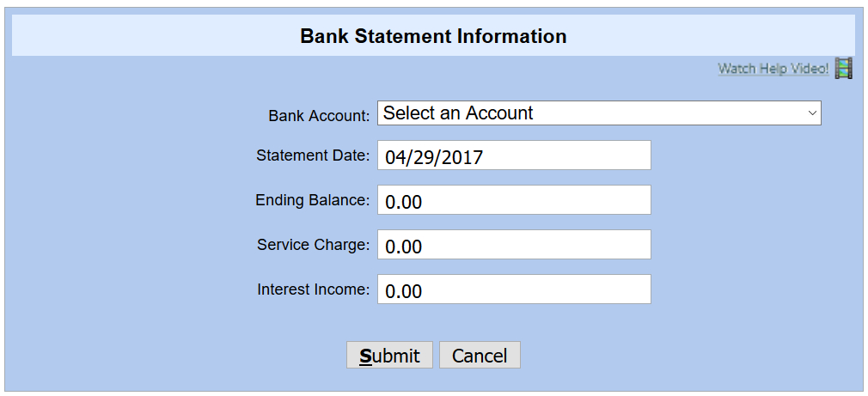
Bank Reconciliation: Connect Now

Slide 33
Bank Reconciliation: Connect Now

Slide 34
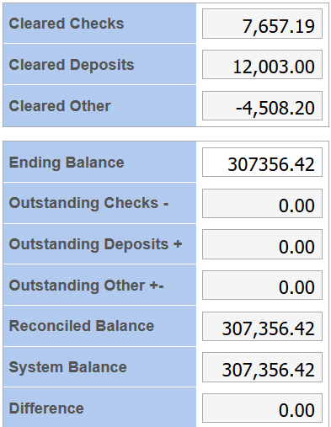
Bank Reconciliation: Connect Now

Slide 35
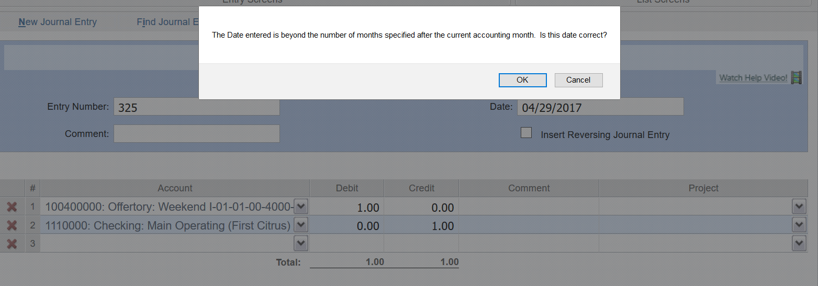
Closing the period: Connect Now

Slide 36
Closing the period: Connect Now

Slide 37
Year-End Closing: Connect Now
Note: All months of the Fiscal Year must be closed prior to End of Year Closing can be completed

Slide 38
Bishop Gregory L. parkes

Slide 39
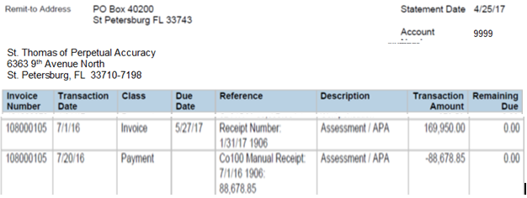
Stewardship conference Parish Assessment Accounting

Slide 40
Stewardship conference Parish Assessment Accounting

Slide 41
Stewardship conference Parish Assessment Accounting

Slide 42
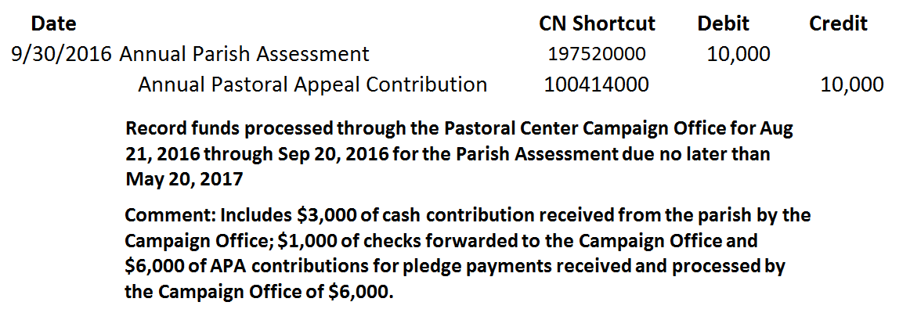
Stewardship conference Parish Assessment Accounting

Slide 43
Stewardship conference Parish Assessment Accounting
Assume:
January 31, 2017 the APA Campaign has fallen $20,000 short of the Parish Assessment due and payable no later than May 27, 2017
Parish leadership has approved payments of $5,000 per month from non-campaign sources.

Slide 44
Parish Assessment Worksheet Schedule
September 15, 2017: Pastoral Center populates worksheet.
By September 26, 2017: Worksheets distributed to parishes via email.
By October 10, 2017:
Review the preliminary Parish Assessment Sheet
Enter proposed changes in Proposed Column 3 Revisions” with a brief “Explanation”.
Submit Worksheet with revisions or approval to financialreporting@dosp.org
Questions:
Tom Heironimus 727.344.1611 tlh@dosp.org

Slide 45
Parish Assessment Worksheet Schedule (continued)
By October 17, 2017: Parishes will receive written response to requests for changes.
By October 28, 2017: Parishes may submit written requests for Administrative Review of their assessment. No requests for adjustment of the assessment will be accepted after this date.
The Annual Assessment and corresponding Annual Pastoral Appeal Goal for each parish will be distributed at a meeting of Pastors and parish Financial Leaders prior to December 15, 2017.

Slide 46
Parish Assessment Worksheet
Includes all General Ledger Revenue included in functional Account Codes 4000 through 4900, Categories and Cost Centers

Slide 47
Parish Assessment Worksheet
Line 2: Amounts recorded in General Ledger Revenue account I-01-03-00-4170-00, Estates & Bequests: Parish, 100417000

Slide 48
Parish Assessment Worksheet
Subsidies and other payments received from the Diocese are to recorded using General Ledger Revenue Function Account Code: 4300 and are deductible from Total General Ledger Revenue
Forward in Faith distributions received by the parish are to be recorded in General Ledger Revenue account I-01-03-00-4300-25, Forward in Faith Distribution, 100430025
FIF distributions are exempt from the Assessable Income calculation

Slide 49
Parish Assessment Worksheet
Line 4, Column 1: Amounts recorded in General Ledger Revenue account:
I-01-03-00-4200-00, Approved Capital Campaign Contributions, 100420000
To be APPROVED Non-Assessable Revenue:
The capital project has been approved in writing by the Bishop’s office
The letter of approval must include a Revenue Exemption from the Parish Assessment

Slide 50
Parish Assessment Worksheet
Line 5: Amounts recorded in General Ledger Revenue account I-01-13-18-4160-01, Donations: Poor Box Collections, 118416001.

Slide 51
Parish Assessment Worksheet
Line 6: Includes parish revenue recorded in functional Account Codes:
4501: Entity Wide Fundraising Revenue
4502: Merchandise Sales
4503: Rental Income

Slide 52
Parish Assessment Worksheet
If the direct costs of fundraising events are recorded as a debit or offset to Gross Fundraising Revenue, enter the total Direct Cost debited to the above Total General Ledger Revenue on Line 7, columns 2. The amount entered will populate see Line 7, column 1.
Best Practice: It is recommended that costs not be recorded as an offset to revenue.

Slide 53
Parish Assessment Worksheet
Line 8, Column 2: Enter the direct cost of entity-wide fundraising events recorded as expense to ConnectNow General Ledger Cost Centers 93 through 96.

Slide 54
Parish Assessment Worksheet
Line 9, Column 3: The amount of the deduction is limited is limited to the lesser of
50% of Line 9, Column 1 or Line 9, Column 2)

Slide 55
Parish Assessment Worksheet
Line 10, Column 1: If you recorded gains or losses reported on your trust statement using G/L Revenue account I-01-03-00-4605-00, Endowment Gains/Losses, 100460500 enter the net amount here in order to exclude them from assessment.
Line 11, Column 1: If you recorded distributions received as a transfer of cash from the trust account to your operating account, enter the total amount here. This amount is assessable.

Slide 56
Parish Assessment Worksheet
The standard revenue exemption for all parishes and missions is $100,000

Slide 57
Parish Assessment Worksheet
Line 13, Column 1: Enter total payments of your Parish Assessment whether donated by parishioners for the current APA Campaign or parish payments made for any shortfall
These amounts are to be recorded in General Ledger Expense account E-01-14-97-5200-00 Parish Assessment 197572000
Note: The amount used for deduction purposes cannot exceed the entity’s actual assessment

Slide 58
Parish Assessment Worksheet
School Support & Tuition Assistance (Line 14, columns 1-3)
The amount to be entered on Line 14, column 1 is the total amounts recorded in the following General Ledger Expense accounts:
E-01-15-98-5210-00, School Assessment: Diocesan, 19852100
E-01-15-98-5215-00, School Support: Trans to Schools, 198521500
E-01-15-98-5220-00, School Support: Tuition Assistance, 198521500
The revenue exemption is limited to a maximum of $100,000 or total school support and tuition assistance payments made, whichever is less.

Slide 59
Parish Assessment Worksheet
Enter on Line 15, column 1 the total amount of loan principal payments made
The interest expense portion of payments made is not deductible
Not all principal reduction payments are deductible. Principal reductions payments on loans for capital projects approved in writing by the Bishop’s office are deductible. Payments on Parish Assessment loans are not deductible.

Slide 60
Parish Assessment Worksheet
Line 16, Column 1: Enter amount collected for faith formation and other parish ministries’ special activities recorded in General Ledger Functional Account Code 4020: Program Income

Slide 61
Parish Assessment Worksheet
Line 17, Column 3: Calculated by deducting from Total General Ledger Revenue (Line 1, Column 3) all amounts included in Line 2 through 16, Column 3

Slide 62
Parish Assessment Worksheet
Assessment Rate calculated by Pastoral Center (Line 18, Column 3):
The established Diocesan Parish Assessment amount ($11,850,000) divided by the Total Assessable Revenue (Line 17, Column 3 for all parishes and missions) equals the Assessment Rate % to be used for all parishes and missions

Slide 63
Parish Assessment Worksheet
Parish Assessment (Line 19, column 3)
Multiply the Assessment Rate % by the parish’s Assessable Revenue to determine the parish’s Annual Assessment and companion Annual Pastoral Appeal goal.

Slide 64
Parish Assessment Worksheet
Effective Assessment Rate as a % of Total General Ledger Revenue (Line 20, column 3)
Divide the parish’s Annual Assessment Line 19, Column 3 by Total General Ledger Income Line 1, column 3 to calculate the Effective Assessment Rate which represents the share of the parish’s total revenue that is to be used to support diocesan-wide ministries.

Slide 65
Human Resources

Slide 66
Listening Session
What are we doing well?
What do we need to improve upon?
What should we be focusing on?

