Slide 1
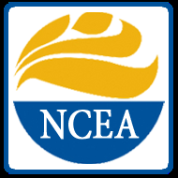
Partnering with Parents to Bring Home the Faith
Copyright Notice:
These materials are copyrighted by the National Federation for Catholic Youth Ministry, Inc. © 2013 and may be adapted for use within the diocese at parishes, schools and institutions. This program and related materials are not to be distributed or used outside the diocese without the express, written consent of NFCYM.
© 2013 by the National Federation for Catholic Youth Ministry, Inc. All rights reserved
Notes:
This PowerPoint is not to be copied or used by anyone except the contracted diocese and their appointed trainers.

Slide 2
Partnering with Parents to Bring Home the Faith
Strong Catholic Families:
Strong Catholic Youth
Parent Session: Living and Sharing Your Faith
© 2013 by the National Federation for Catholic Youth Ministry, Inc. All rights reserved
Notes:
Presenter should have this on in the background as people arrive.
Begin with a welcome and introduce self and your experience as a teen, as a parent and as a LEM in the church.
Introduce the title of the series and the image of the tree reflection – it is symbolic of the family - the deeper and stronger our faith and family roots are, the better and more clear the reflected image will be (our teens and children).

Slide 3
Objectives
To actively explore ways that families can share faith at home.
To offer support and guidance to parents for how they can lead their families toward a stronger faith.

Slide 4
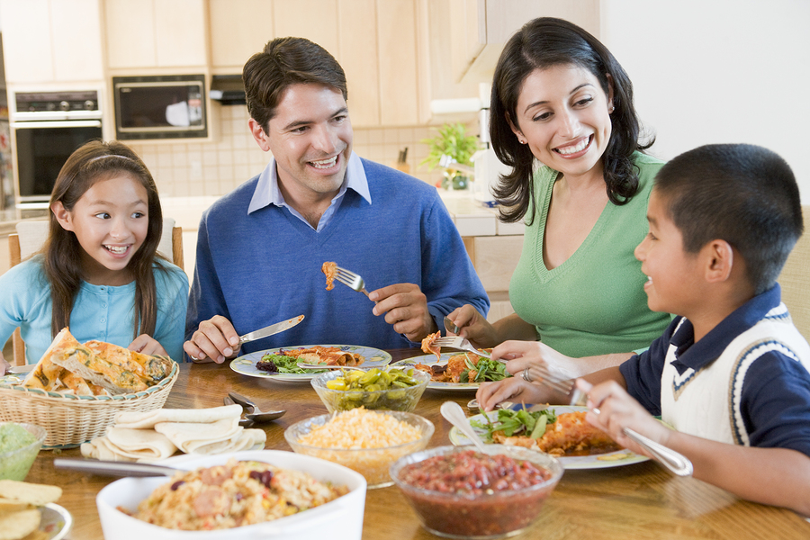
Remember the Parental Mirror
“The single most important influence on the religious and spiritual lives of adolescents is their parents.”
Soul Searching: The Religious and Spiritual Lives of American Teenagers, p 261
Notes:
Remind the parents of the NSYR finding that teens tend to mirror their parents in faith practice so if we begin modeling a Strong Faith, children and teens will be more likely to follow in their footsteps.

Slide 5
Your Family is a Domestic Church
The Domestic Church
Family Life is Sacred
Family Has a Unique Ministry
Family is a Believing and Evangelizing Community
Family Activity is Holy
Notes:
Use the notes below (found in the Family Faith Resource Booklet) to give a brief overview of the “Domestic Church” noting that this is not a new phenomenon, but one that is rooted in the earliest traditions of our faith…
References to the home as being the “domestic Church” are not new. The early church began to grow in and through home churches where extended families would gather to celebrate and share their faith with one another. The Second Vatican Council reclaimed the importance of passing on the faith at home by stating “in what might be regarded as the domestic church, the parents are to be the first preachers of the faith for their children by word and example” (Lumen Gentium, #11).
Pope John Paul II further underscored the important role the home plays in the growth of faith by declaring that “the Christian family constitutes a specific revelation and realization of ecclesial communion, and for this reason too it can and should be called “the domestic Church” (Familiaris Consortio, 58). Most recently Pope Benedict XVI referenced the important role between evangelization and the family, stating that “the New Evangelization depends largely on the domestic Church” (Address of His Holiness Benedict XVI to Participants at the Plenary Assembly of the Pontifical Council for the Family. December 1, 2011.)
So what makes the home a domestic church? There are four truths that families of faith are called upon to illuminate in and through their daily interactions.
1. Family Life Is Sacred—Consider how your family might behave if members actually believed they were stepping into church every time they walked in the door of your home. How much more sacred might the time spent together become? How would differences be reconciled? How would daily events be shared and celebrated? How quickly might we seek peace and healing of the brokenness that often is a part of family life?
2. Family Activity Is Holy—If family life is sacred, then certainly the activity that flows from and through the family is holy. That does not mean we never fall short of expectations, but this truth does remind us that God is always present to and with us, especially as we relate together through our actions and interactions as family.
3. Families Are an Evangelizing Community— Our faith, which is grown and nurtured in the home, is not meant to be confined within the walls of the domestic church any more than it is to be limited to the walls of our parish community. Our faith is to be intentionally shared, through both word and action, with the world. This is known as evangelization and this is a core responsibility of the domestic church.
4. Families Have a Unique Ministry—Just as each person is challenged to discover and use the gifts God has given them for service in the world, so too is each family called to discover its unique ministry. Is your family invited to share space with someone who does not have one, to reach out to an unwed mother, become a home to an orphan, or mentor an at-risk teen? Perhaps your family is called to promote vocations or help catechize others in the faith. Part of living as a domestic church is discerning and find out how God is asking you to “be church” to the world.

Slide 6
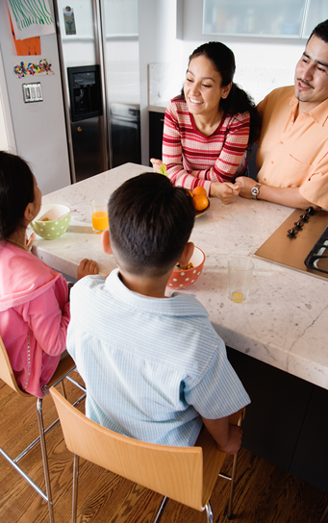
Building up the Domestic Church Building Faith at Home
Through Family and Community
Make Meal Times Sacred
Choose Wisely
Decorate Your Home
Model God’s Love
Connect with Other Parents
Share Your Cross Moments
Notes:
Refer to the Family Faith Inventory they previously filled out (at the first session or prior to this one) and explain that this session will focus on modeling and practicing some faith sharing skills and activities that they can use or begin implementing in their home.
– and let them know that later they will have a chance to contemplate the changes they would like to see occur in their family to grow stronger in faith
Offer a BRIEF example for each of these and invite parents to share their “best practices” with one another if they are currently doing any of this at home. The information below comes from the Family Faith Resource Booklet each family should have….
PRESENTER AWARENESS: Even if a family implements these in their family life, there is no guarantee that their youth will automatically follow through with the same faith practices. There are lots of things in our external world that we cannot control—but we can control how we communicate our faith expression—why we do what we do: home altars, statues, etc.
Family and Community
Recognize the sacredness of a family meal and learn to discover God in the ordinary events of car pools, purchasing groceries, and helping with homework, how God is present and operative. We are swimming in a sea of God’s grace, so seek ways to celebrate and embrace the gifts of life and the grace found in the present moment of family and parish life as well as the life of the larger community.
Make Meal Time Sacred – Establish set days of the week that are set aside as “family meal nights” and ask everyone commit to working their schedules around these sacred times. Use these meals to pray together and share joys, hopes, disappointments, and sorrows. Help bring to life the connection between your home table with the Lord’s Table.
Choose Wisely - The top two memories that your children will remember is how much love was in your home and how much time you spent together as a family. When contemplating schedule or activity additions or changes, ask yourself, “Will doing this activity or turning on this screen strengthen or weaken our family life?”
Fill Your Home with Faith Images – Go shopping at a nearby or online religious store and invite each person to select an item of faith they would like to see displayed in the home somewhere. Also, be sure you have family and youth-friendly bibles around the home and in each person’s bedroom (for a list of recommended bibles, visit the Strong Catholic Family website referenced later in this booklet).
Model God’s Love -Marital love is reciprocal, parental love is intergenerational. The love of parents goes to their children, which is again passed on to the next generation. Our love for one another in our homes should mirror God’s love for all people and all ages, races, and cultures. Be sure that moments of family forgiveness and reconciliation are made visible to the family. Don’t “hide” apologies, let the family members who were witnesses to family conflict, know that the conflict has been worked out.
Connect with Other Parents - Seek out other adults and parents who share your commitment to Catholic parenting. Learn from their stories, strategies, and life lessons. Ask your parish to begin convening a Strong Catholic Family group (live or online) where parents can come together on a regular basis to share, pray, and support one another along this shared journey.
Share Your Cross Moments - “cross moments” are a simple and meaningful way to focus on significant moments during family meal nights or other family gatherings (SHOW NEXT SLIDE). Invite each person to share a time in the recent past (day, week, month) that their lives intersected or crossed with God. In other words, where did they see evidence of the presence of God in their life or in the world recently?

Slide 7
Cross Moments
Notes:
Cross Moments are easy faith sharing option for families - looking back over the past week, find a time when your life intersected with God – seeing God in the here and now.

Slide 8
Building up the Domestic Church Building Faith at Home
Through Prayer and Worship
Develop your prayer life
Pray together
Daily blessings
Eating out meal prayers
Seize the Seasons
Creative family faith sharing
Notes:
Offer a BRIEF example for each of these and invite parents to share their “best practices” with one another if they are currently doing any of this at home. The information below comes from the Family Faith Resource Booklet each family should have….
NOTE: Ask parents for examples and affirm them for what they are already doing at home. Recognize to them that their younger children may be eager to be involved in these practices but pre-teens and teens may resist a little and display feelings of self-consciousness and discomfort. It is important to follow through with faith practices and expressions anyway, even as teenagers start resisting.
Prayer and Worship
Family prayer and worship are central to building a strong Catholic family. Keep in mind that the goal of individual, family or communal prayer and faith sharing is to make the “God connection.” When we share faith with others, we are trying to answer the questions: “Where is God in all of this?” and “What is God saying to me today?”
Take Time to Pray on Your Own – It is very difficult to pray out loud, even with family members, if you do not take time to develop your own prayer life. Take a few minutes in the morning, after dinner or later in the evening to turn off all outside “voices” and to turn on your connection with God. Find a quiet, uninterrupted space and read some scripture, and share with God your concerns, your hopes, and your fears and then be silent and open yourself to God’s reply. If it is helpful, use a journal to write out your reflection during your prayer time.
Pray Together – Think of all the sacred family moments that prayer can be brought into: birthdays, anniversaries, crises, trips, church and civic holidays, car wrecks, achievements, proms, and other occasions large and small. Use traditional prayers such as the rosary or Our Father or the printed prayers and other ideas found in this booklet and invite different family members to lead them.
Offer Daily Blessings – Bless one another on a regular basis by making the sign of the cross on their forehead while saying “May God bless you and be with you”. Do this as a nightly ritual before bedtime and a morning ritual before leaving the home or going on a trip.
Pray Before Meals When You Eat Out – When you eat out as a family, take the time to pause, make the sign of the cross and offer a prayer for the meal you are about to eat. This is a public testimony to your family’s faith and speaks volumes to your family about living your Catholic faith.
Seize the Seasons – Use the liturgical seasons of Advent and Lent as times to grow deeper in faith and to begin a family faith practice such as lectio divina (outlined in the “Formation” section) or praying the rosary. Perform acts of service and sacrifice together as a family and support one another in these efforts so they can be maintained after the season concludes.
Be Creative Prayer with Family Prayer – To engage the minds of young and old alike, use objects or images to help family members connect life with faith. SHOW NEXT SLIDE AS AN EXAMPLE

Slide 9
Pocket Prayer Sharing
Which object best represents my relationship with God right now?
What are some ways I express this faith?
Notes:
Pocket Prayers – Invite everyone to reach into their pocket or purse and place one object on the middle of the table. Then invite each person to think about their relationship with God right now and pick the one object that best describes it. Go around the room (youngest to oldest) and have each person share their reflection.

Slide 10
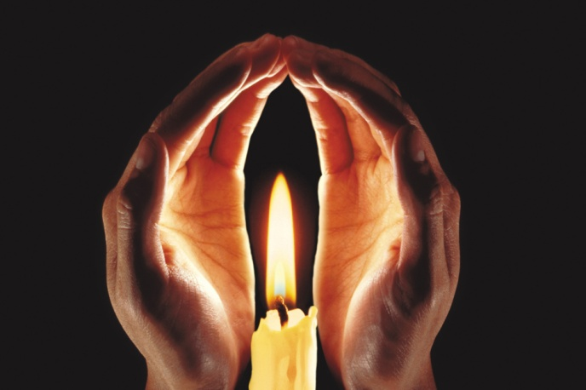
Faith Sharing = Theological Reflection
Our Story
The Story
Faith Growth
Where is God?
Notes:
Explain that these types of prayer experiences are known as Faith Sharing and they simply try to connect our life (our story) with Faith (The Story) so that we are always asking and answering the question, “where is God in all that is happening in my life?”
Review some of the other types of simple but engaging creative faith sharing that can be done in the home Here are just a few ideas for sharing faith using objects and images:
Pocket Prayers – Invite everyone to reach into their pocket or purse and place one object on the middle of the table. Then invite each person to think about their relationship with God right now and pick the one object that best describes it. Go around the room (youngest to oldest) and have each person share their reflection.
Paper Prayers – Distribute sections of the paper (or various papers) to each person in the family and give them time to find a headline or ad that best describes their life right now. After each person shares their reflection, conclude with shared prayer, asking God to be present with each of them in their journeys of life and faith.
Nature Prayers – Invite each person to bring in an object from outside that best describes their family at the moment. Invite each to share (youngest to oldest) and conclude by joining hands and saying the Our Father followed by a Gesture of Peace.
Picture Prayers – Use an old photo album or pictures hanging in the home, invite each person to think of the one image that best reflects their faith right now (or that defines Family or Home or Life right now). Invite each to share and conclude with each person offering a prayer intention.
Cupboard Prayers – Invite each person to select a food item that is in the home (cupboard or refrigerator) that best symbolizes the past week for them. Invite each to share (youngest to oldest) and conclude with spontaneous or traditional prayer.
Pray the Music – Young people find great meaning in their music. Invite your children and teens to play a song that has particular meaning for them and that speaks a message of faith and to share why. This can also be done with films.

Slide 11
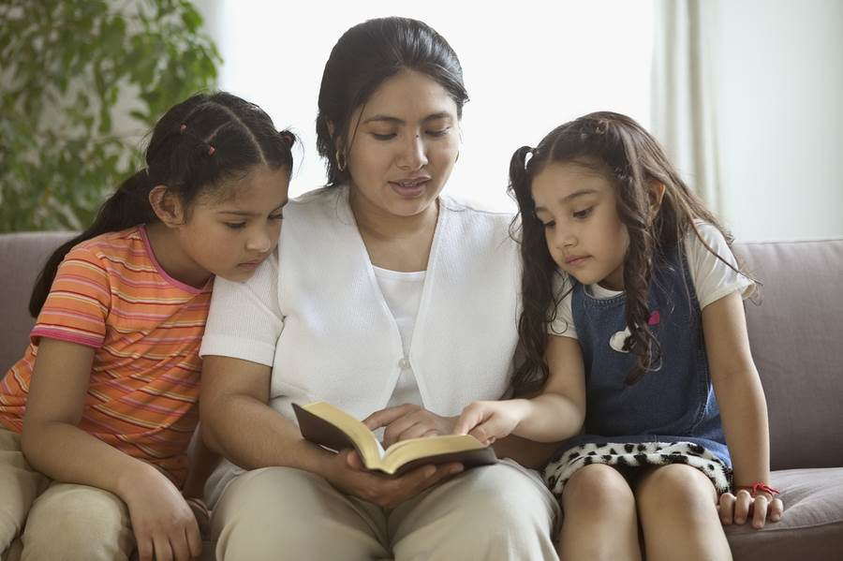
Building up the Domestic Church Building Faith at Home
Through Formation
Support lifelong faith formation
Retreats and other Youth Ministry events
Connecting faith with family stories
Reading and praying with Scripture
Notes:
Offer a BRIEF example for each of these and invite parents to share their “best practices” with one another if they are currently doing any of this at home. The information below comes from the Family Faith Resource Booklet each family should have….
Formation
Our church documents are clear that parents are the primary catechists or teachers of faith for their children. Seek ways to pass on a living and active faith to your children and teens and to partner with the parish (and Catholic school if applicable) in supporting a lifelong journey of faith that is modeled throughout all generations within the family.
Expect to Pass on the Faith – Evangelization means to share the good news of our faith with others. In order to meet this expectation we must first name and claim the faith for ourselves. No one ever graduates from “faith formation” – it is a life long journey. Therefore, be sure that every family member is involved in some way of growing in their own faith. Parents who participate in adult bible studies, retreats, adult formation programs or serve as catechists and sponsors can’t help but pass along this updated and re-energized faith to other friends and family members.
Think of what other rituals and actions of our faith that you can begin to teach or reinforce such as:
the sign of the cross
basic prayers
Genuflecting
using holy water
fasting/abstaining
participating in Mass
Support Retreats and Youth Ministry Efforts – Expect that your teens will participate regularly in parish youth ministry and faith formation activities, especially retreats and mission trips which are known to bear great fruit in the faith growth of young people. Support these and other efforts often with your time, your prayers and perhaps, even your gifts or leadership.
Family Storytelling -It was no accident that Jesus used stories to communicate great truths and deep wisdom. Great wisdom, values and meaning can often be brought to life through our family stories. Recall some of the significant family events and stories (or watch old videos of these special moments) and ask family members to reflect on what these have taught each of them about God’s love, God’s forgiveness, and the meaning of suffering and grace?
Reading and Praying with Scripture at Home – (SEE NEXT SLIDE)

Slide 12
Praying Scripture
Lectio Divina (Divine Reading)
Word of God word (1 word)
Word of God words (1 phrase)
Word of God prayer (reflection on what God is saying to you)
Notes:
This simple three step adaptation of an ancient monastic prayer form called Lectio Divina (divine reading) involves reading a short scripture reading three times (preferably a section from one of the upcoming Sunday readings). Each time there is a different response that takes the person deeper into the reading. It is suggested that every person have a bible of the same Catholic translation such as the New American Bible (NAB) which is the translation used at Mass or the New Revised Standard Version (NRSV) .
1. Proclaim the reading – Pause – Invite each person to share one word that speaks to them (no other sharing at this time).
2. Proclaim the reading – Pause – Invite each person to share one phrase that speaks to them (no other sharing at this time). The phrase does not need to include the word from the first step.
3. Proclaim the reading – Pause – Invite each person to share what God is saying to them through this reading.
Now let’s practice it….

Slide 13
2 Timothy 4:1-4 (NRSV)
“In the presence of God and of Christ Jesus, who is to judge the living and the dead, and in view of his appearing and his kingdom, I solemnly urge you:
Proclaim the message;
Be persistent whether the time is favorable or unfavorable;
Convince, rebuke, and encourage; with the utmost patience in teaching.
For the time is coming when people will not put up with sound doctrine, but having itching ears, they will accumulate for themselves teachers to suit their own desires, and will turn away from listening to the truth and wander away to myths.”
Notes:
Use this reading and the lectio divina process in small groups of 3-5 to show how it’s done.
1. Proclaim the reading – Pause – Invite each person to share one word that speaks to them (no other sharing at this time).
2. Proclaim the reading – Pause – Invite each person to share one phrase that speaks to them (no other sharing at this time). The phrase does not need to include the word from the first step.
3. Proclaim the reading – Pause – Invite each person to share what God is saying to them through this reading.

Slide 14
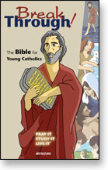
Bibles, Bibles and More Bibles…
Which One is Best For Us?
NAB – New American Bible
The version used at Mass
Lots of footnotes, great study bible
NRSV – New Revised Standard Version
More inclusive language
Easier reading for personal use
GNT – Good News Translation (Catholic Edition)
Most “modern” translation
Best for children/young teens
Notes:
If needed, offer a quick review of the different Catholic bibles.
Listed are three of the most popular versions used with families and teens today. Note that there are more versions and more bibles available but that these three are particularly well developed for use in family gatherings and personal prayer and reflection.
For specific recommendations on user-friendly bibles for families and teens, have them visit our Family and Parent website.

Slide 15
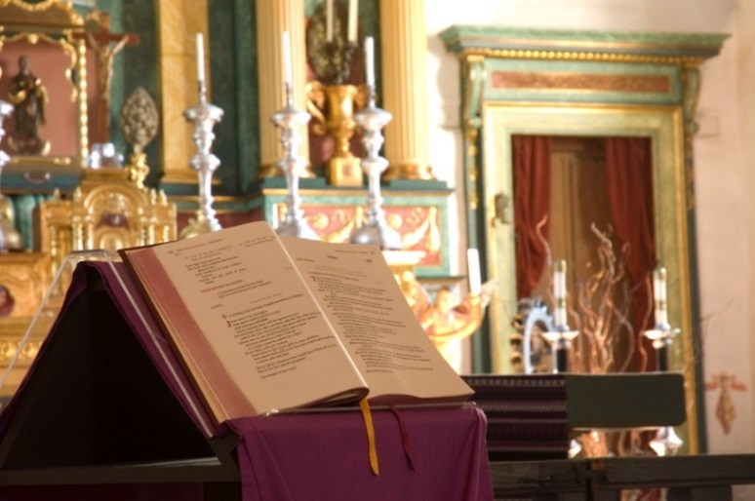
Building up the Domestic Church Building Faith at Home
Through Justice and Service
Serve together at the parish
Connect with the larger community
Embrace suffering, loss and death with faith
Differentiate between wants and needs
Use a Catholic lens
Notes:
Offer a BRIEF example for each of these and invite parents to share their “best practices” with one another if they are currently doing any of this at home. The information below comes from the Family Faith Resource Booklet each family should have….
NOTE: This may be an opportunity to raise awareness with the audience on how they can help out at home, neighbors, and their general local area—we, as Catholics, are known to live out our faith through acts of service and justice.
Justice and Service
There are many needs both within the parish as well as the larger community and our faith demands that we do what we can to feed the hungry, shelter and clothe the homeless, visit the sick and imprisoned and care for the marginalized. Seek opportunities to perform these works of mercy both individually and as a family in your neighborhood, church, or other organizatioan. These acts of self-giving show living faith in action and are an essential element of discipleship.
Minister Together – Expect that each person in the family will be involved in some ministry at the parish, with the higher goal of serving together with another family member. Perhaps mother and daughter can serve as lectors or father and son can serve as a catechist and aid or the whole family can serve as hospitality ministers/ushers on a regular basis. Reflect on the gifts each member has and help them discern the best place to use those gifts for the life and mission of the parish community.
Reach Beyond the Parish to Serve – Seek ways to participate together as a family in community service, perhaps working together at a homeless shelter, spending a Saturday morning doing Meals on Wheels or “adopting” a family in need around each of the holidays.
Embrace Suffering, Loss and Death - Just as Jesus experienced life, death, and resurrection, so too do parents and children. When we deny pain, struggle, disappointment, and loss it deprives our children of essential lessons about love, suffering, and the meanings of life and death. Visit the grave of a family member or attend a funeral together as a family and allow these moments to provoke a conversation about life, death, resurrection and eternal life - the very basis for our Catholic faith.
Teach the Difference between Wants and Needs - Be wary of giving many material things to your children. It can kill initiative and create expectations that lead to selfishness. Work together as a family in discerning whether something is a “want” or a “need” and what difference obtaining it will make both individually and in the life of the family. Before something is obtained or bought, have family members look through the home for what can be given back or traded in (i.e.: donated) to keep material items to a minimum.
Use a Catholic Lens in Your Family Discussions – When discussing current events and tough decisions, be mindful to incorporate what perspective our Catholic faith and values will shed on the discussion. To treat others as we wish to be treated, to forgive generously, to uphold the sanctity of all life from womb to tomb, to note the special care we are called to show for the poor, marginalized and the oppressed, and to treat all of our brothers and sisters around the world with respect and dignity are important lenses to use and name when we hold family discussions or enter into family problem solving.

Slide 16
Connecting Faith/Life: Levels of Faith Practice
3. Leadership * Become a catechist or sponsor * Live faith/values at work and home * Leading daily prayer and faith sharing at home * Apprentice teens
2. Involvement: * Community Service * Serve together in ministry * Bible Study * Faith Sharing * Youth Ministry and Faith Formation
1. Presence: * Attend Mass * Pray at meals * Read Scripture * Display religious art
Notes:
Connecting Faith with Life – Levels of Faith Practice
Bottom line to growing in faith as a family is to Get Involved connecting your faith with the life of the parish and the larger community (Refer to Gallup Research which says “Belonging Leads to Believing”)
Highlight three levels of living out faith, each one taking you into a deeper engagement with the faith community and in sharing your faith with others.
Presence
Involvement
Leadership
Start at the level you are most comfortable and work your way to deeper engagement as you grow in your own faith.
Highlight any opportunities at the parish where parent and teen can serve together and be sure to have the contact info and process they need to go through to get involved.
NOTE: Families are to be encouraged to do what they can and not necessarily try everything at once. This slide illustrates what active involvement could look like and where it leads to connecting faith with life.

Slide 17
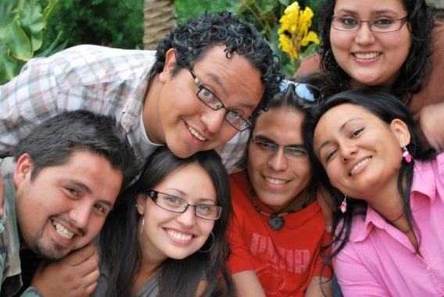
The Website for Developing
Strong Catholic Families and Youth
www.strongcatholicfamilies.org
Understanding Youth Culture
Our Catholic Faith
Parenting and Family Life
Multicultural Reality and Gift
Resources and Research
Notes:
This is an overview of the NFCYM’s Parent and Family page which is being updated regularly as a resource specifically for parents.
If parents have not completed a Parent to Parish Response form, please allow them time to do so now so they can turn it in prior to leaving.

Slide 18
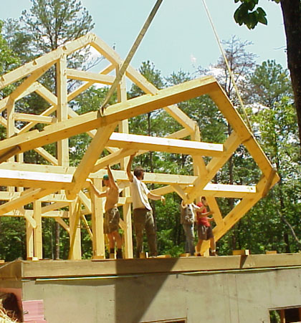
Five Critical Implications for Building Strong Catholic Families
First Decade of Life is Critical
Parents Need to Live Faith Out Loud
Prayer IS the Answer!
Integrate Faith AND Religion
God IS Good (All the Time)!
Developed by Sean Reynolds, Archdiocese of Cincinnati
Notes:
IF time allows, use this information to do an ending summary of the critical findings from the NSYR research covered in the first session.
If time is running out, SKIP THIS SLIDE AND CONCLUDE WITH A PRAYER FROM THE FAMILY FAITH RESOURCE BOOKLET.
From the NSYR and Souls in Transition Research, There are 5 Critical Implications for All We’ve Talked About…
1. First Decade Focus: The foundation of a life of faith is laid (or not) during the first decade of life. Conclusion: Ministry with young parents and families must be a top priority, equipping them to do what only they have the power to do: shape their children firmly in faith, prayer and church.
2. High-Impact Parents: Those parents who are living their faith “out loud,” modeling it, talking about it, loving it and doing so generously, genuinely and wholeheartedly instill faith in their kids. Conclusion: We not only need to equip parents to share faith with their children, we need to help them find fire for their own faith, prayer and spirituality.
3. Powerful Prayer: An active personal relationship with God in prayer is key to kids sticking with their faith into their twenties. Conclusion: Provide powerful prayer experiences and help young people learn the habits and skills of regular, frequent personal prayer.
4. Faith AND Religion: The research makes clear that without active religious involvement, faith fades away. Conclusion: Make sure that faith is a strong, family priority, certainly at home but also at church. That means not only participation in Sunday Mass, but also lots of other church-based opportunities so that faith and religion become an indispensable part of their lives.
5. Our God is Good (All the time)!: An abstract, distant, dry or passionless faith lacks staying power. Conclusion: Help our young people experience the miracles of grace and God’s abundant, awesome love. Vibrant experiences of faith, prayer, worship and community are absolutely essential…ALL THE TIME!

Slide 19
Partnering with Parents to Bring Home the Faith
Strong Catholic Families:
Strong Catholic Youth
Parent Session: Living and Sharing Your Faith
© 2013 by the National Federation for Catholic Youth Ministry, Inc. All rights reserved

