Slide 1
Accreditation A New Direction
Florida Catholic
Conference
National Standards
and Benchmarks

Slide 2
An explanation of the Catholic Standards and Benchmarks for Effective Elementary and Secondary Schools.
The link below takes you to a 7 minute video by Elizabeth Fulham. The purpose of the video is to provide a clear and simple explanation of the FCC accreditation program to parents. Schools are advised to show this video as they are beginning the CIPA process. Staff members can also benefit from the information.
https://www.dropbox.com/l/LAjsgxzk4VFhZZdPuiJEJf

Slide 3
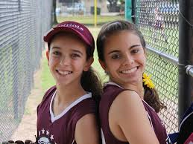
WHAT IS Accreditation?
Accreditation is a means for…
a school to determine their compliance with a specific set of standards and benchmarks
determining strengths and opportunities for growth
based on evidence.
planning for improvement.

Slide 4
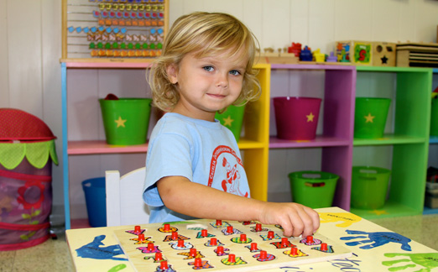
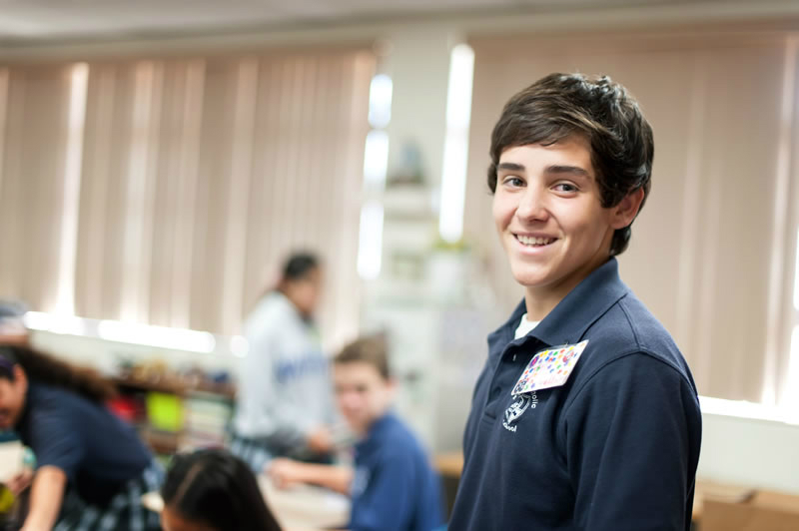
Implementing the National Catholic Standards and Benchmarks into the School Improvement Plan MAKES OUR SCHOOLS STRONGER.
Diocese of St. Petersburg

Slide 5
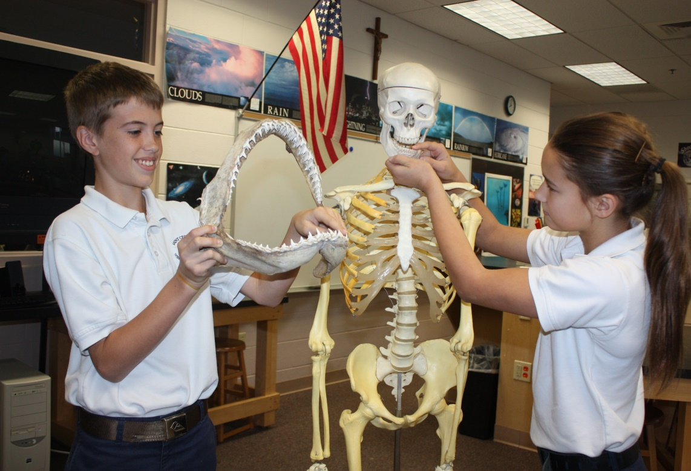
National Catholic Standards and Benchmarks 13 National Standards 70 Benchmarks
Standards 1-4 Mission and Catholic Identity
Standards 5-6 Governance and Leadership
Standards 7-9 Academic Excellence
Standards 10–13 Operational Vitality

Slide 6
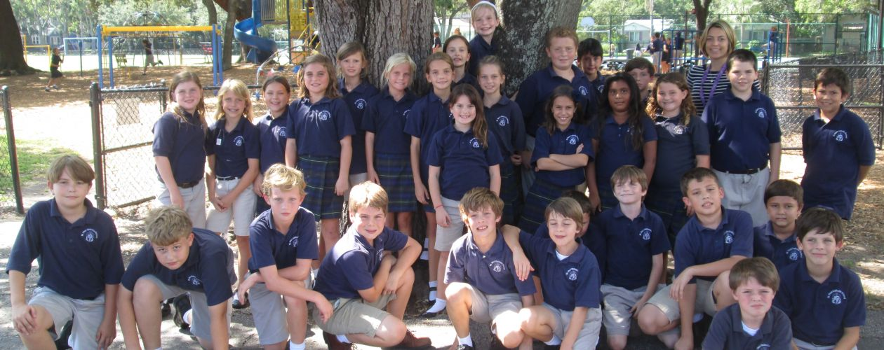
Continuous Improvement
Process for
Accreditation
(CIPA)
We’re worth it!

Slide 7
Key Changes SINCE YOUR LAST FCC VISITATION
Four-point scale rubrics to self-assess school performance.
Schools must provide evidence of performance
Larger Action Plan with more measurable goals and a realistic timeline for implementation
ARCA – Based on Catholic School Standards
First and Third Year Reviews -
Higher accountability for entire staff
Full staff participation

Slide 8
SURVEY CHANGES
Previously used surveys replaced by the surveys developed for the Catholic School Standards Project.
Defining Characteristics for staff, parents, & students
Program Effectiveness for staff, parents, & students
Staff survey : 59 questions
Parent survey: 59 questions
Students 5 - 8: 30 questions
Students 9 – 12 52 questions
ONE SURVEY

Slide 9
Surveys
There is one survey for parents, one for staff, and one for students in grades 5-8 and High School. The parent and staff survey are identical.
One survey, given in the beginning of SIP, covers the entire SIP process.
The survey will include questions that relate to each area.
Your school must have a Survey Monkey account.
When you are ready to receive your surveys, send the name of your school Survey Monkey account to Mary Camp.
Once your school receives the survey from Mary, it is editable. You may add specific questions that you would like to ask.
Surveys will be free.

Slide 10
WHERE DO WE BEGIN?
Establish your Committees

Slide 11
The Steering COmMittee Who are they and what do they do?
The leadership team for the entire CIPA process from beginning to end. The SC administers the survey, oversees all the committee work, facilitates staff meetings, communicates progress to all stakeholders, and writes the action plan based on evidence as well as input from stakeholders.
The Steering Committee should have two Co-Chairpersons.
The four domain chairpersons should also serve on the Steering Committee.

Slide 12
Domain Committees:
Mission and Catholic Identity
Governance and Leadership
Academic Excellence
Operational Vitality
Each Committee
has
a Chairperson

Slide 13
WHAT DO THE DOMAIN COMMITTEES DO?
Each domain committee focuses on the domain they have been assigned, such as Mission and Catholic Identity.
The committee meets as a group to discuss each specific benchmark within the domain. Their primary job is to look at the rubric scores and evidence from the ARCA and come to consensus on whether they agree or disagree with the rubric scores.
Committees will share with the staff the rubric scores and evidence for their domain, while remaining open for further questions, and suggestions. Changes are often made after a faculty discussion has taken place.

Slide 14
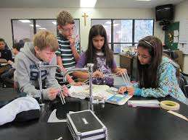
CIPA
Crucial parts of the CIPA are the discussions that take place between faculty and staff members as they determine the school’s level of compliance.

Slide 15
Domain 1 Examples
2.6 Catholic culture and faith are expressed in the school through multiple and diverse forms of visual and performing arts, music and architecture
3.2 Every student is offered timely, regular, and age- appropriate opportunities to reflect on their life experiences and faith through retreats and other spiritual experiences.
4.5 Every administrator, faculty, and staff member visibly supports the faith life of the school community

Slide 16
DOMAIN 2 EXAMPLE
6.3 The leadership team takes responsibility for the development and oversight of personnel, including recruitment, professional growth, faith formation, and formal assessment of faculty and staff in compliance with diocesan policies.

Slide 17
DOMAIN 3 Examples
7.4 Curriculum and instruction for the 21st century learning prepares students to become expert users of technology, able to create, publish, and critique digital products that reflect their understanding of the content and their technological skills.
7.6 Classroom instruction is designed to engage and motivate all students, addressing the diverse needs and capabilities of each student, and accommodating students with special needs as fully as possible.

Slide 18
DOMAIN 3 Examples
7.7 Faculty collaborate in professional learning communities to develop, implement and continuously improve the effectiveness of the curriculum and instruction to result in high levels of student achievement.
7.10 Faculty and staff engage in high quality professional development, including religious formation, and are accountable for implementation that supports student learning.

Slide 19
DOMAIN 4 EXAMPLE
13.1 The marketing plan requires school leaders and staff to insure the implementation of contemporary, multiple information technologies to reach targeted audiences, and to establish reliable and secure databases and accountability to stakeholders.

Slide 20
Key Parts of the Process
Review Standards and Benchmarks - everyone
Analyze student data to use as evidence - committee
Compare survey results between staff, students, and parents. Use as evidence. S.C.
Score the rubrics and provide evidence. Domain Committees
Staff agrees as to where the school is on the rubrics and provides evidence to back it up.
Update your Action Plan – S.C
Communicate to stakeholders - Administration

Slide 21
Principal
Executive Summary: A brief overview of what has been accomplished since the last accreditation visit.
Domain Reports: Each domain requires a paragraph that summarizes strengths and areas to improve

Slide 22
DON’T UNDERESTIMATE THE IMPORTANCE OF YOUR ACTION PLAN
The school Action Plan will serve as your roadmap for the future. It will guide future decisions and assist you in documenting progress.

Slide 23
Sample Action Plan GOAL
Goal 1
St. Michael Catholic School faculty will use Catholic intellectual tradition to help students think critically about the world around them. Eighth graders will demonstrate an improved understanding of Catholic intellectual tradition and seventh graders will demonstrate an improved ability to debate by the spring of 2020 (2.5)

Slide 24
Sample Action Plan GOAL
Goal 2
St. Gregory Catholic School will update our facilities management and technology plans so that we have an integrated set of planning documents that will enable the school to better use our resources. Through implementation of a new integrated plan, there will be a cost savings of 2% by 2018 and the ability to add $20,000 to upgrade technology in 2017. (12.1)

Slide 25
Action Plan
Goal Statement (includes specific audience, measurable change, and time frame)
Evidence (List of evidence that will be used to document and evaluate the success of the goal)
Strategy Timeline Person Responsible Resources
Teachers will…
Students will…

Slide 26
WHAT TO EXPECT DURING THE FCC VISITATION

Slide 27
During the Visitation
Team members are provided with the CIPA report and Action plan approximately six weeks prior to arriving for the visit. Upon arrival, the team will begin to discuss the information that was provided to them.
Classroom observations and parents, student, and faculty interviews are also used to validate the benchmark ratings and action plans.
A team can always ask for more or specific evidence.

Slide 28
During the Visitation
Meet with Pastor, Administration, Staff, Parents, and Students
Observe each classroom for 10 to 20 minutes to validate level of compliance with specific benchmarks:
Mission statement visible 1.4
Catholic Culture visible 2.6
Role Model 3.4 / supports faith life 4.5
Instruction allows students to become evaluators, problem solvers, decision makers 7.3
Instruction prepares students to be excellent users of technology 7.4
Instruction addresses affective dimensions 7.5
Instruction engages and motivates all students 7.6

Slide 29
Reviewing the Action Plan The team will discuss the following
Are the goals specific and measurable?
Will the evidence demonstrate success of the goal?
Are a timeline, person responsible, and resources listed for the steps?
Taken as a whole do the steps lead toward success of the goal?

Slide 30
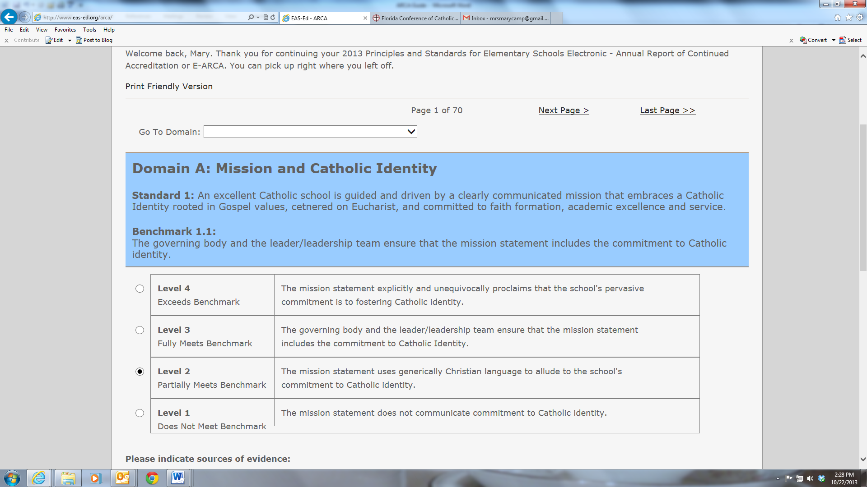
WHEN YOU ARE READY TO REPORT Work is completed online: www.eas-ed.org Login to see the school ARCA and forms.
Level of Compliance

Slide 31
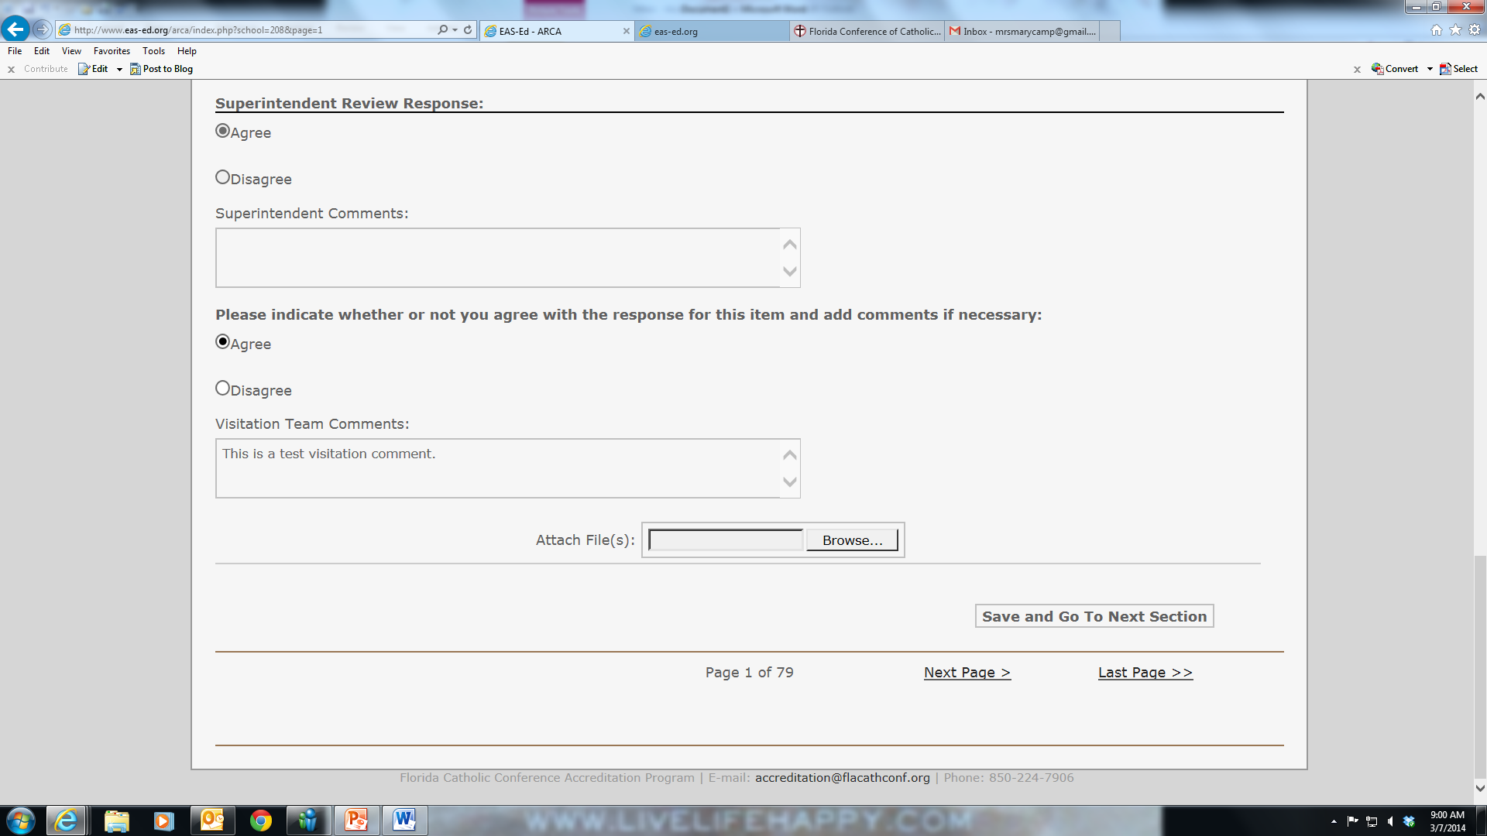
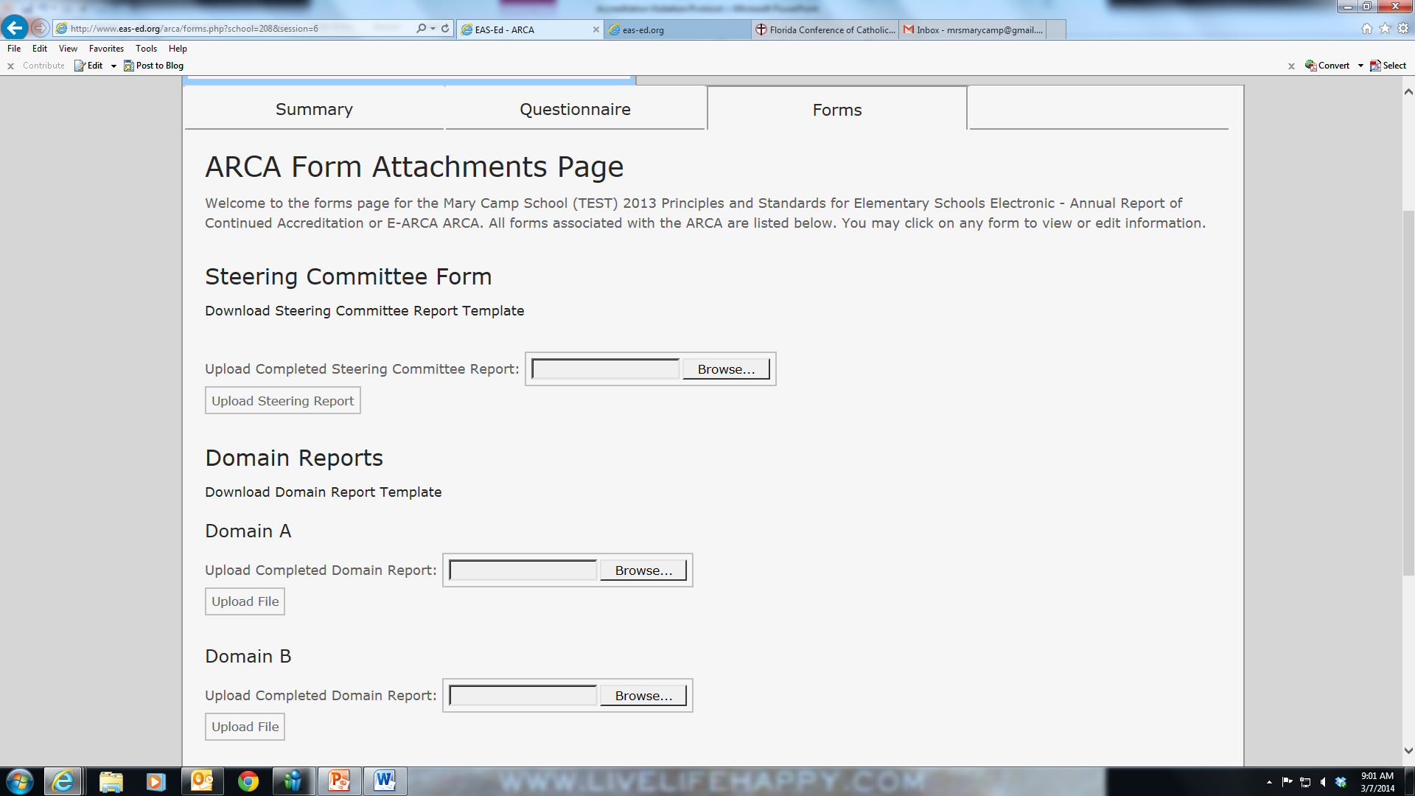
Completing the Report
The visitation report is the team’s response on each benchmark and a form that is uploaded on the Forms tab regarding the action plan and general comments.

Slide 32
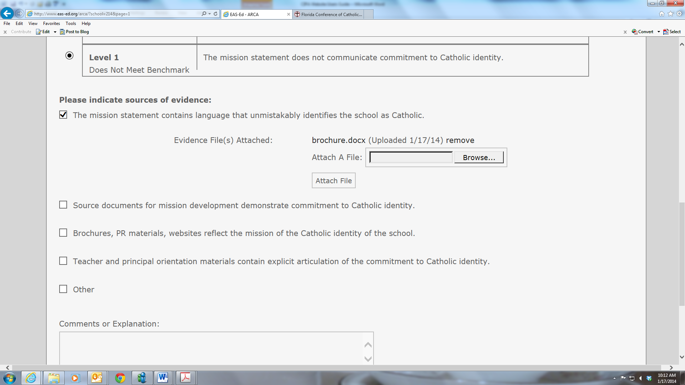
EAS-ED.ORG

Slide 33
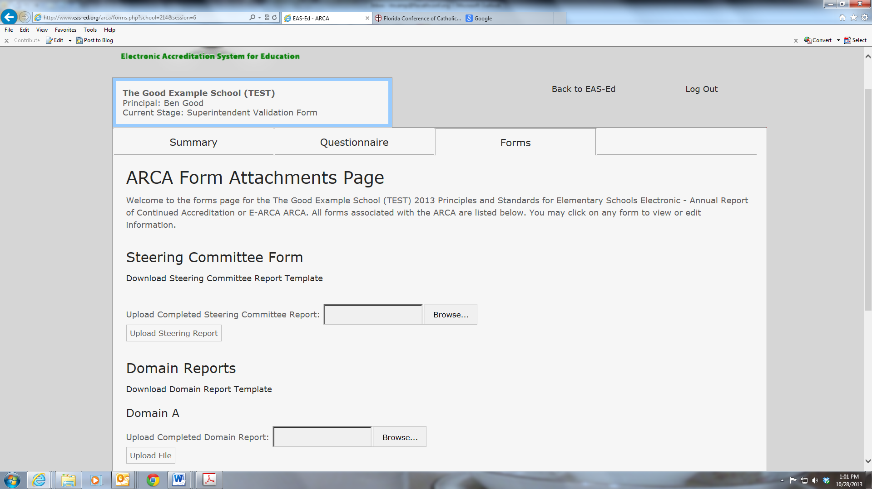
CIPA

Slide 34
YOU ARCA DUE DATE WILL BE DIFFERENT
You will not submit the ARCA the year prior to your FCC Visitation.
Your ARCA will be submitted 6-8 weeks prior to your FCC Visitation.

