Slide 1
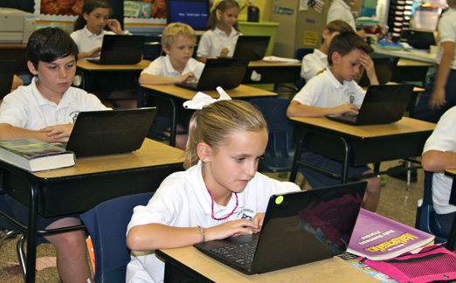
Chairing a Florida Catholic Conference Accreditation Visitation

Slide 2
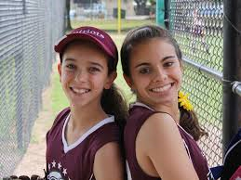
The Purpose of the Visit
Validate the school’s compliance with the benchmarks.
Is there enough evidence to support the rubric scores? Does the team agree or disagree with the scores?
Validate the Action Plan.
Does the Action Plan align with the needs of the school according to the evidence/lack of evidence, surveys, and interviews.

Slide 3
5-6 Weeks Prior to Visit: Call the Superintendent or Associate to Discuss the following:
Introduce yourself as Chairperson for one of his/her schools.
Discuss the fact that you are in the process of reviewing all of the CIPA materials, rubrics and evidence, and wanted to know if the Superintendent had any concerns or questions about the upcoming visit.
What materials will be reviewed by the diocese prior to the visit?
Clarification needed regarding diocesan policy and expectations
How will the Superintendent or Associate participate in the Visitation?
Contact the school administrator to set the date for the pre-visit conference and confirm when you should expect to receive the CIPA materials

Slide 4
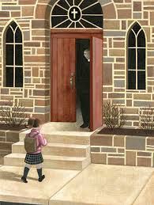
4-5 Weeks Prior To Visit Pre-Visitation Conference Call or Site Visit with Principal
General discussion on rubric scores and evidence
Review the Action Plan
Review the Visitation Schedule
Discuss Travel, lodging, and
meal plans

Slide 5
How to view the CIPA materials for the school you are visiting
Login on EAS-ed as you normally would.
Click on Visitations on the right-hand side of the dashboard.
Click on the name of the school.
Click on View ARCA. The school's rating for each benchmark, evidence, and comments are on the Questionnaire Tab and the Steering and Domain Committees Reports are on the Forms Tab. Full details are in the Chairperson Guide and the Visitation Handbook.

Slide 6
Chairperson’s Responsibilities
Contact the team members
Be sure they know how to access the CIPA materials
Assign specific standards and benchmarks for each team member to focus on. Assign grades for classroom observations and meetings with specific people.
Share the schedule for the visit, or tell them you will send it to them shortly.
Review all the CIPA materials (Rubrics and evidence)

Slide 7
The Visitation – Team Responsibilities
Review the CIPA documents and evidence
Review the rating and evidence for each benchmark. As a team, determine validation and comments/suggestions.
Observe each classroom for 10 to 20 minutes to validate level of compliance with specific benchmarks: Use classroom observation worksheet
Agree on how to complete the Visitation Report (The Chairperson’s responsibility)
Plan and execute a meaningful exit report

Slide 8
Documents to Review Clarify with the Superintendent which items will be reviewed by the diocesan office. Divide items between team members
Schedules (2.2, 14.7)
Professional Development Plan (7.10)
Tuition / Registration information (10.7)
Facilities, Equipment, and Technology Management Plan and budget for this (12.1-12.3)
Marketing Plan (13.1)
Enrollment Management Plan (13.2)
Development Plan (13.3)
Health Plan (14.1)
Health Records – random check (14.2)
Inspection Forms (14.3)
Safety Plan (14.4)
Nondiscrimination statement – posted or in handbook, bulletin, etc. (14.6)
School Year Calendar (14.7)
Entry Age Policy (14.8)
Student Records – random check (14.9)

Slide 9
Sample Schedule Day 1
Team arrives the evening before the visit and has an introductory meeting.
7:30 am Arrival at school / Introductions / Tour
8:30 – 9:15 Morning Meet with steering committee co-chairs for clarifications
9:15 – 9:45 Brief team meeting
9:45 – 11:00 Observations
11:00 – 12:30 Team work sessions
12:30 – 1:30 Afternoon Observations
Meet with Pastor; Students
3:30 – 4:15 Meet with teachers
Team work sessions
Evening Team dinner and work

Slide 10
Day 2
8:15 – 9:00 Meet with Parents
9:15 Meet with Pastor
9:45 – 10:30 Meet with Students
10:30 – 11:30 Continue observations / meetings as needed
Morning Talk with Diocesan Schools Office
12:15 Dismissal
12:45 Exit Report
Exit Report

Slide 11
Team Members Responsibilities
Review CIPA materials and other assigned documents
Identify questions, concerns or items needing clarification
Classroom observations
Meet with pastor, administration, staff, students, and parents to validate level of compliance with specific benchmarks.
Review the Action Plan: Do the goals align with the needs of the school according to rubric scores, interviews, and surveys?
As a team determine validation and comments/suggestions.

Slide 12
Classroom Observation Form
Classroom: | Yes | No | Comments
1.4 Mission Statement Visible
2.6 Catholic Culture Visible
4.5 Evidence of supporting faith life
7.3 Instruction allows students to become evaluators, problem solvers, decision makers
7.4 Instruction prepares students to be excellent users of technology
7.5 Instruction addresses affective dimensions
7.6 Instruction engages and motivates all students
Types of student work
Type of instruction

Slide 13
Reviewing the Action Plan
Are the goals specific and measurable?
Will the evidence demonstrate success of the goal?
Are a timeline, person responsible, and resources listed for the steps?
Taken as a whole do the steps lead toward success of the goal?

Slide 14
Final Report
Exactly like ARCA
Click agree/disagree with each benchmark.
Make comments as appropriate.
Chairperson has access to school’s ARCA on-line and the report will be viewed by Mary Camp when completed
A few highlights from each Domain, including some of the recommendations and some of the comments from the stakeholder meetings A few comments regarding the Action Plan, including some of the recommendations Appreciation for hospitality

Slide 15
Completing the Exit Report
Each team member presents their Domain to the team
Discussion on any benchmarks where the team member does not agree with the school
Comments are made on all “disagree” marks; Comments may be made on “agree” marks
Team makes any comments or recommendations for the action plan and any general comments not covered else where

Slide 16
Completing the Visitation Report
Login on www.eas-ed.org.
On the right-hand side of the dashboard, click on visitations. Then click on Blessed Trinity. Click on view ARCA. Click on the Questionnaire tab.
At the end of each benchmark click agree or disagree and write any comments you have in the comments boxes.

Slide 17
Visitation Team Addendum to Report
School Name:
Action Plan – Please describe any comments, recommendations, or commendations to the action plan here:
Executive Summary – Please describe any comments, recommendations or commendations to the executive summary here:
If the team has any other comments to make, please write them here:

Slide 18
Stipends and Travel Reimbursement
The school reimburses the visitation team members for any travel and lodging expenses incurred. The automobile mileage reimbursement rate used is the rate of the school’s diocese. The school gives each team member an honorarium of $175 and the chairperson $350. Each team member completes a voucher form during the visitation and the school gives them a check before they leave.
FLORIDA CATHOLIC CONFERENCE
VOUCHER FORM FOR VISITATION TEAM MEMBERS AND CHAIRPERSON
NAME ________________________________________
DATE _________________________________________
SCHOOL VISITED _______________________________
TRAVEL:
CAR _____________________________ (Submit receipts)
PLANE ___________________________
OTHER ___________________________
MEALS ________________________ (Submit receipts)
HONORARIUM (In addition to reimbursement for travel, lodging, and meals, the school provides an honorarium to each team member as follows.)
Chairperson: $350.00
Team Member: $175.00
_______________________________________
(Signature of Team Member)

