Slide 1
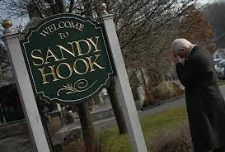
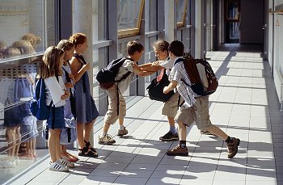
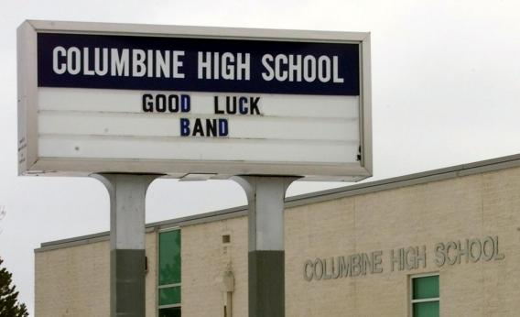
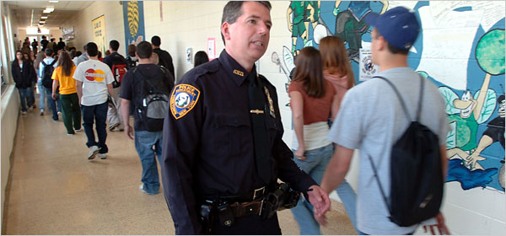
CRITICAL INCIDENT RESPONSES IN SCHOOL
“DEFINING, DECIDING AND DOING”

Slide 2
Curtis Lavarello, Executive Director School Safety Advocacy Council E-MAIL – RESOURCER@AOL.COM
SCHOOL SAFETY
“DEFINING, DECIDING AND DOING”

Slide 3
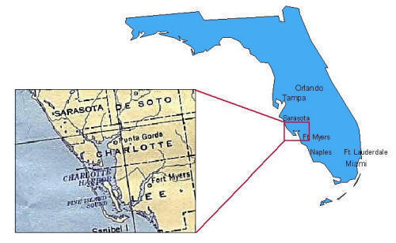
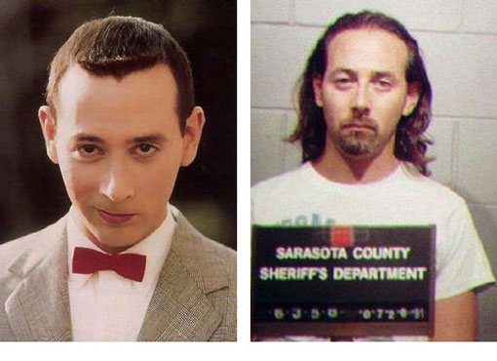
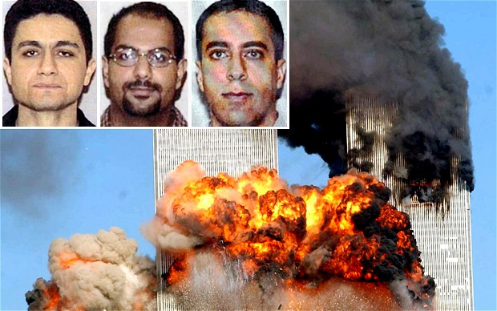
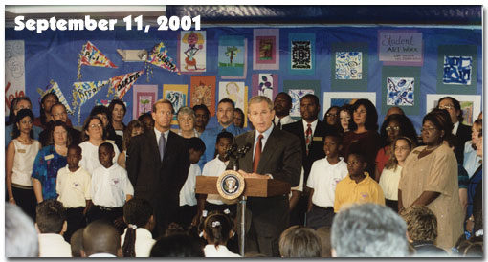
Sarasota, FL

Slide 4
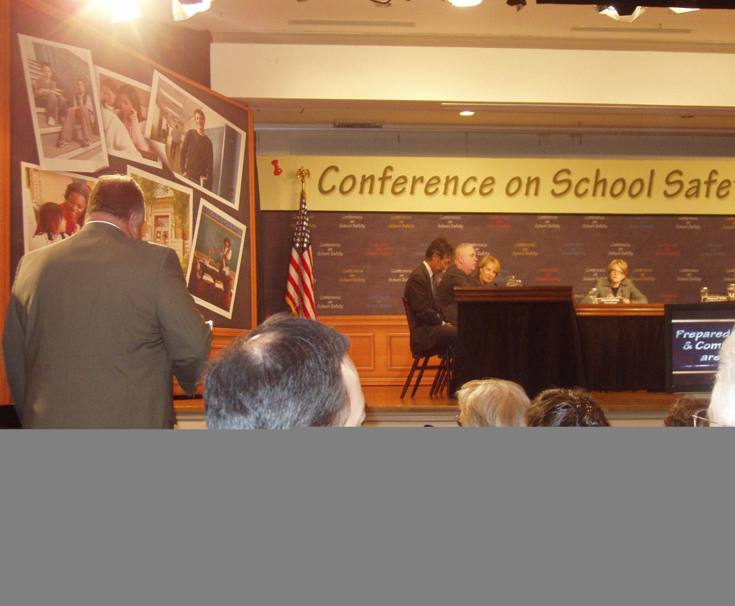
SCHOOL SAFETY ADVOCACY COUNCIL
ADVOCACY / LOBBYING AND SUPPORT
TRAINING
SCHOOL SAFETY / CLIMATE ASSESSMENTS

Slide 5
SCHOOL SAFETY
“DEFINING, DECIDING AND DOING”

Slide 6
HAPPIEST PLACE ON EARTH

Slide 7
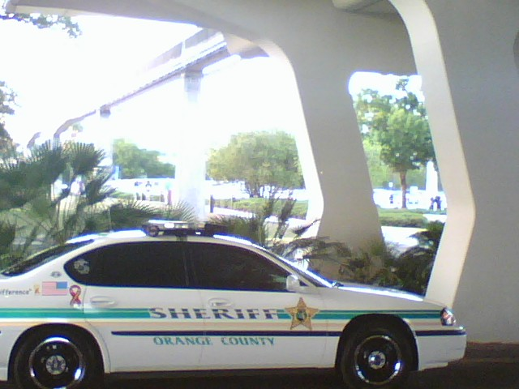
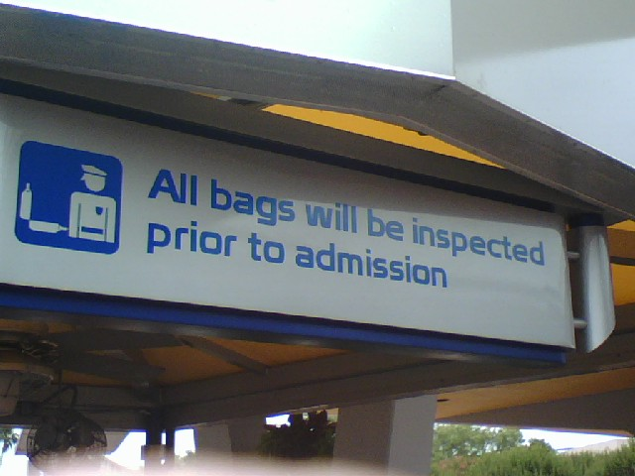
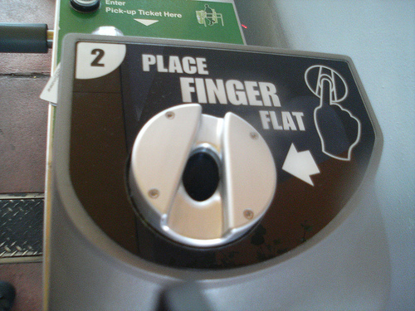
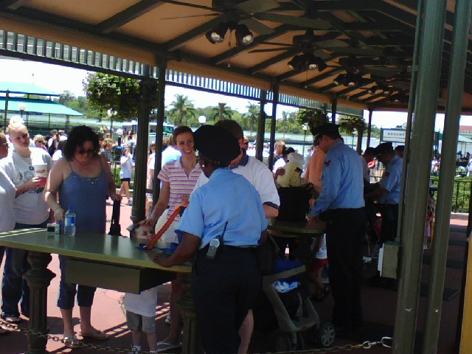
EVEN AT THE MOUSE HOUSE TIMES HAVE CHANGED!

Slide 8
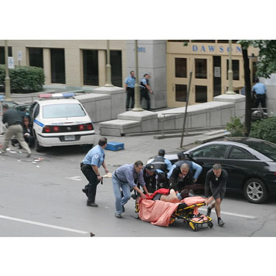
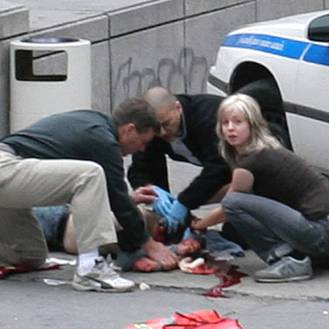
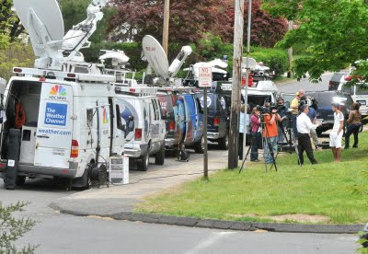
UN-Happiest Place on Earth

Slide 9
United States Secret Service
Threat Assessment Report

Slide 10
Major Changes in School Safety?
Columbine High School (4/20/99)
9/11/2001 – New York City
Beltway Sniper Incident (10/02)
Benjamin Tasker Middle, MD
Sandy Hook Elementary (12/14/12)

Slide 11
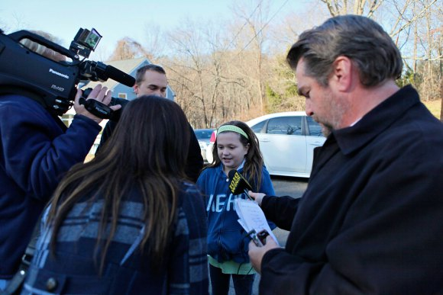
WHAT IS THE MOST COMMON STATEMENT FROM HEARD FOLLOWING A SERIOUS SCHOOL TRAGEDY?

Slide 12
“I NEVER THOUGHT IT WOULD HAPPEN HERE”

Slide 13
What is a Safe School? ►Statistic? ►Government Report? ►School Resource Officer? ►Walk-through Metal Detector? ►Aggressive Crime Reporting? ►Mental Health Services? ►Updated Crisis Plans?
SCHOOL SAFETY
“DEFINING, DECIDING AND DOING”

Slide 14
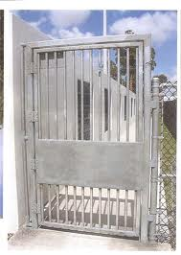
WHAT DOES A SAFE SCHOOL LOOK LIKE?
SCHOOL SAFETY
“DEFINING, DECIDING AND DOING”

Slide 15
THE SIMPLE THINGS
School Based Law Enforcement / LEEP Training
Visibility – Being seen where students don’t expect you to be seen
Student Restrooms
Cafeteria
Student Parking Lots
But be careful of Scheduled Assignments
Bus drop areas
Engage students by name when possible
and parent contact is crucial

Slide 16
The Simple Things….
Who is Responsible for Safety & Security at your School????
SCHOOL SAFETY
“DEFINING, DECIDING AND DOING”

Slide 17
10 Most Frequent items found problematic during a School Safety Assessment
Crisis plan that is either copied or has not been updated.
Minimal or no specific school critical incident training for faculty and staff
SCHOOL SAFETY
“DEFINING, DECIDING AND DOING”

Slide 18
10 Most Frequent items found problematic during a School Safety Assessment
Phones in the School cannot dial 911
Policy that states Principal must be notified before dialing 911
SCHOOL SAFETY
“DEFINING, DECIDING AND DOING”

Slide 19
10 Most Frequent items found problematic during a School Safety Assessment
Lack of Adult Supervision in Student Gathering areas
Graffiti or overall cleanliness of the School
Dress codes that are not enforced
SCHOOL SAFETY
“DEFINING, DECIDING AND DOING”

Slide 20
10 Most Frequent items found problematic during a School Safety Assessment
Little or no communication with area 1st responders
Evacuation locations (no drills, contacts or alternate sites
No Re-unification Plan for Crisis
SCHOOL SAFETY
“DEFINING, DECIDING AND DOING”

Slide 21
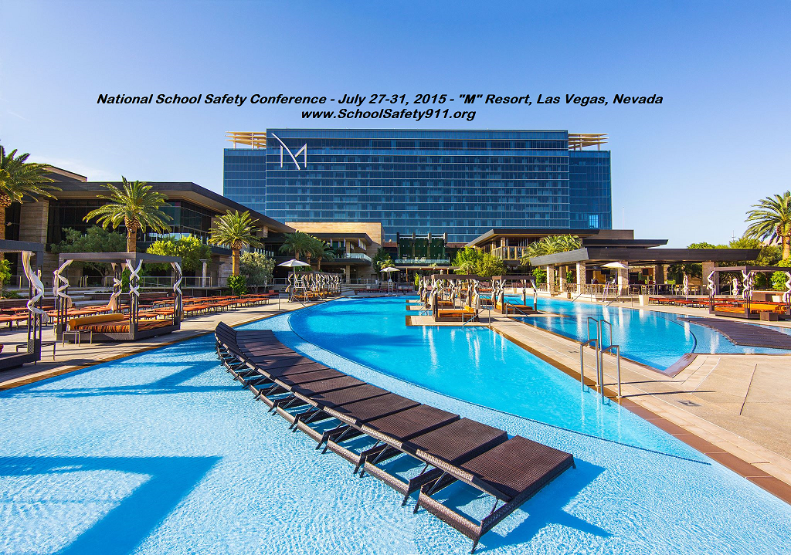

Slide 22
School Safety Advocacy Council www.schoolsafety911.org 888-485-2440
SCHOOL SAFETY
“DEFINING, DECIDING AND DOING”

